Slide 1
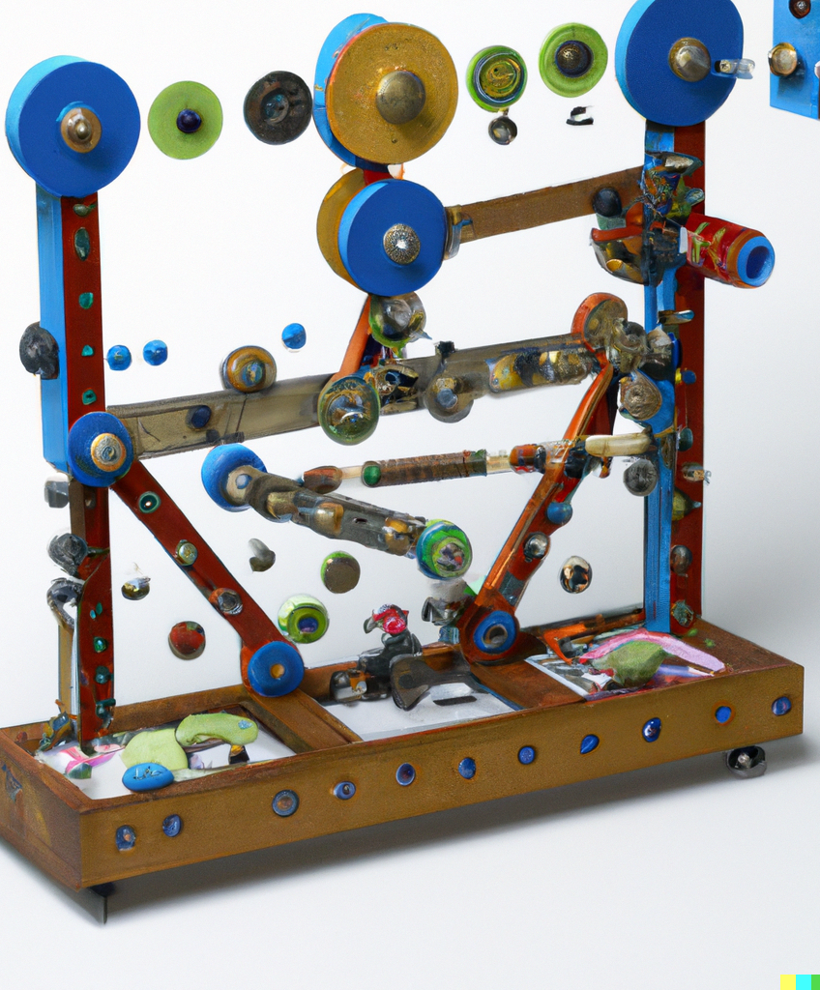
CS21 Decidability and Tractability
Lecture 9
January 24, 2024

Slide 2
Deciding CFLs
Convert CFG into Chomsky Normal Form
parse tree for string x generated by nonterminal A:
A
If A $→$^{k} x (k > 1) then there must be a way to split x:
x = yz
A → BC is a production and
B $→$^{i} y and C $⇒$^{j} z for i, j < k
B
C
x

Slide 3
Deciding CFLs
An algorithm:
IsGenerated(x, A)
if |x| = 1, then return YES if A → x is a production, else return NO
for all n-1 ways of splitting x = yz
for all ≤ m productions of form A → BC
if IsGenerated(y, B) and IsGenerated(z, C), return YES
return NO
worst case running time?

Slide 4
Deciding CFLs
worst case running time exp(n)
Idea: avoid recursive calls
build table of YES/NO answers to calls to IsGenerated, in order of length of substring
example of general algorithmic strategy called dynamic programming
notation: x[i,j] = substring of x from i to j
table: T(i, j) contains
{A: A nonterminal such that A $→$* x[i,j]}

Slide 5
Deciding CFLs
IsGenerated(x = x₁x₂x₃…x_{n}, G)
for i = 1 to n
T[i, i] = {A: “A → x_{i}” is a production in G}
for k = 1 to n - 1
for i = 1 to n - k
for k splittings x[i, i+k] = x[i,i+j]x[i+j+1, i+k]
T[i, i+k] = {A: “A → BC” is a production in G and B $∈$ T[i,i+j] and
C $∈$ T[i+j+1,i+k] }
output “YES” if S $∈$T[1, n], else output “NO”

Slide 6
Deciding CFLs
IsGenerated(x = x₁x₂x₃…x_{n}, G)
for i = 1 to n
T[i, i] = {A: “A → x_{i}” is a production in G}
for k = 1 to n - 1
for i = 1 to n - k
for k splittings x[i, i+k] = x[i,i+j]x[i+j+1, i+k]
T[i, i+k] = {A: “A → BC” is a production in G and B $∈$ T[i,i+j] and
C $∈$ T[i+j+1,i+k] }
output “YES” if S $∈$T[1, n], else output “NO”
O(nm) steps
O(n³m³) steps

Slide 7
Deterministic PDA
A NPDA is a 6-tuple (Q, Σ, $Γ,$ δ, q₀, F) where:
δ:Q x (Σ $∪$ {ε}) x ($Γ∪$ {ε}) → P (Q x ($Γ∪$ {ε})) is a function called the transition function
A deterministic PDA has only one option at every step:
for every state q $∈$Q, a $∈$ Σ, and t $∈Γ$, exactly 1 element in δ(q, a, t), or
exactly 1 element in δ(q, ε, t), and δ(q, a, t) empty for all a $∈$Σ

Slide 8
Deterministic PDA
A technical detail:
we will give our deterministic machine the ability to detect end of input string
add special symbol ■ to alphabet
require input tape to contain x■
language recognized by a deterministic PDA is called a deterministic CFL (DCFL)

Slide 9
Example deterministic PDA
0, ε → 0
ε, ε → $
Σ = {0, 1}
$Γ$ = {0, 1, $}
1, 0 → ε
■, $ → ε
1, 0 → ε
L = {0^{n}1^{n} : n $≥$0}
(unpictured transitions go to a “reject” state and stay there)

Slide 10
Deterministic PDA
Theorem: DCFLs are closed under complement
(complement of L in Σ* is (Σ* - L) )
Proof attempt:
swap accept/non-accept states
problem: might enter infinite loop before reading entire string
machine for complement must accept in these cases, and read to end of string

Slide 11
Example of problem
1, ε → ε
0, ε → ε
0, ε → ε
■, ε → ε
■, ε → ε
1, ε → ε
ε, ε → $
ε, ε → $
Language of this DPDA is 0$Σ$*

Slide 12
Example of problem
1, ε → ε
0, ε → ε
0, ε → ε
■, ε → ε
■, ε → ε
1, ε → ε
ε, ε → $
ε, ε → $
Language of this DPDA is {$ε$}

Slide 13
Deterministic PDA
Proof:
convert machine into “normal form”
always reads to end of input
always enters either an accept state or single distinguished “reject” state, and stay there
step 1: keep track of when we have read to end of input
step 2: eliminate infinite loops

Slide 14
Deterministic PDA
step 1: keep track of when we have read to end of input
q₀
q₁
q₀’
q₁’
■, ? → ?
■, ? → ?
q₃
q₃’
q₂
q₂’

Slide 15
Deterministic PDA
step 1: keep track of when we have read to end of input
q₀
q₁
■, ? → ?
q₀’
q₁’
■, ? → ?
q₃
q₃’
q₂
q₂’
for accept state q’: replace outgoing “ε, ? → ?” transition with self-loop with same label

Slide 16
Deterministic PDA
step 2: eliminate infinite loops
add new “reject” states
a, t →t (for all a, t)
ε, t → t (for all t)
r
r’
■, t → t (for all t)

Slide 17
Deterministic PDA
step 2: eliminate infinite loops
on input x, if infinite loop, then:
stack height
time
i₀
i₁
i₂
i₃
infinite sequence i₀< i₁< i₂< … such that for all k, stack height never decreases below ht(i_{k}) after time i_{k}

Slide 18
Deterministic PDA
step 2: eliminate infinite loops
infinite seq. i₀< i₁< … such that for all k, stack height never decreases below ht(i_{k}) after time i_{k}
infinite subsequence j₀< j₁< j₂< … such that same transition is applied at each time j_{k}
never see any stack symbol below t from j_{k} on
we are in a periodic, deterministic sequence of stack operations independent of the input
p
ε, t → s

Slide 19
Deterministic PDA
step 2: eliminate infinite loops
infinite subsequence j₀< j₁< j₂< … such that same transition is applied at each time j_{k}
safe to replace:
a, t →t (for all a, t)
ε, t → t (for all t)
ε, t → s
p
r
r’
ε, t → s
ε, t → s
or
■, t → t (for all t)
p’
ε, t → s

Slide 20
Deterministic PDA
finishing up…
have a machine M with no infinite loops
therefore it always reads to end of input
either enters an accept state q’, or enters “reject” state r’
now, can swap: make r’ unique accept state to get a machine recognizing complement of L

Slide 21
Summary
Nondeterministic Pushdown Automata (NPDA)
Context-Free Grammars (CFGs) describe Context-Free Languages (CFLs)
terminals, non-terminals
productions
yields, derivations
parse trees

Slide 22
Summary
grouping determined by grammar
Chomsky Normal Form (CNF)
NDPAs and CFGs are equivalent
CFL Pumping Lemma is used to show certain languages are not CFLs

Slide 23
Summary
deterministic PDAs recognize DCFLs
DCFLs are closed under complement
there is an efficient algorithm (based on dynamic programming) to determine if a string x is generated by a given grammar G

Slide 24
So far…
several models of computation
finite automata
pushdown automata
fail to capture our intuitive notion of what is computable
all languages
regular languages
context free languages

Slide 25
So far…
We proved (using constructions of FA and NPDAs and the two pumping lemmas):
{a^{n}b^{n} : n ≥ 0 }
{w : w$∈${a,b}* has an even # of b’s}
regular languages
all languages
context free languages
{a^{n}b^{n}c^{n} : n ≥ 0 }

Slide 26
A more powerful machine
limitation of NPDA related to fact that their memory is stack-based (last in, first out)
What is the simplest alteration that adds general-purpose “memory” to our machine?
Should be able to recognize, e.g., {a^{n}b^{n}c^{n} : n ≥ 0 }

Slide 27
Turing Machines
input tape
…
0
1
1
0
0
1
1
1
0
1
0
0
finite control
read/write head
q₀
New capabilities:
infinite tape
can read OR write to tape
read/write head can move left and right

Slide 28
Turing Machine
Informal description:
input written on left-most squares of tape
rest of squares are blank
at each point, take a step determined by
current symbol being read
current state of finite control
a step consists of
writing new symbol
moving read/write head left or right
changing state

Slide 29
Example Turing Machine
language L = {w#w : w $∈$ {0,1}*}
input tape
…
0
1
#
0
1
finite control
q₀
read/write head

Slide 30
Turing Machine diagrams
a → b,L
a → R
states (1 accept + 1 reject)
start state
b → L
q_{reject}
b → R
q_{accept}
b → a,R
transition label: (tape symbol read → tape symbol written, direction moved)
“_” means blank tape square
a → R means “read a, move right”
a → L means “read a, move left”
a → b, R means “read a, write b, move right

Slide 31
Example TM diagram
0,1 → R
0,1 → R
0,1,# → L
0,1 → R
x → R
#→R
_→L
_→R
#→R
q₁
q₃
q₅
q₇
q₉
0 → _,R
0 → x, R
0 → x, L
0,1,x,# → L
x → R
x → R
q₀
_→R
#→R
_→R
q₁₁
q₁₂
q₁₃
q_{accept}
# → R
1 → x, R
1 → x, L
1 → _,R
q₂
q₄
q₆
q₈
q₁₀
#→R
_→L
_→R
#→R
0,1 → R
0,1 → R
0,1,# → L
0,1 → R
x → R

