Slide 1

CS21
Decidability and Tractability
Lecture 4
January 10, 2024

Slide 2
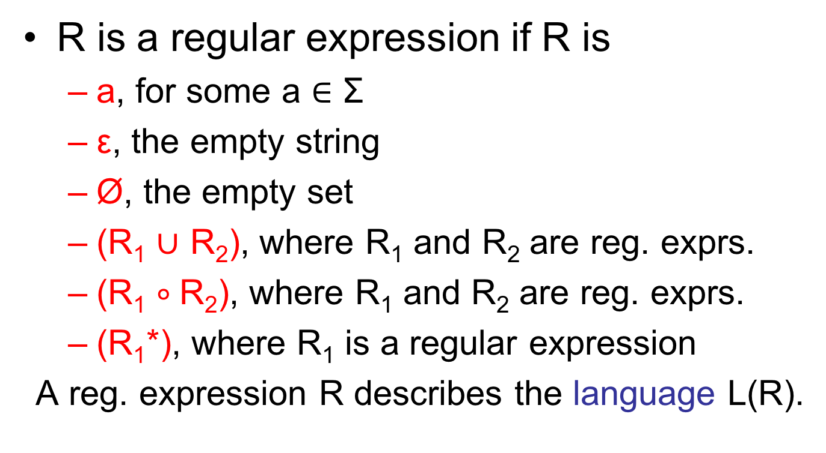
Regular expressions
R is a regular expression if R is
  a, for some a $∈$ Σ
  ε, the empty string
  Ø, the empty set
  (R₁ $∪$ R₂), where R₁ and R₂ are reg. exprs.
  (R₁ $∘$R₂), where R₁ and R₂ are reg. exprs.
  (R₁*), where R₁ is a regular expression
A reg. expression R describes the language L(R).

Slide 3
Regular expressions and FA
Theorem: a language L is recognized by a FA if and only if L is described by a regular expression.
Must prove two directions:
  ($⇒$) L is recognized by a FA implies L is described by a regular expression
  ($⇐$) L is described by a regular expression implies L is recognized by a FA.

Slide 4
Regular expressions and FA
  ($⇐$) L is described by a regular expression implies L is recognized by a FA
Proof: given regular expression R we will build a NFA that recognizes L(R).
  then NFA, FA equivalence implies a FA for L(R).

Slide 5
Regular expressions and FA
R is a regular expression if R is
  a, for some a $∈$Σ
  ε, the empty string
  Ø, the empty set
a

Slide 6
Regular expressions and FA
  (R₁ $∪$R₂), where R₁ and R₂ are reg. exprs.
  (R₁ $∘$R₂), where R₁ and R₂ are reg. exprs.
  (R₁*), where R₁ is a regular expression
ε
ε
ε
ε
ε
ε
ε

Slide 7
Regular expressions and FA
Theorem: a language L is recognized by a FA if and only if L is described by a regular expression.
Must prove two directions:
  ($⇒$) L is recognized by a FA implies L is described by a regular expression
  ($⇐$) L is described by a regular expression implies L is recognized by a FA.

Slide 8
Regular expressions and FA
  ($⇒$) L is recognized by a FA implies L is described by a regular expression
Proof: given FA M that recognizes L, we will
  build an equivalent machine “Generalized Nondeterministic Finite Automaton” (GNFA)
  convert the GNFA into a regular expression

Slide 9
Regular expressions and FA
GNFA definition:
  it is a NFA, but may have regular expressions labeling its transitions
  GNFA accepts string w $∈$Σ* if can be written
  w = w₁w₂w₃… w_{k}
  where each w_{i} $∈$Σ*, and there is a path from the start state to an accept state in which the i^{th} transition traversed is labeled with R for which w_{i} $∈$L(R)

Slide 10
Regular expressions and FA
Recall step 1: build an equivalent GNFA
Our FA M is a GNFA.
We will require “normal form” for GNFA to make the proof easier:
  single accept state q_{accept} that has all possible incoming arrows
  every state has all possible outgoing arrows; exception: start state q₀ has no self-loop

Slide 11
Regular expressions and FA
converting our FA M into GNFA in normal form:
0,1
0 $∪$ 1
ε
ε
Ø
Ø
Ø
ε
Ø
Ø
M
Ø
Ø

Slide 12
Regular expressions and FA
On to step 2: convert the GNFA into a regular expression
  if normal-form GNFA has two states:
  the regular expression R labeling the single transition describes the language recognized by the GNFA
R

Slide 13
Regular expressions and FA
  if GNFA has more than 2 states:
  select one “q_{rip}”; delete it; repair transitions so that machine still recognizes same language.
  repeat until only 2 states.
q_{rip}

Slide 14
Regular expressions and FA
  how to repair the transitions:
  for every pair of states q_{i} and q_{j} do
R₄
q_{i}
q_{j}
(R₁ )(R₂ )*(R₃) $∪$ (R₄)
R₃
R₁
q_{i}
q_{j}
q_{rip}
R₂

Slide 15
Regular expressions and FA
  summary:
  FA M → k-state GNFA → (k-1)-state GNFA
  → (k-2)-state GNFA →…→ 2-state GNFA → R
  want to prove that this procedure is correct, i.e. L(R) = language recognized by M
    FA M equivalent to k-state GNFA
    i-state GNFA equivalent to (i-1)-state GNFA
    (we will prove…)
    2-state GFNA equivalent to R

Slide 16
Regular expressions and FA
  Claim: i-state GNFA G equivalent to (i-1)-state GNFA G’ (obtained by removing q_{rip})
  Proof:
    if G accepts string w, then it does so by entering states: q₀, q₁, q₂, q₃, … , q_{accept}
    if none are q_{rip} then G’ accepts w (see slide)
    else, break state sequence into runs of q_{rip}:
    q₀q₁…q_{i}q_{rip}q_{rip}…q_{rip}q_{j}…q_{accept}
    transition from q_{i} to q_{j} in G’ allows all strings taking G from q_{i} to q_{j} using q_{rip} (see slide)
    thus G’ accepts w

Slide 17
Regular expressions and FA
R₄
q_{i}
q_{j}
(R₁ )(R₂ )*(R₃) $∪$ (R₄)
R₃
R₁
q_{i}
q_{j}
q_{rip}
R₂

Slide 18
Regular expressions and FA
R₄
q_{i}
q_{j}
(R₁ )(R₂ )*(R₃) $∪$ (R₄)
R₃
R₁
q_{i}
q_{j}
q_{rip}
R₂

Slide 19
Regular expressions and FA
  Proof (continued):
    if G’ accepts string w, then every transition from q_{i} to q_{j} traversed in G’ corresponds to
    either
    a transition from q_{i} to q_{j} in G
    or
    transitions from q_{i} to q_{j} via q_{rip} in G
    In both cases G accepts w.
    Conclude: G and G’ recognize the same language.

Slide 20
Regular expressions and FA
Theorem: a language L is recognized by a FA iff L is described by a regular expr.
Languages recognized by a FA are called regular languages.
Rephrasing what we know so far:
  regular languages closed under 3 operations
  NFA recognize exactly the regular languages
  regular expressions describe exactly the regular languages

Slide 21
Limits on the power of FA
Is every language describable by a sufficiently complex regular expression?
If someone asks you to design a FA for a language that seems hard, how do you know when to give up?
Is this language regular?
{w : w has an equal # of “01” and “10” substrings}

Slide 22
Limits on the power of FA
Intuition:
  FA can only remember finite amount of information. They cannot count
  languages that “entail counting” should be non-regular…
Intuition not enough:
{w : w has an equal # of “01” and “10” substrings}
= 0Σ*0 $∪$ 1Σ*1
but {w: w has an equal # of “0” and “1” substrings} is not regular!

Slide 23
Limits on the power of FA
How do you prove that there is no Finite Automaton recognizing a given language?

Slide 24
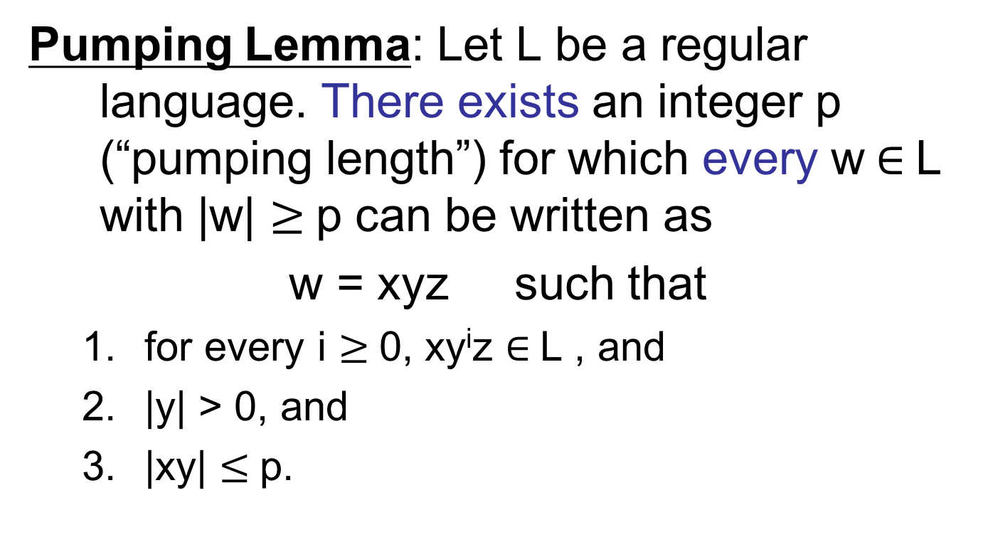
Non-regular languages
Pumping Lemma: Let L be a regular language. There exists an integer p (“pumping length”) for which every w $∈$L with |w| $≥$p can be written as
w = xyz such that
  for every i $≥$0, xy^{i}z $∈$L , and
  |y| > 0, and
  |xy| $≤$p.

Slide 25
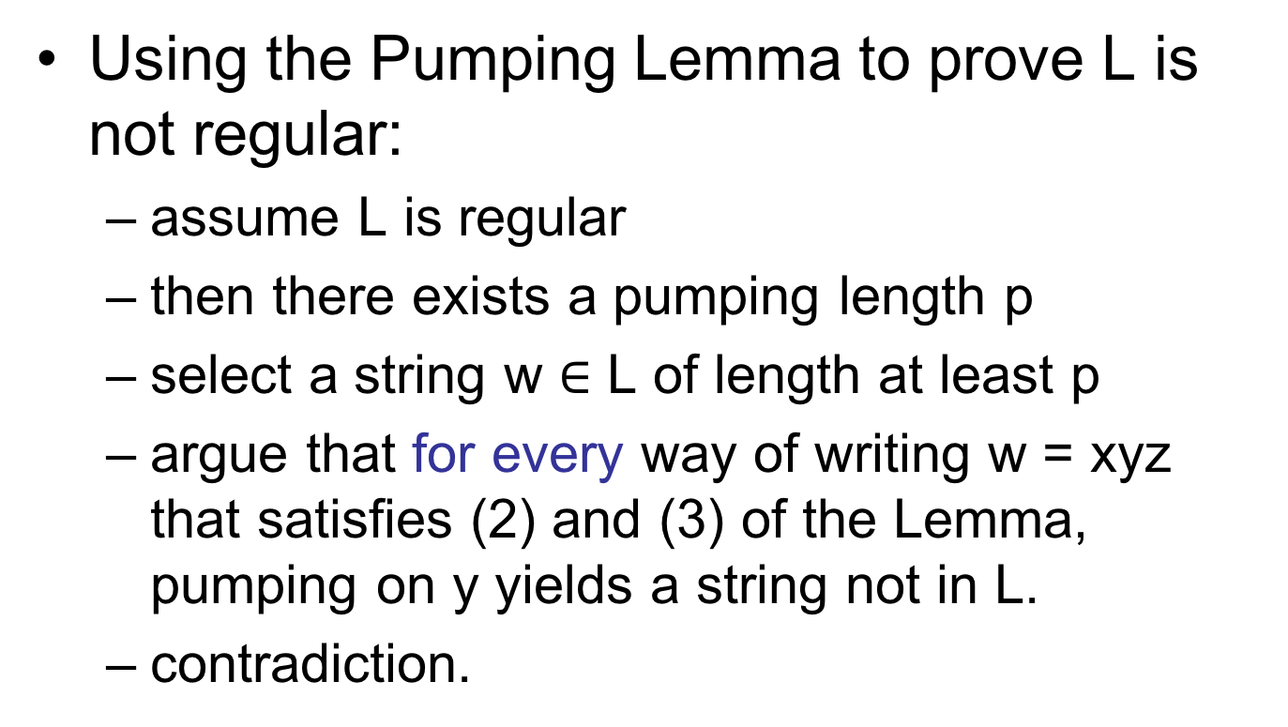
Non-regular languages
Using the Pumping Lemma to prove L is not regular:
  assume L is regular
  then there exists a pumping length p
  select a string w $∈$ L of length at least p
  argue that for every way of writing w = xyz that satisfies (2) and (3) of the Lemma, pumping on y yields a string not in L.
  contradiction.

Slide 26
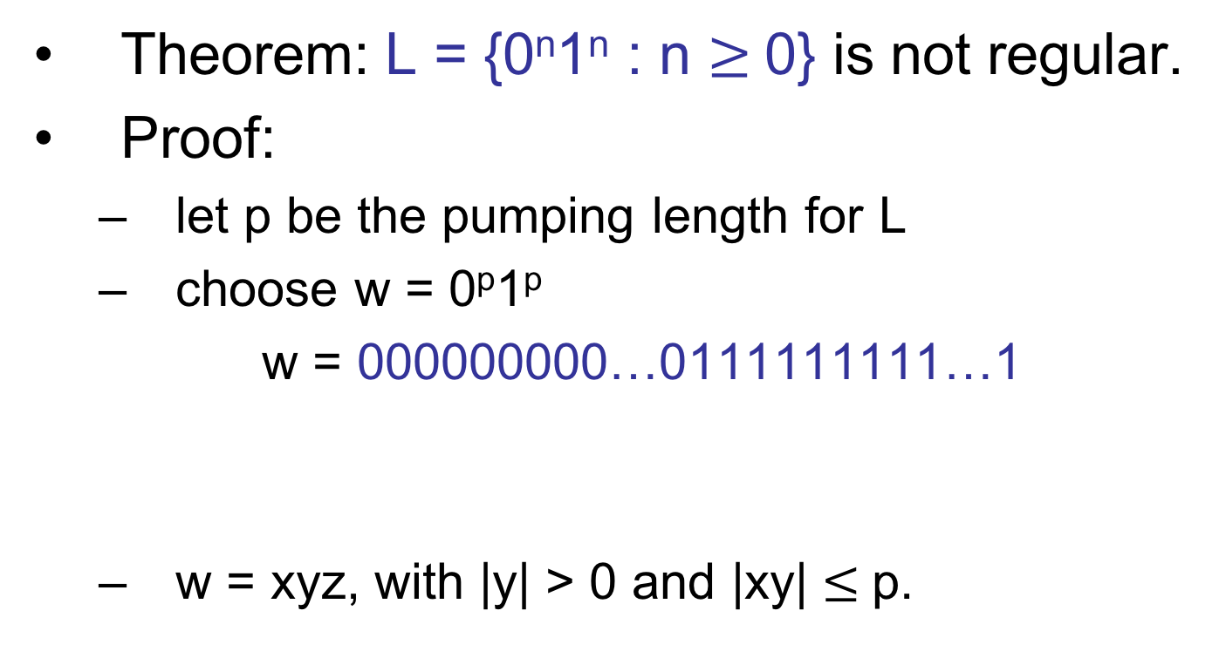
Pumping Lemma Examples
Theorem: L = {0^{n}1^{n} : n $≥$0} is not regular.
Proof:
  let p be the pumping length for L
  choose w = 0^{p}1^{p}
  w = 000000000…0111111111…1
  w = xyz, with |y| > 0 and |xy| $≤$p.
p
p

Slide 27
Pumping Lemma Examples
  3 possibilities:
  w = 000000000…0111111111…1
  w = 000000000…0111111111…1
  w = 000000000…0111111111…1
  in each case, pumping on y gives a string not in language L.
x
y
z
x
y
z
x
y
z

Slide 28
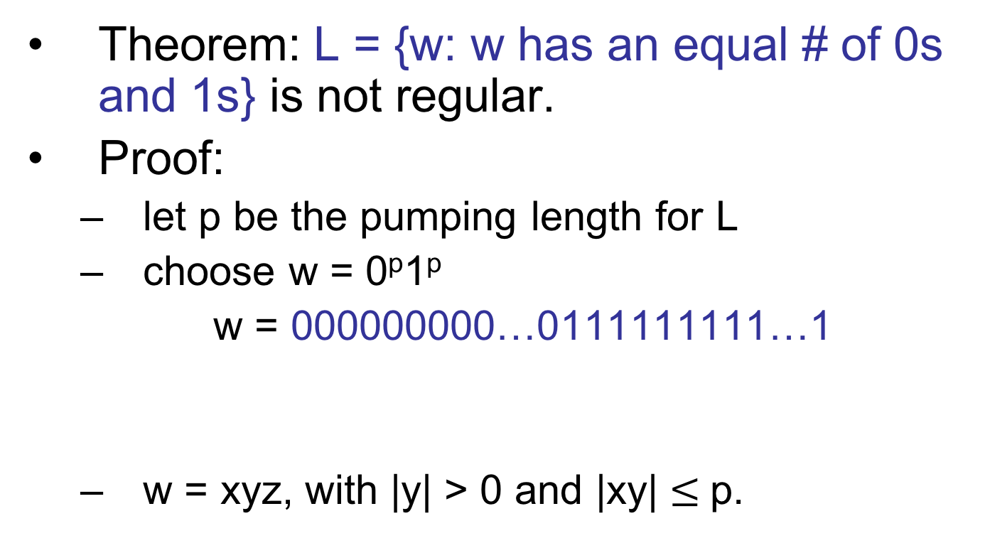
Pumping Lemma Examples
Theorem: L = {w: w has an equal # of 0s and 1s} is not regular.
Proof:
  let p be the pumping length for L
  choose w = 0^{p}1^{p}
  w = 000000000…0111111111…1
  w = xyz, with |y| > 0 and |xy| $≤$p.
p
p

Slide 29
Pumping Lemma Examples
  3 possibilities:
  w = 000000000…0111111111…1
  w = 000000000…0111111111…1
  w = 000000000…0111111111…1
  first 2 cases, pumping on y gives a string not in language L; 3rd case a problem!
x
y
z
x
y
z
x
y
z

Slide 30
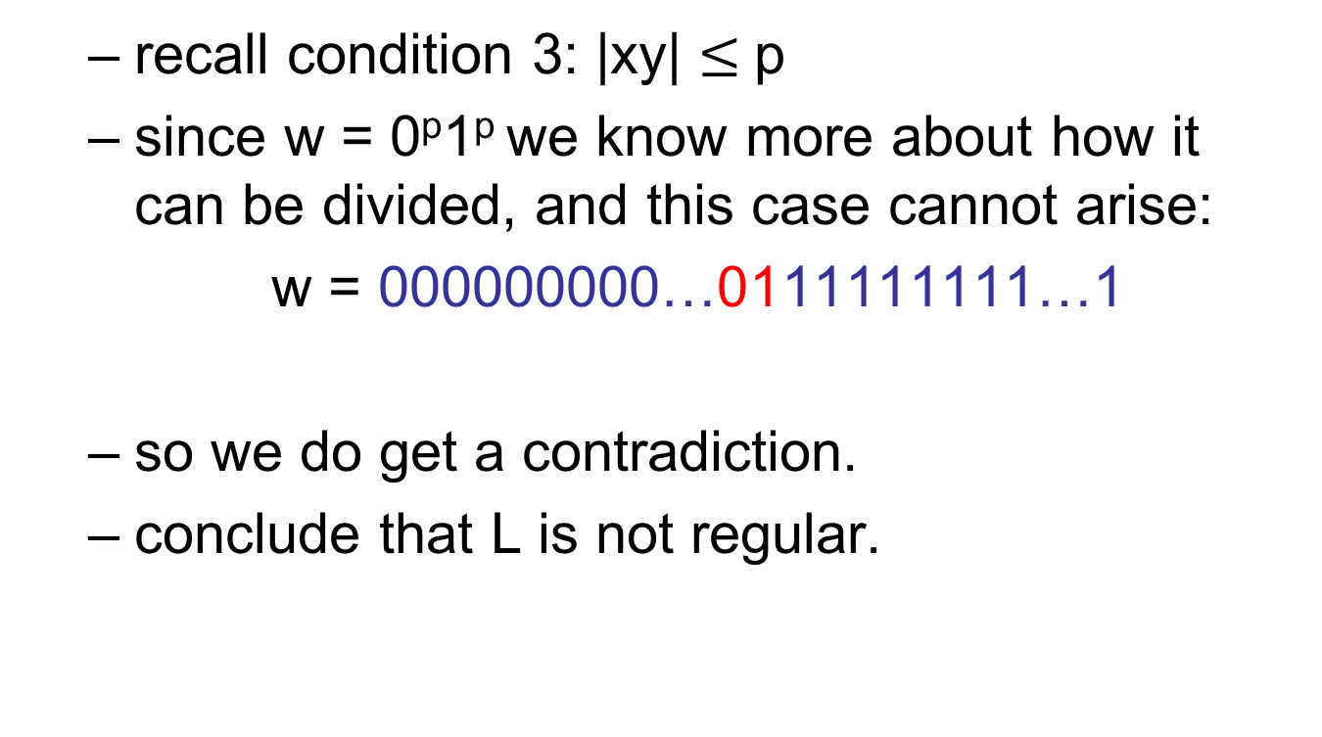
Pumping Lemma Examples
  recall condition 3: |xy| $≤$p
  since w = 0^{p}1^{p} we know more about how it can be divided, and this case cannot arise:
  w = 000000000…0111111111…1
  so we do get a contradiction.
  conclude that L is not regular.
x
y
z

