Slide 1
CS21 Decidability and Tractability
Lecture 26
March 6, 2024

Slide 2
Outline
Challenges to Extended Church-Turing
randomized computation
quantum computation
Course review

Slide 3
Extended Church-Turing Thesis
the belief that TMs formalize our intuitive notion of an efficient algorithm is:
randomized computation challenges this belief
The “extended” Church-Turing Thesis
everything we can compute in time t(n) on a physical computer can be computed on a Turing Machine in time t(n)^{O(1)} (polynomial slowdown)

Slide 4
RP,coRP, BPP
ZPP
coRP
P
RP
PSPACE
BPP
EXP
from definitions: ZPP $⊆$ RP, coRP $⊆$ BPP

Slide 5
Polynomial identity testing
Given: polynomial p(x₁, x₂, …, x_{n}) as arithmetic formula (fan-out 1):
*
multiplication (fan-in 2)
addition (fan-in 2)
negation (fan-in 1)
-
*
*
+
-
x₁
x₂
x₃
…
x_{n}
variables take values in finite field F

Slide 6
Polynomial identity testing
Question: Is p identically zero?
i.e., is p(x) = 0 for all x $∈$F^{n}
(assume |F| larger than degree…)
“polynomial identity testing” because given two polynomials p, q, we can check the identity p $≡$q by checking if (p – q) $≡$ 0

Slide 7
Polynomial identity testing
Lemma (Schwartz-Zippel): Let
p(x₁, x₂, …, x_{n})
be a total degree d polynomial over a field F and let S be any subset of F. Then if p is not identically 0,
Pr_{r1,r2,…,rn}$∈$_{S}[ p(r₁, r₂, …, r_{n}) = 0] ≤ d/|S|.

Slide 8
Polynomial identity testing
Given: polynomial p(x₁, x₂, …, x_{n}) over field F
Is p identically zero?
Note: degree d is at most the size of input
*
-
*
*
+
-
x₁
x₂
x₃
…
x_{n}

Slide 9
Polynomial identity testing
randomized algorithm: pick a subset S $⊆$ F of size 2d
pick r₁, r₂, …, r_{n} from S uniformly at random
if p(r₁, r₂, …, r_{n}) = 0, answer “yes”
if p(r₁, r₂, …, r_{n}) ≠ 0, answer “no”
if p identically zero, never wrong
if not, Schwartz-Zippel ensures probability of error at most ½

Slide 10
Randomized complexity classes
We have shown:
Polynomial Identity Testing is in coRP
note: no sub-exponential time deterministic algorithm know

Slide 11
Randomized complexity classes
How powerful is randomized computation?
We have seen an example of a problem in
BPP
that we only know how to solve deterministically in EXP.
Is randomness a panacea for intractability?

Slide 12
Randomized complexity classes
ZPP
coRP
P
RP
PSPACE
BPP
EXP
believed that P = ZPP = RP = coRP = BPP (!)

Slide 13
Course
Review

Slide 14
Review
Highest level: 2 main points
1. Decidability
problem solvable by an algorithm = problem is decidable
some problems are not decidable (e.g. HALT)

Slide 15
Review
Highest level: 2 main points
2. Tractability
problem solvable in polynomial time = problem is tractable
some problems are not tractable (EXP-complete problems)
huge number of problems are likely not to be tractable (NP-complete problems)

Slide 16
Review
Important ideas
“problem” formalized as language
language = set of strings
“computation” formalized as simple machine
finite automata
pushdown automata
Turing Machine
“power” of machine formalized as the set of languages it recognizes

Slide 17
Review
Important ideas (continued):
simulation used to show one model at least as powerful as another
diagonalization used to show one model strictly more powerful than another
also Pumping Lemma
reduction used to compare one problem to another

Slide 18
Review
Important ideas (continued):
complexity theory investigates the resources required to solve problems
time, space, others…
complexity class = set of languages
language L is C-hard if every problem in C reduces to L
language L is C-complete if L is C-hard and L is in C.

Slide 19
Review
Important ideas (continued):
A complete problem is a surrogate for the entire class.

Slide 20
Summary
Part I: automata

Slide 21
Finite Automata
(single) start state
alphabet Σ = {0,1}
0,1
1
states
0
(several) accept states
transition for each symbol
0,1
read input one symbol at a time; follow arrows; accept if end in accept state

Slide 22
Finite Automata
Non-deterministic variant: NFA
Regular expressions built up from:
unions
concatenations
star operations
Main results: same set of languages recognized by FA, NFA and regular expressions (“regular languages”).

Slide 23
Pushdown Automata
input tape
finite control
0
1
1
0
0
1
1
1
0
1
0
0
1
0
1
q₀
New capabilities:
can push symbol onto stack
can pop symbol off of stack
0
(infinite) stack
1
1
0
:

Slide 24
Context-Free Grammars
A → 0A1
A → B
B → #
start symbol
terminal symbols
non-terminal symbols
production

Slide 25
Pushdown Automata
Main results: same set of languages recognized by NPDA, and context-free grammars (“context-free languages”).
and DPDA’s weaker than NPDA’s…

Slide 26
Non-regular languages
Pumping Lemma: Let L be a regular language. There exists an integer p (“pumping length”) for which every w $∈$L with |w| $≥$p can be written as
w = xyz such that
for every i $≥$0, xy^{i}z $∈$L , and
|y| > 0, and
|xy| $≤$p.

Slide 27
Pumping Lemma for CFLs
CFL Pumping Lemma: Let L be a CFL. There exists an integer p (“pumping length”) for which every w $∈$L with |w| $≥$p can be written as
w = uvxyz such that
for every i $≥$0, uv^{i}xy^{i}z $∈$L , and
|vy| > 0, and
|vxy| $≤$p.

Slide 28
Summary
Part II: Turing Machines and decidability

Slide 29
Turing Machines
input tape
…
0
1
1
0
0
1
1
1
0
1
0
0
finite control
read/write head
q₀
New capabilities:
infinite tape
can read OR write to tape
read/write head can move left and right

Slide 30
Deciding and Recognizing
accept
reject
loop forever
input
machine
TM M:
L(M) is the language it recognizes
if M rejects every x $∉$ L(M) it decides L
set of languages recognized by some TM is called Turing-recognizable or recursively enumerable (RE)
set of languages decided by some TM is called Turing-decidable or decidable or recursive

Slide 31
Church-Turing Thesis
the belief that TMs formalize our intuitive notion of an algorithm is:
Note: this is a belief, not a theorem.
The Church-Turing Thesis
everything we can compute on a physical computer
can be computed on a Turing Machine

Slide 32
The Halting Problem
box (M, x): does M halt on x?
inputs
Y
Turing Machines
n
Y
n
The existence of H which tells us yes/no for each box allows us to construct a TM H’ that cannot be in the table.
n
Y
n
H’ :
n
Y
n
Y
Y
n
Y

Slide 33
Decidable, RE, coRE…
co-HALT
{a^{n}b^{n} : n ≥ 0 }
some language
co-RE
decidable
all languages
regular languages
context free languages
RE
{a^{n}b^{n}c^{n} : n ≥ 0 }
HALT
some problems (e.g HALT) have no algorithms

Slide 34
Definition of reduction
More refined notion of reduction:
“many-one” reduction (commonly)
“mapping” reduction (book)
A
B
f
yes
yes
reduction from language A to language B
f
no
no

Slide 35
Using reductions
Used reductions to prove lots of problems were:
undecidable (reduce from undecidable)
non-RE (reduce from non-RE)
or show undecidable, and coRE
non-coRE (reduce from non-coRE)
or show undecidable, and RE
Rice’s Theorem: Every nontrivial TM property is undecidable.

Slide 36
The Recursion Theorem
Theorem: Let T be a TM that computes fn:
t: Σ* x Σ* → Σ*
There is a TM R that computes the fn:
r: Σ* → Σ*
defined as r(w) = t(w, <R>).
In the course of computation, a Turing Machine can output its own description.

Slide 37
Summary
Part III: Complexity

Slide 38
Complexity
Complexity Theory = study of what is computationally feasible (or tractable) with limited resources:
running time
storage space
number of random bits
degree of parallelism
rounds of interaction
others…
main focus
not in this course

Slide 39
Time and Space Complexity
Definition: the time complexity of a TM M is a function f:N → N, where f(n) is the maximum number of steps M uses on any input of length n.
Definition: the space complexity of a TM M is a function f:N → N, where f(n) is the maximum number of tape cells M scans on any input of length n.

Slide 40
Complexity Classes
Definition: TIME(t(n)) = {L : there exists a TM M that decides L in time O(t(n))}
P = $∪$_{k ≥ 1} TIME(n^{k})
EXP = $∪$_{k ≥ 1} TIME(2^{nk})
Definition: SPACE(t(n)) = {L : there exists a TM M that decides L in space O(t(n))}
PSPACE= $∪$_{k ≥ 1} SPACE(n^{k})

Slide 41
Complexity Classes
Definition: NTIME(t(n)) = {L : there exists a NTM M that decides L in time O(t(n))}
NP= $∪$_{k ≥ 1} NTIME(n^{k})
Theorem: P $⊆$EXP
P $⊆$NP $⊆$PSPACE $⊆$EXP
Don’t know if any of the containments are proper.

Slide 42
Alternate definition of NP
Theorem: language L is in NP if and only if it is expressible as:
L = { x | $∃$ y, |y| ≤ |x|^{k}, (x, y) $∈$ R }
where R is a language in P.

Slide 43
Poly-time reductions
Type of reduction we will use:
“many-one” poly-time reduction (commonly)
“mapping” poly-time reduction (book)
f poly-time computable
YES maps to YES
NO maps to NO
A
B
f
yes
yes
f
no
no

Slide 44
Hardness and completeness
Definition: a language L is C-hard if for every language A $∈$ C, A poly-time reduces to L; i.e., A ≤_{P} L.
can show L is C-hard by reducing from a known C-hard problem
Definition: a language L is C-complete if L is C-hard and L $∈$ C

Slide 45
Complete problems
EXP-complete: ATM_{B} = {<M, x, m> : M is a TM that accepts x within at most m steps}
PSPACE-complete: QSAT = {φ : φ is a 3-CNF, and $∃$x₁$∀$x₂$∃$x₃… $∀$x_{n} φ(x₁, x₂, … x_{n}) }
NP-complete: 3SAT = {φ : φ is a satisfiable 3-CNF formula}

Slide 46
Lots of NP-complete problems
Indendent Set
Vertex Cover
Clique
Hamilton Path (directed and undirected)
Hamilton Cycle and TSP
Subset Sum
NAE3SAT
Max Cut
Problem sets: max/min Bisection, 3-coloring, subgraph isomorphism, subset sum, (3,3)-SAT, Partition, Knapsack, Max2SAT…

Slide 47
Other complexity classes
coNP – complement of NP
complete problems: UNSAT, DNF-TAUTOLOGY
NP intersect coNP
contains (decision version of ) FACTORING
PSPACE
complete problems: QSAT, GEOGRAPHY

Slide 48
Complexity classes
EXP
coNP
PSPACE
decidable languages
P
NP
all containments believed to be proper

Slide 49
Quantum
Computation

Slide 50
Extended Church-Turing Thesis
the belief that TMs formalize our intuitive notion of an efficient algorithm is:
Quantum computation challenges this belief
The “extended” Church-Turing Thesis
everything we can compute in time t(n) on a physical computer can be computed on a (probabilistic)Turing Machine in time t(n)^{O(1)} (polynomial slowdown)

Slide 51
For use later…
Fourier transform:
time domain
frequency domain
r
can recover r from position
time domain
frequency domain

Slide 52
A different model
infinite tape of a Turing Machine is an idealized model of computer
real computer is a Finite Automaton (!)
n bits of memory
2^{n} states

Slide 53
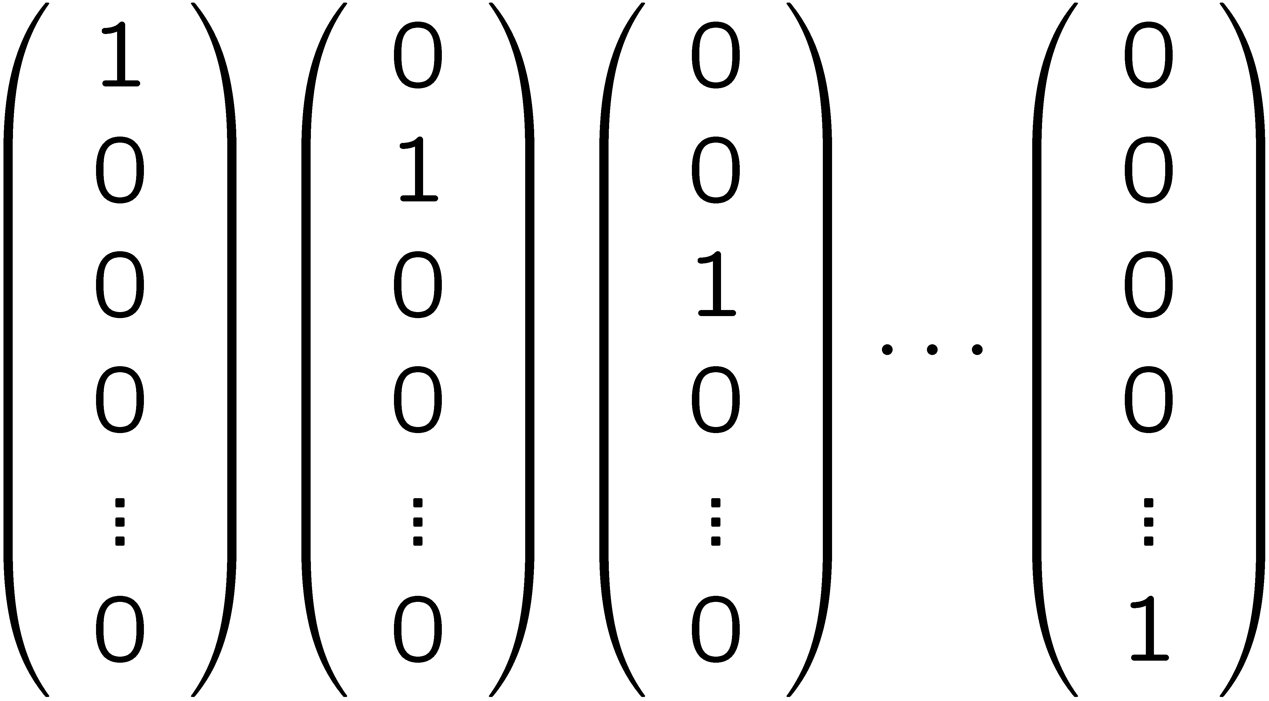
Model of deterministic computation
2^{n} possible basic states
state at time t+1
state at time t
one 1 per column

Slide 54
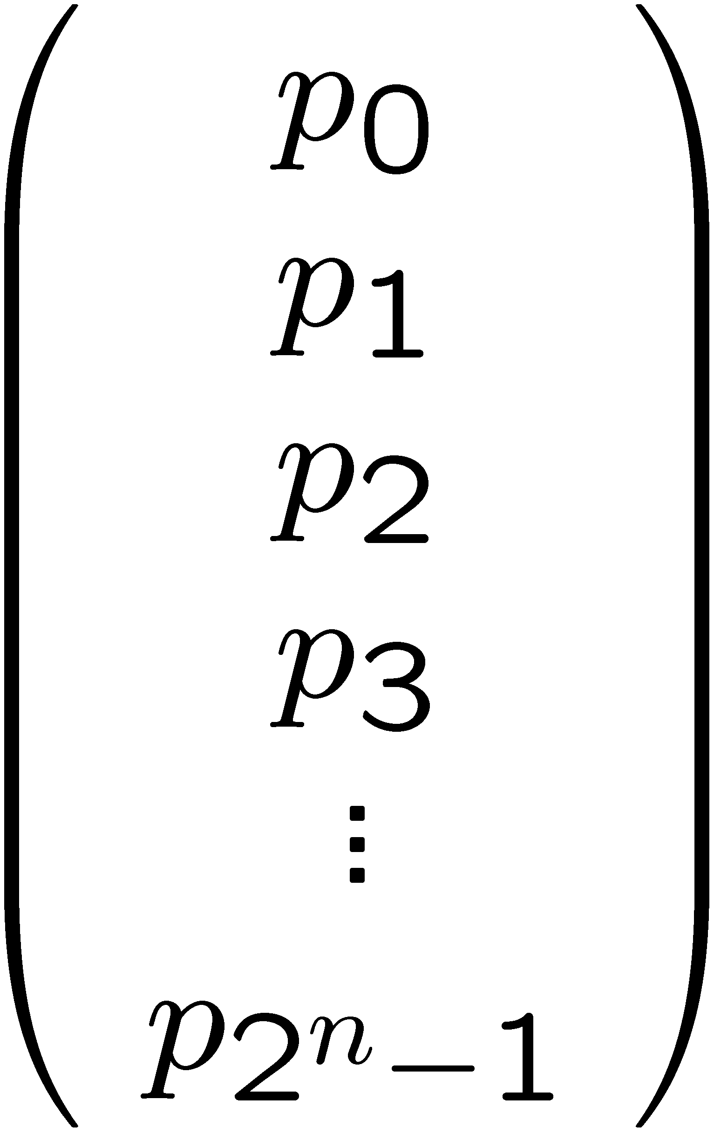
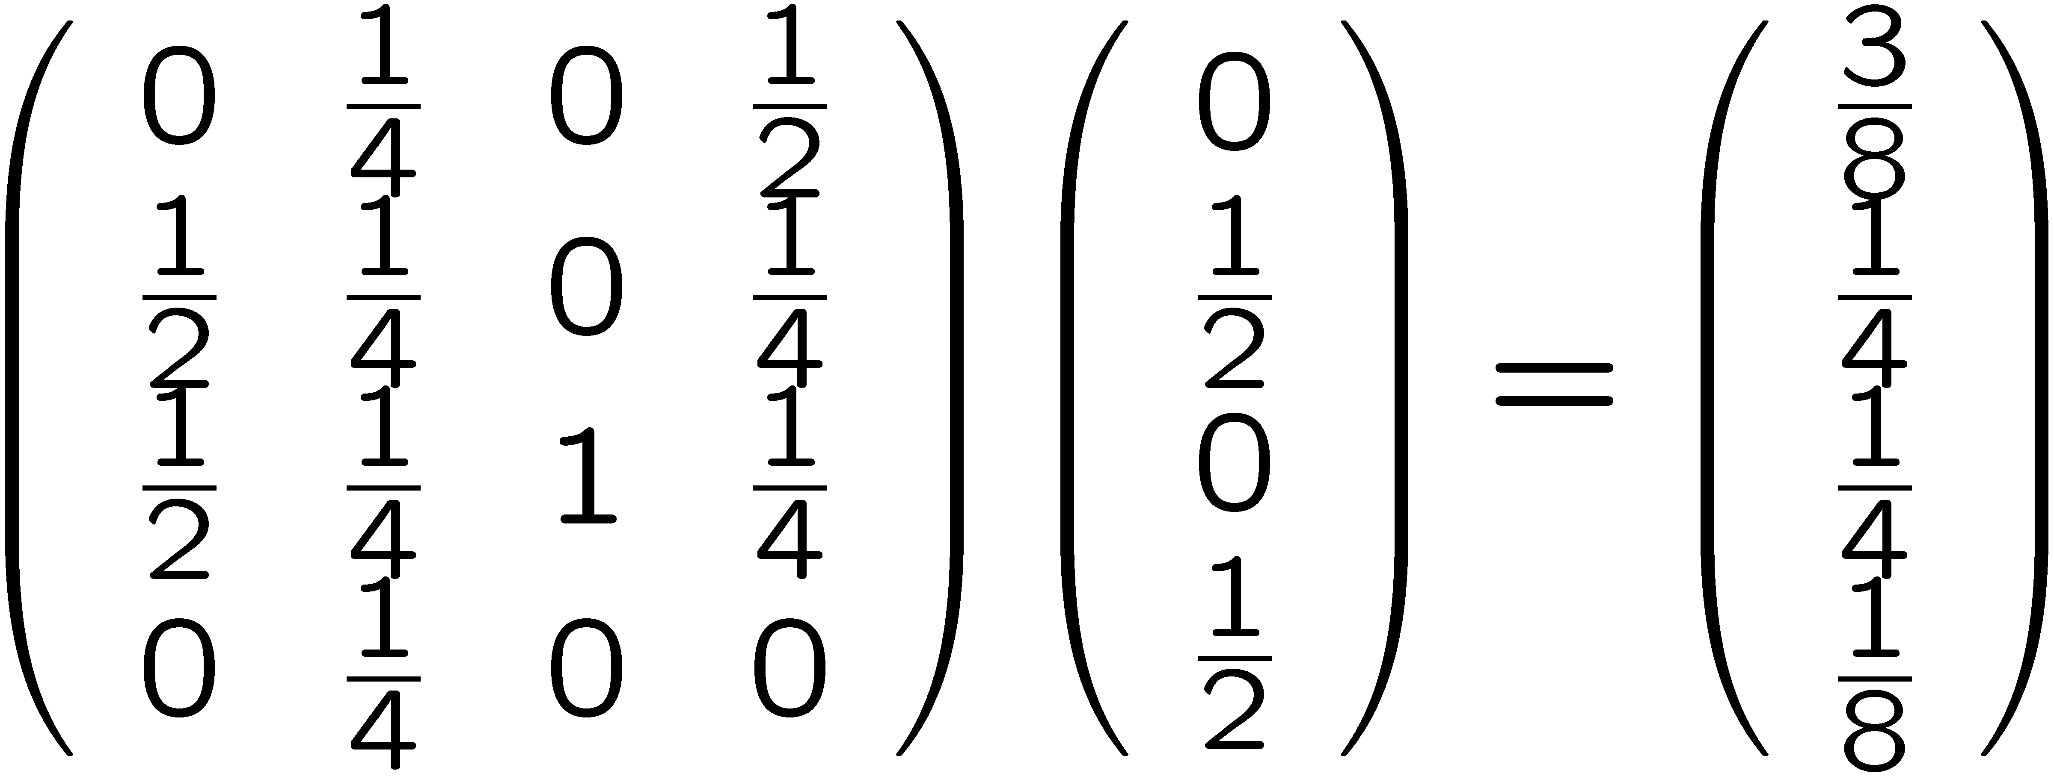
Model of randomized computation
possible states at time t:
$\sum_{i}{p_{i}}$ = 1 p_{i} $∈$R⁺
state at time t+1
state at time t
“stochastic matrix ” sum in each column = 1

Slide 55
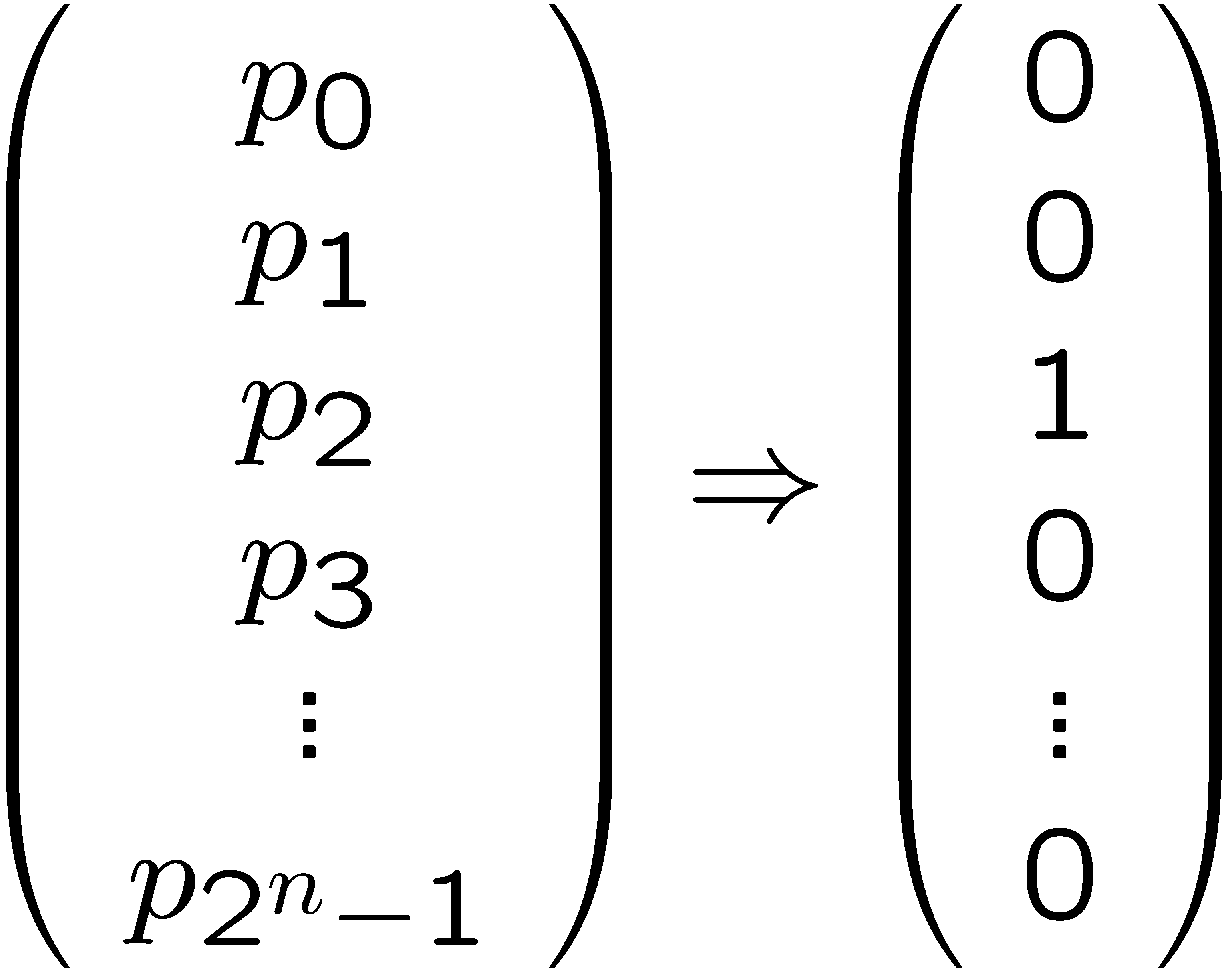
Model of randomized computation
at end of computation, see specific state
demand correct result with high probability
think of as “measuring” system:
see i^{th} basic state with probability p_{i}

