Slide 1
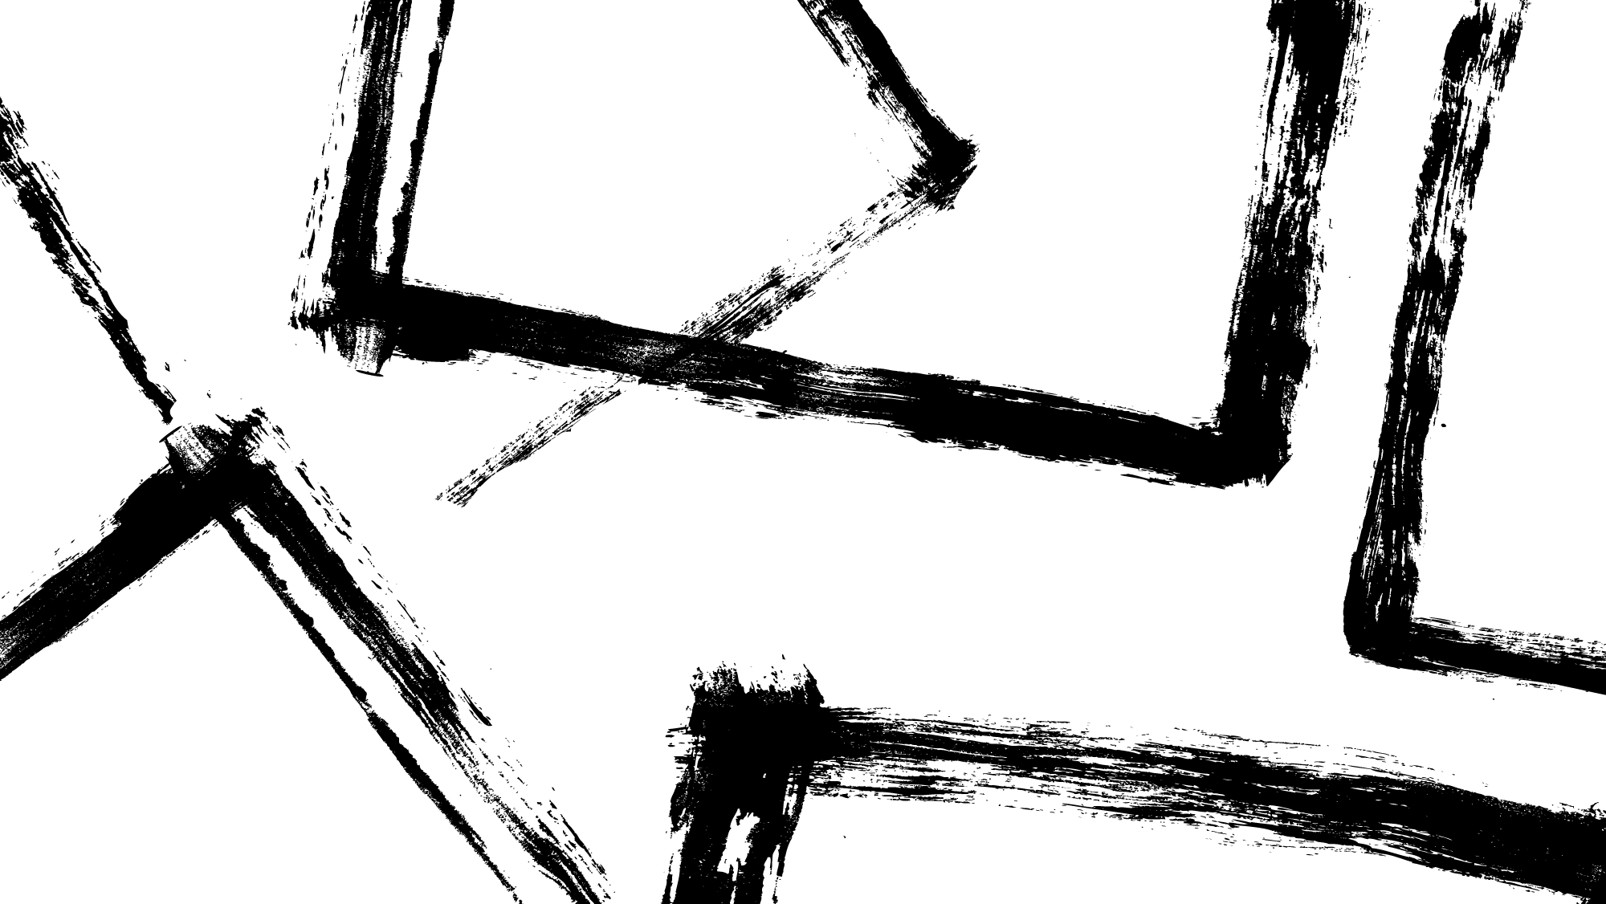
CS21 Decidability and Tractability
Lecture 14
February 5, 2024

Slide 2
Outline
undecidable problems
computation histories
surprising contrasts between decidable/undecidable
Rice’s Theorem
Post Correspondence Problem (skip)
Beyond RE and co-RE
Recursion Theorem

Slide 3
Dec. and undec. problems
two problems regarding Context-Free Grammars:
does a CFG generate all strings:
ALL_{CFG} = {<G> : G is a CFG and L(G) = Σ*}
CFG emptiness:
E_{CFG} = {<G> : G is a CFG and L(G) = Ø}
Both decidable? both undecidable? one decidable?

Slide 4
Dec. and undec. problems
Theorem: E_{CFG} is decidable.
Proof:
observation: for each nonterminal A, the set
S_{A} = {w : A $⇒$* w}
is non-empty iff there is some rule:
A → x
and for all non-terminals B in string x, $S_{B}≠∅$

Slide 5
Dec. and undec. problems
Proof:
on input <G>
mark all terminals in G
repeat until no new non-terminals get marked:
if there is a production A→x₁x₂x₃…x_{k}
and each symbol x₁, x₂, …, x_{k} has been marked
then mark A
if S marked, reject (G $∉$ E_{CFG}), else accept (G$∈$E_{CFG}).
terminates? correct?

Slide 6
Dec. and undec. problems
Theorem: ALL_{CFG} is undecidable.
Proof:
reduce from co-A_{TM} (i.e. show co-A_{TM} ≤_{m} ALL_{CFG})
what should f(<M, w>) produce?
Idea:
produce CFG G that generates all strings that are not accepting computation histories of M on w

Slide 7
Dec. and undec. problems
Proof:
build a NPDA, then convert to CFG
want to accept strings not of this form,
#C₁#C₂#C₃#...#C_{k}#
plus strings of this form but where
C₁ is not the start config. of M on input w, or
C_{k} is not an accept. config. of M on input w, or
C_{i} does not yield in one step C_{i+1} for some i

Slide 8
Dec. and undec. problems
Proof:
our NPDA nondeterministically checks one of:
C₁ is not the start config. of M on input w, or
C_{k} is not an accept. config. of M on input w, or
C_{i} does not yield in one step C_{i+1} for some i
input has fewer than two #’s
details of first two?
to check third condition:
nondeterministically guess C_{i} starting position
how to check that C_{i} doesn’t yield in 1 step C_{i+1} ?

Slide 9
Dec. and undec. problems
Proof:
checking:
C_{i} does not yield in one step C_{i+1} for some i
push C_{i} onto stack
at #, start popping C_{i} and compare to C_{i+1}
accept if mismatch away from head location, or
symbols around head changed in a way inconsistent with M’s transition function.
is everything described possible with NPDA?

Slide 10
Dec. and undec. problems
Proof:
Problem: cannot compare C_{i} to C_{i+1}
could prove in same way that proved
{ww: w $∈$ Σ*} not context-free
recall that
{ww^{R}: w $∈$ Σ*} is context-free
free to tweak construction of G in the reduction
solution: write computation history:
#C₁#C₂^{R} #C₃#C₄^{R}...#C_{k}#

Slide 11
Dec. and undec. problems
Proof:
f(<M, w>) = <G> equiv. to NPDA below:
on input x, accept if not of form:
#C₁#C₂^{R} #C₃#C₄^{R}...#C_{k}#
accept if C₁ is the not the start configuration for M on input w
accept if check that C_{i} does not yield in one step C_{i+1}
accept if C_{k} is not an accepting configuration for M
is f computable?
YES maps to YES?
<M, w> $∈$ co-A_{TM} $⇒$f(M, w) $∈$ ALL_{CFG}
NO maps to NO?
<M, w> $∉$ co-A_{TM} $⇒$f(M, w) $∉$ ALL_{CFG}

Slide 12
Rice’s Theorem
We have seen that the following properties of TM’s are undecidable:
TM accepts string w
TM halts on input w
TM accepts the empty language
TM accepts a regular language
Can we describe a single generic reduction for all these proofs?
Yes. Every property of TMs undecidable!

Slide 13
Rice’s Theorem
A TM property is a language P for which
if L(M₁) = L(M₂) then <M₁> $∈$P iff <M₂> $∈$P
TM property P is nontrivial if
there exists a TM M₁ for which <M₁> $∈$P, and
there exists a TM M₂ for which <M₂> $∉$P.
Rice’s Theorem: Every nontrivial TM property is undecidable.

Slide 14
Rice’s Theorem
The setup:
let T_{Ø} be a TM for which L(T_{Ø}) = Ø
technicality: if <T_{Ø}> $∈$ P then work with property co-P instead of P.
conclude co-P undecidable; therefore P undec. due to closure under complement
so, WLOG, assume <T_{Ø}> $∉$ P
non-triviality ensures existence of TM M₁ such that <M₁> $∈$P

Slide 15
Rice’s Theorem
Proof:
reduce from A_{TM} (i.e. show A_{TM} ≤_{m} P)
what should f(<M, w>) produce?
f(<M, w>) = <M’> described below:
on input x,
accept iff M accepts w and M₁ accepts x
(intersection of two RE languages)
f computable?
YES maps to YES?
<M, w> $∈$ A_{TM} $⇒$L(f(M, w)) = L(M₁) $⇒$f(M, w) $∈$P

Slide 16
Rice’s Theorem
Proof:
reduce from A_{TM} (i.e. show A_{TM} ≤_{m} P)
what should f(<M, w>) produce?
f(<M, w>) = <M’> described below:
on input x,
accept iff M accepts w and M₁ accepts x
(intersection of two RE languages)
NO maps to NO?
<M, w> $∉$ A_{TM} $⇒$L(f(M, w)) = L(T_{Ø}) $⇒$f(M, w) $∉$P

