Slide 1
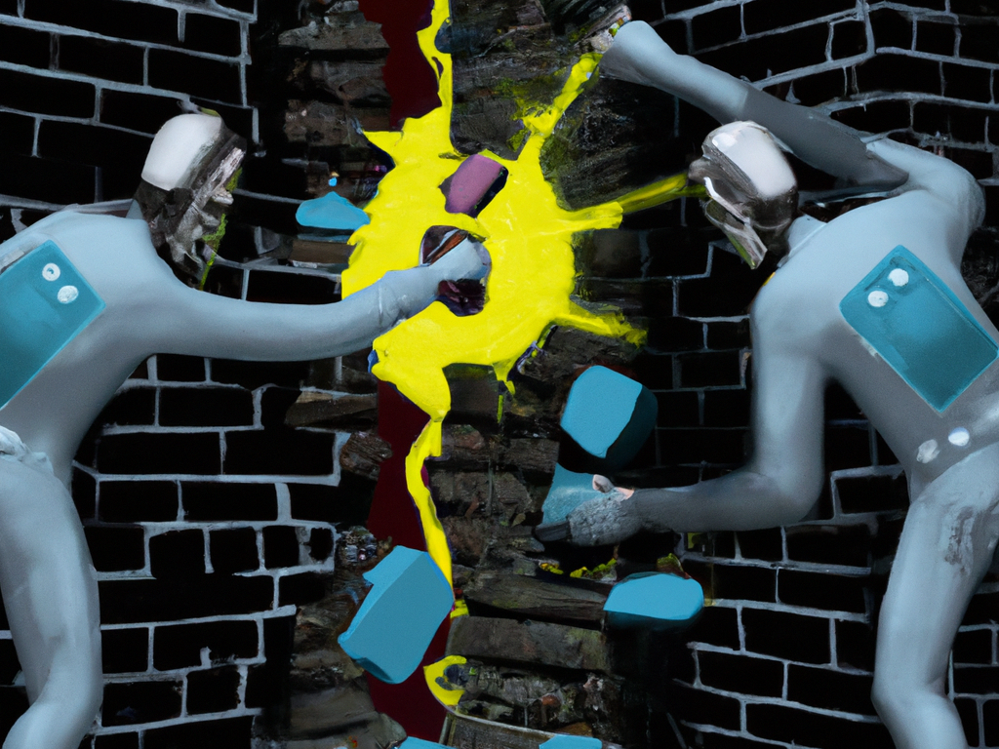
CS151 Complexity Theory
Lecture 17
May 30, 2023

Slide 2
NP $⊆$ PCP[log n, polylog n]
MAX-k-PCS gap problem:
given:
variables x₁, x₂, …, x_{n} taking values from field F_{q}
n = q^{m} for some integer m
k-ary constraints C₁, C₂, …, C_{t}
assignment viewed as f:(F_{q})^{m} $→$ F_{q}
YES: some degree d assignment satisfies all constraints
NO: no degree d assignment satisfies more than (1-$ε$) fraction of constraints

Slide 3
NP $⊆$ PCP[log n, polylog n]
Lemma: for every constant 1 > ε > 0, the MAX-k-PCS gap problem with
t = poly(n) k-ary constraints with k = polylog(n)
field size q = polylog(n)
n = q^{m} variables with m = O(log n / loglog n)
degree of assignments d = polylog(n)
gap $ε$
is NP-hard.

Slide 4
NP $⊆$ PCP[log n, polylog n]
Proof of Lemma
reduce from 3-SAT
3-CNF φ(x₁, x₂,…, x_{n})
can encode as $ψ$:[n] x [n] x [n] x {0,1}³$→${0,1}
$ψ$(i₁, i₂, i₃, b₁, b₂, b₃) = 1 iff φ contains clause
(x_{i1}^{b1} $∨$ x_{i2}^{b2} $∨$ x_{i3}^{b3})
e.g. (x₃$∨¬$x₅$∨$x₂) $⇒$ $ψ$(3,5,2,1,0,1) = 1

Slide 5
NP $⊆$ PCP[log n, polylog n]
pick H $⊆$ F_{q} with {0,1} $⊆$ H, |H| = polylog n
pick m = O(log n/loglog n) so |H|^{m} = n
identify [n] with H^{m}
$ψ$:H^{m} x H^{m} x H^{m} x H³ $→$ {0,1} encodes φ
assignment a:H^{m} $→$ {0,1}
Key: a satisfies φ iff $∀$i₁,i₂,i₃,b₁,b₂,b₃
$ψ$(i₁,i₂,i₃,b₁,b₂,b₃) = 0 or
a(i₁)=b₁ or a(i₂)=b₂ or a(i₃)=b₃

Slide 6
NP $⊆$ PCP[log n, polylog n]
$ψ$:H^{m} x H^{m} x H^{m} x H³ $→$ {0,1} encodes φ
a satisfies φ iff $∀$i₁,i₂,i₃,b₁,b₂,b₃
$ψ$(i₁,i₂,i₃,b₁,b₂,b₃) = 0 or a(i₁)=b₁ or a(i₂)=b₂ or a(i₃)=b₃
extend $ψ$ to a function $ψ$’:(F_{q})^{3m+3} $→$ F_{q} with degree at most |H| in each variable
can extend any assignment a:H^{m} $→${0,1} to a’:(F_{q})^{m} $→$ F_{q} with degree |H| in each variable

Slide 7
NP $⊆$ PCP[log n, polylog n]
$ψ$’:(F_{q})^{3m+3} $→$ F_{q} encodes φ
a’:(F_{q})^{m} $→$F_{q} s.a. iff $∀$(i₁,i₂,i₃,b₁,b₂,b₃) $∈$ H^{3m+3}
$ψ$’(i₁,i₂,i₃,b₁,b₂,b₃) = 0 or a’(i₁)=b₁ or a’(i₂)=b₂ or a’(i₃)=b₃
define: p_{a’}:(F_{q})^{3m+3} $→$F_{q} from a’ as follows
p_{a’}(i₁,i₂,i₃,b₁,b₂,b₃) =
$ψ$’(i₁,i₂,i₃,b₁,b₂,b₃)(a’(i₁) - b₁ )(a’(i₂) - b₂ )(a’(i₃) - b₃)
a’ s.a. iff $∀$(i₁,i₂,i₃,b₁,b₂,b₃) $∈$ H^{3m+3}
p_{a’}(i₁,i₂,i₃,b₁,b₂,b₃) = 0

Slide 8
NP $⊆$ PCP[log n, polylog n]
$ψ$’:(F_{q})^{3m+3} $→$ F_{q} encodes φ
a’:(F_{q})^{m} $→$F_{q} s.a. iff $∀$(i₁,i₂,i₃,b₁,b₂,b₃) $∈$ H^{3m+3}
p_{a’}(i₁,i₂,i₃,b₁,b₂,b₃) = 0
note: deg(p_{a’}) ≤ 2(3m+3)|H|
start using Z as shorthand for (i₁,i₂,i₃,b₁,b₂,b₃)
another way to write “a’ s.a.” is:
exists p₀:(F_{q})^{3m+3} $→$F_{q} of degree ≤ 2(3m+3)|H|
p₀(Z) = p_{a’}(Z) $∀$Z $∈$ (F_{q})^{3m+3}
p₀(Z) = 0 $∀$Z$∈$ H^{3m+3}

Slide 9
NP $⊆$ PCP[log n, polylog n]
Focus on “p₀(Z) = 0 $∀$Z $∈$ H^{3m+3}”
given: p₀:(F_{q})^{3m+3} $→$ F_{q}
define: p₁(x₁, x₂, x₃, …, x_{3m+3}) =
Σ_{hj}$∈$_{H}p₀(h_{j}, x₂, x₃, …, x_{3m+3})x₁^{j}
Claim:
p₀(Z)=0 $∀$Z$∈$H^{3m+3} $⇔$ p₁(Z)=0 $∀$Z$∈$ F_{q}xH^{3m+3-1}
Proof ($⇒$) for each x₂, x₃, …, x_{3m+3} $∈$ H^{3m+3-1}, resulting univariate poly in x₁ has all 0 coeffs.

Slide 10
NP $⊆$ PCP[log n, polylog n]
Focus on “p₀(Z) = 0 $∀$Z $∈$ H^{3m+3}”
given: p₀:(F_{q})^{3m+3} $→$ F_{q}
define: p₁(x₁, x₂, x₃, …, x_{3m+3}) =
Σ_{hj}$∈$_{H}p₀(h_{j}, x₂, x₃, …, x_{3m+3})x₁^{j}
Claim:
p₀(Z)=0 $∀$Z$∈$H^{3m+3} $⇔$ p₁(Z)=0 $∀$Z$∈$ F_{q}xH^{3m+3-1}
Proof ($⇐$) for each x₂, x₃, …, x_{3m+3} $∈$H^{3m+3-1}, univariate poly in x₁ is $≡$ 0 $⇒$ has all 0 coeffs.
deg(p₁) ≤ deg(p₀) + |H|

Slide 11
NP $⊆$ PCP[log n, polylog n]
deg(p₂) ≤ deg(p₁) + |H|
given: p₁:(F_{q})^{3m+3} $→$ F_{q}
define: p₂(x₁, x₂, x₃, …, x_{3m+3}) =
Σ_{hj} $∈$_{H}p₁(x₁, h_{j}, x₃, x₄, …, x_{3m+3})x₂^{j}
Claim:
p₁(Z)=0 $∀$Z $∈$ F_{q} x H^{3m+3-1}
$$⇔$$
p₂(Z)=0 $∀$Z$∈$ (F_{q})² x H^{3m+3-2}
Proof: same.

Slide 12
NP $∈$ PCP[log n, polylog n]
deg(p_{i}) ≤ deg(p_{i-1}) + |H|
given: p_{i-1}:(F_{q})^{3m+3} $→$ F_{q}
define: p_{i}(x₁, x₂, x₃, …, x_{3m+3}) =
Σ_{hj} $∈$_{H}p_{i-1}(x₁, x₂, …, x_{i-1}, h_{j}, x_{i+1}, x_{i+2}, …, x_{3m+3})x_{i}^{j}
Claim:
p_{i-1}(Z)=0 $∀$Z $∈$ (F_{q})^{i-1} x H^{3m+3-(i-1)}
$⇔$
p_{i}(Z)=0 $∀$Z$∈$ (F_{q})^{i} x H^{3m+3-i}
Proof: same.

Slide 13
NP $∈$ PCP[log n, polylog n]
define degree 3m+3+2 poly. δ_{i}:F_{q} $→$F_{q} so that
δ_{i}(v) = 1 if v = i
δ_{i}(v) = 0 if 0 ≤ v ≤ 3m+3+1 and v ≠ i
define Q:F_{q} x (F_{q})^{3m+3} $→$ F_{q} by:
Q(v, Z) = Σ_{i=0…3m+3}δ_{i}(v)p_{i}(Z) + δ_{3m+3+1}(v)a’(Z)
note: degree of Q is at most
3(3m+3)|H| + 3m + 3 + 2 < 10m|H|

Slide 14
NP $⊆$PCP[log n, polylog n]
Recall: MAX-k-PCS gap problem:
given:
variables x₁, x₂, …, x_{n} taking values from field F_{q}
n = q^{m} for some integer m
k-ary constraints C₁, C₂, …, C_{t}
assignment viewed as f:(F_{q})^{m} $→$ F_{q}
YES: some degree d assignment satisfies all constraints
NO: no degree d assignment satisfies more than (1-$ε$) fraction of constraints

Slide 15
NP $⊆$ PCP[log n, polylog n]
Instance of MAX-k-PCS gap problem:
set d = 10m|H|
given assignment Q:F_{q} x (F_{q})^{3m+3} $→$ F_{q}
expect it to be formed in the way we have described from an assignment a:H^{m} $→$ {0,1} to φ
note
to access a’(Z), evaluate Q(3m+3+1, Z)
p_{a’}(Z) formed from a’ and $ψ$’ (formed from φ)
to access p_{i}(Z), evaluate Q(i, Z)

Slide 16
NP $⊆$ PCP[log n, polylog n]
Instance of MAX-k-PCS gap problem:
set d = 10m|H|
given assignment Q:F_{q} x (F_{q})^{3m+3} $→$ F_{q}
expect it to be formed in the way we have described from an assignment a:H^{m} $→$ {0,1} to φ
constraints: $∀$Z $∈$ (F_{q})^{3m+3}
(C₀,_{Z}): p₀(Z) = p_{a’}(Z)
0<i≤3m+2 (C_{i},_{Z}): p_{i}(z₁, z₂, …, z_{i}, z_{i+1}, …, z_{3m+3}) =
Σ_{hj}$∈$_{H} p_{i-1}(z₁, z₂, …, z_{i-1}, h_{j}, z_{i+1}, …, z_{k})z_{i}^{j}
(C_{3m+3},_{Z}): p_{3m+3}(Z) = 0

Slide 17
NP $⊆$ PCP[log n, polylog n]
given Q:F_{q} x (F_{q})^{3m+3} $→$ F_{q} of degree d = 10m|H|
constraints: $∀$Z $∈$ (F_{q})^{3m+3}
(C₀,_{Z}): p₀(Z) = p_{a’}(Z)
(C_{i},_{Z}): p_{i}(z₁, z₂, …, z_{i}, z_{i+1}, …, z_{3m+3}) =
Σ_{hj}$∈$_{H} p_{i-1}(z₁, z₂, …, z_{i-1}, h_{j}, z_{i+1}, …, z_{k})z_{i}^{j}
(C_{3m+3},_{Z}): p_{3m+3}(Z) = 0
Schwartz-Zippel: if any one of these sets of constraints is violated at all then at least a (1 – 12m|H|/q) fraction in the set are violated
Key: all low-degree polys

Slide 18
NP $⊆$ PCP[log n, polylog n]
Proof of Lemma (summary):
reducing 3-SAT to MAX-k-PCS gap problem
φ(x₁, x₂,…, x_{n}) instance of 3-SAT
set m = O(log n/loglog n)
H $⊆$ F_{q} such that |H|^{m} = n (|H| = polylog n, q $≈$|H|³)
generate |F_{q}|^{3m+3} = poly(n) constraints:
C_{Z} = $⋀$_{i=0…3m+3+1} C_{i, Z}
each refers to assignment poly Q and φ (via p_{a’})
all polys degree d = O(m|H|) = polylog n
either all are satisfied or at most d/q = o(1) << ε

Slide 19
NP $⊆$ PCP[log n, polylog n]
O(log n) random bits to pick a constraint
query assignment in O(polylog(n)) locations to determine if constraint is satisfied
completeness 1
soundness (1-$ε$) if prover keeps promise to supply degree d polynomial
prover can cheat by not supplying proof in expected form

Slide 20
NP $⊆$ PCP[log n, polylog n]
Low-degree testing:
want: randomized procedure that is given d, oracle access to f:(F_{q})^{m} $→$ F_{q}
runs in poly(m, d) time
always accepts if deg(f) ≤ d
rejects with high probability if deg(f) > d
too much to ask. Why?

Slide 21
NP $⊆$ PCP[log n, polylog n]
Definition: functions f, g are δ-close if
Pr_{x}[f(x) ≠ g(x)] $≤$ δ
Lemma: $∃$δ > 0 and a randomized procedure that is given d, oracle access to f:(F_{q})^{m} $→$ F_{q}
runs in poly(m, d) time
uses O(m log |F_{q}|) random bits
always accepts if deg(f) ≤ d
rejects with high probability if f is not δ-close to any g with deg(g) ≤ d

Slide 22
NP $⊆$ PCP[log n, polylog n]
idea of proof:
restrict to random line L
check if it is low degree
always accepts if deg(f) ≤ d
other direction more complex
(F_{q})^{m}

Slide 23
NP $⊆$ PCP[log n, polylog n]
can only force prover to supply function f that is close to a low-degree polynomial
how to bridge the gap?
recall low-degree polynomials form an error correcting code (Reed-Muller)
view “close” function as corrupted codeword

Slide 24
NP $⊆$ PCP[log n, polylog n]
Self-correction:
want: randomized procedure that is given x, oracle access to f:(F_{q})^{m} $→$ (F_{q}) that is δ-close to a (unique) degree d polynomial g
runs in poly(m, d) time
uses O(m log |F_{q}|) random bits
with high probability outputs g(x)

Slide 25
NP $⊆$ PCP[log n, polylog n]
Lemma: $∃$a randomized procedure that is given x, oracle access to f:(F_{q})^{m} $→$ (F_{q}) that is δ-close to a (unique) degree d polynomial g
runs in poly(m, d) time
uses O(m log |F_{q}|) random bits
outputs g(x) with high probability

Slide 26
NP $⊆$ PCP[log n, polylog n]
idea of proof:
restrict to random line L passing through x
query points along line
apply error correction
(F_{q})^{m}

Slide 27
NP $⊆$ PCP[log n, polylog n]
Putting it all together:
given L $∈$ NP and an instance x, verifier computes reduction to MAX-k-PCS gap problem
prover supplies proof in form
f:(F_{q})^{m} $→$ (F_{q})
(plus some other info used for low-degree testing)
verifier runs low-degree test
rejects if f not close to some low degree function g
verifier picks random constraint C_{i}; checks if sat. by g
uses self-correction to get values of g from f
accept if C_{i} satisfied; otherwise reject

Slide 28
New topic: relativization and natural proofs

Slide 29
Approaches to open problems
Almost all major open problems we have seen entail proving lower bounds
P ≠ NP - P = BPP *
L ≠ P - NP = AM *
P ≠ PSPACE
NC proper
BPP ≠ EXP
PH proper
EXP $⊆$ P/poly
we know circuit lower bounds imply derandomization
more difficult (and recent): derandomization implies circuit lower bounds!

Slide 30
Approaches to open problems
two natural approaches
simulation + diagonalization (uniform)
circuit lower bounds (non-uniform)
no success for either approach as applied to date
Why?

Slide 31
Approaches to open problems
in a precise, formal sense
these approaches are
too powerful !
if they could be used to resolve major open problems, a side effect would be:
proving something that is false, or
proving something that is believed to be false

Slide 32
Relativization
Many proofs and techniques we have seen relativize:
they hold after replacing all TMs with oracle TMs that have access to an oracle A
e.g. L^{A} $⊆$ P^{A} for all oracles A
e.g. P^{A} ≠ EXP^{A} for all oracles A

Slide 33
Relativization
Idea: design an oracle A relative to which some statement is false
implies there can be no relativizing proof of that statement
e.g. design A for which P^{A} = NP^{A}
Better: also design an oracle B relative to which statement is true
e.g. also design B for which P^{B} ≠ NP^{B}
implies no relativizing proof can resolve truth of the statement either way !

Slide 34
Relativization
Oracles are known that falsify almost every major conjecture concerning complexity classes
for these conjectures, non-relativizing proofs are required
almost all known proofs in Complexity relativize (sometimes after some reformulation)
notable exceptions:
The PCP Theorem
IP = PSPACE
most circuit lower bounds (more on these later)

Slide 35
Oracles for P vs. NP
Goal:
oracle A for which P^{A} = NP^{A}
oracle B for which P^{B} ≠ NP^{B}
conclusion: resolving
P vs. NP
requires a non-relativizing proof

Slide 36
Oracles for P vs. NP
for P^{A} = NP^{A} need A to be powerful
warning: intend to make P more powerful, but also make NP more powerful.
e.g. A = SAT doesn’t work
however A = QSAT works:
PSPACE $⊆$ P^{QSAT} $⊆$ NP^{QSAT} $⊆$ NPSPACE
and we know NPSPACE $=$ PSPACE

Slide 37
Oracles for P vs. NP
Theorem: there exists an oracle B for which P^{B} ≠ NP^{B}.
Proof:
define
L = {1^{k} : $∃$ x $∈$ B s.t. |x| = k}
we will show L $∈$ NP^{B} – P^{B}.
easy: L $∈$ NP^{B} (no matter what B is)

Slide 38
Oracles for P vs. NP
design B by diagonalizing against all
“P^{B} machines”
M₁, M₂, M₃, … is an enumeration of deterministic OTMs
each machine appears infinitely often
B_{i} will be those strings of length $≤$i in B
we build B_{i} after simulating machine M_{i}

Slide 39
Oracles for P vs. NP
L = {1^{k} : $∃$ x $∈$ B s.t. |x| = k}
Proof (continued):
maintain “exceptions” X that must not go in B
initially X = { }, B₀ = { }
Stage i:
simulate M_{i}(1^{i}) for i^{log i} steps
when M_{i} makes an oracle query q:
if |q| < i, answer using B_{i-1}
if |q| $≥$ i, answer “no”; add q to X
if simulated M_{i} accepts 1^{i} then B_{i} = B_{i-1}
if simulated M_{i} rejects 1^{i}, B_{i} = B_{i-1} $∪$ {x $∈$ {0,1}^{i} : x $∉$ X}

Slide 40
Oracles for P vs. NP
L = {1^{k} : $∃$ x $∈$ B s.t. |x| = k}
Proof (continued):
if M_{i} accepts, we ensure no strings of length i in B
therefore 1^{i} $∉$L, and so M_{i} does not decide L
if M_{i} rejects, we ensure some string of length i in B
Why?
B_{i} = B_{i-1} $∪${x $∈$ {0,1}^{i} : x $∉$ X}
and |X| is at most Σ_{j} $≤$_{i} j^{log j} << 2^{i}
therefore 1^{i} $∈$ L, and so M_{i} does not decide L
Conclude: L $∉$ P^{B}

Slide 41
Circuit lower bounds
Relativizing techniques are out…
but most circuit lower bound techniques do not relativize
exponential circuit lower bounds known for weak models:
e.g. constant-depth poly-size circuits
But, utter failure (so far) for more general models. Why?

Slide 42
Natural Proofs
Razborov and Rudich defined the following “natural” format for circuit lower bounds:
identify property P of functions f:{0,1}* $→$ {0,1}
P = $∪$_{n} P_{n} is a natural property if:
(useful) $∀$n f_{n} $∈$ P_{n} implies f does not have poly-size circuits [i.e. f_{n} $∈$ P_{n} implies ckt size $≥$ s(n) >> poly(n)]
(constructive) can decide “f_{n} $∈$ P_{n}?” in poly time given the truth table of f_{n}
(large) at least (½)^{O(n)} fraction of all 2^{2n} functions on n bits are in P_{n}
show some function family g = {g_{n}} is in P_{n}

Slide 43
Natural Proofs
all known circuit lower bound techniques are natural for a suitably parameterized version of the definition
Theorem (RR): if there is a 2^{n}$ε$-OWF, then there is no natural property P.
factoring believed to be 2^{n}$ε$-OWF
general version also rules out natural properties useful for proving many other separations, under similar cryptographic assumptions

