Slide 1

CS151
Complexity Theory
Lecture11
May 9, 2023

Slide 2
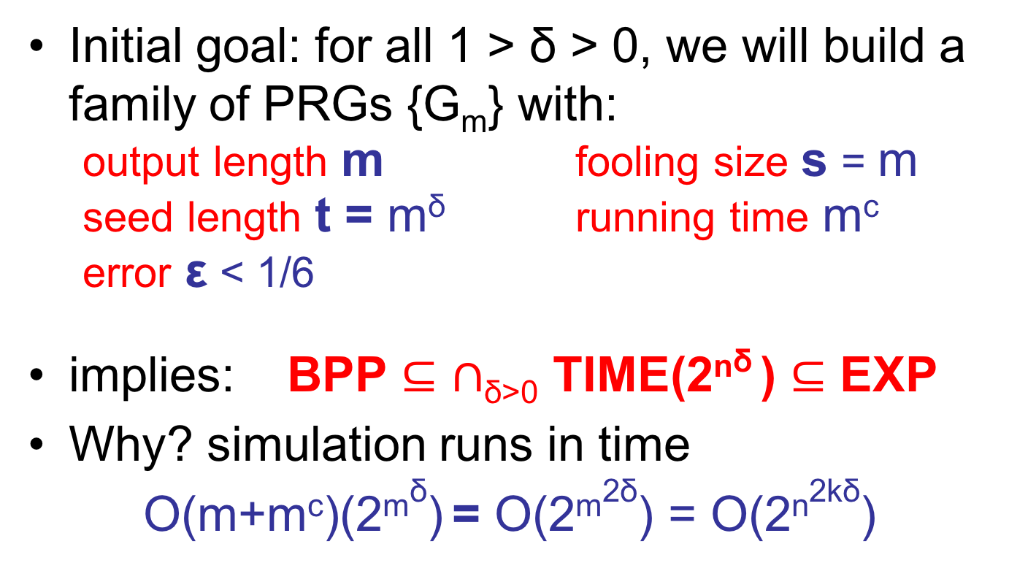
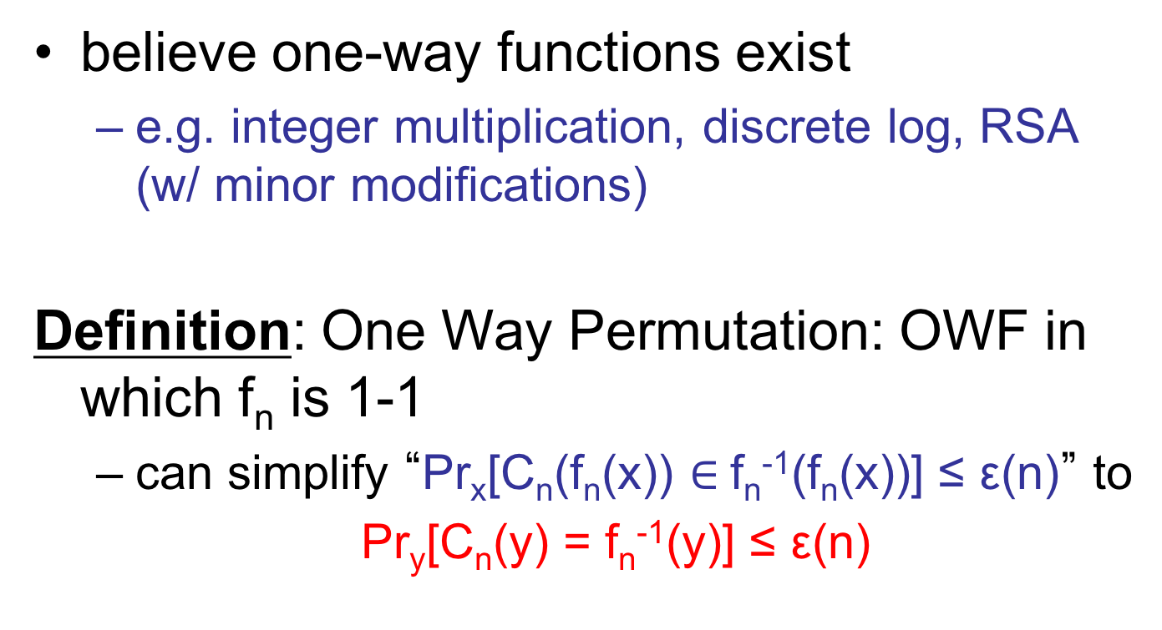
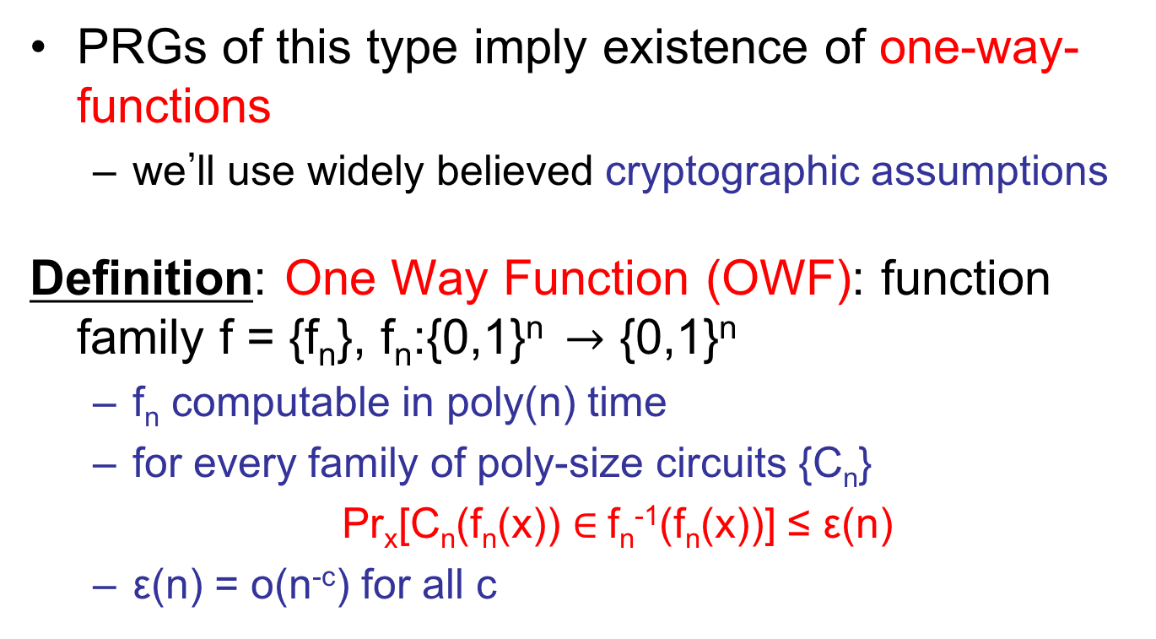
Codes and Hardness
f:{0,1}^{log k} $→$ {0,1}
m:
0
1
1
0
0
0
1
0
f ’:{0,1}^{log n} $→$ {0,1}
Enc(m):
0
1
1
0
0
0
1
0
0
0
0
1
0
small circuit C approximating f’
R:
0
0
1
0
1
0
1
0
0
0
1
0
0
small circuit that computes f exactly
decoding procedure
C
D
i $∈$ {0,1}^{log k}
f(i)

Slide 3
Encoding
use a (variant of) Reed-Muller code concatenated with the Hadamard code
  q (field size), t (dimension), h (degree)
encoding procedure:
  message m $∈$ {0,1}^{k}
  subset S $⊆$ F_{q} of size h
  efficient 1-1 function Emb: [k] $→$ S^{t}
  find coeffs of degree h polynomial p_{m}:F_{q}^{t} $→$ F_{q} for which p_{m}(Emb(i)) = m_{i} for all i (linear algebra)
so, need h^{t} ≥ k

Slide 4
Encoding
encoding procedure (continued):
  Hadamard code Had:{0,1}^{log q} $→$ {0,1}^{q}
    = Reed-Muller with field size 2, dim. log q, deg. 1
    distance ½ by Schwartz-Zippel
  final codeword: (Had(p_{m}(x)))_{x} $∈$ _{Fq}t
    evaluate p_{m} at all points, and encode each evaluation with the Hadamard code

Slide 5
Encoding
m:
0
1
1
0
0
0
1
0
F_{q}^{t}
p_{m} degree h polynomial with p_{m}(Emb(i)) = m_{i}
Emb: [k] $→$ S^{t}
S^{t}
evaluate at all x $∈$ F_{q}^{t}
5
2
7
1
2
9
0
3
6
8
3
encode each symbol with
Had:{0,1}^{log q}$→${0,1}^{q}
. . .
. . .
0
1
0
0
1
0
1
0

Slide 6
Decoding
Enc(m):
0
1
1
0
0
0
1
0
0
0
0
1
R:
0
0
1
0
1
0
1
0
0
0
1
0
small circuit C computing R, agreement ½ + $δ$
Decoding step 1
  produce circuit C’ from C
    given x $∈$ F_{q}^{t} outputs “guess” for p_{m}(x)
    C’ computes {z : Had(z) has agreement ½ + $δ/2$ with x-th block}, outputs random z in this set

Slide 7
Decoding
Decoding step 1 (continued):
  for at least $δ$/2 of blocks, agreement in block is at least ½ + $δ$/2
  Johnson Bound: when this happens, list size is S = O(1/$δ$²), so probability C’ correct is 1/S
  altogether:
    Pr_{x}[C’(x) = p_{m}(x)] ≥ $Ω$($δ$³)
    C’ makes q queries to C
    C’ runs in time poly(q)

Slide 8
Decoding
    small circuit C’ computing R’, agreement $δ$’ = $Ω$($δ$³)
Decoding step 2
  produce circuit C’’ from C’
    given x $∈$ emb(1,2,…,k) outputs p_{m}(x)
    idea: restrict p_{m} to a random curve; apply efficient R-S list-decoding; fix “good” random choices
p_{m}:
5
2
7
1
2
9
0
3
6
8
3
R’:
5
9
7
1
6
9
0
3
6
8
1

Slide 9
Restricting to a curve
  points x=$α$₁, $α$₂, $α$₃, …, $α$_{r} $∈$ F_{q}^{t} specify a degree r curve L : F_{q} $→$ F_{q}^{t}
w₁, w₂, …, w_{r} are distinct elements of F_{q}
for each i, L_{i} :F_{q} $→$ F_{q}
is the degree r poly for which L_{i}(w_{j}) = ($α$_{j})_{i} for all j
Write p_{m}(L(z)) to mean p_{m}(L₁(z), L₂(z), …, L_{t}(z))
p_{m}(L(w₁)) = p_{m}(x)
$α$₂
$α$_{r}
$α$₃
x=$α$₁
degree r$⋅$h$⋅$t univariate poly

Slide 10
Restricting to a curve
Example:
  p_{m}(x₁, x₂) = x₁²x₂² + x₂
  w₁ = 1, w₂ = 0
  L₁(z) = 2z + 1(1-z) = z + 1
  L₂(z) = 1z + 0(1-z) = z
  p_{m}(L(z)) = (z+1)²z² + z = z⁴ + 2z³ + z² + z
$α$₁ = (2,1)
$α$₂ = (1,0)
F_{q}^{t}

Slide 11
Decoding
    small circuit C’ computing R’, agreement $δ$’ = $Ω$($δ$³)
Decoding step 2 (continued):
  pick random w₁, w₂, …, w_{r}; $α$₂, $α$₃, …, $α$_{r} to determine curve L
  points on L are (r-1)-wise independent
  random variable: Agr = |{z : C’(L(z)) = p_{m}(L(z))}|
  E[Agr] = $δ$’q and Pr[Agr < ($δ$’q)/2] < O(1/($δ$’q))^{(r-1)/2}
p_{m}:
5
2
7
1
2
9
0
3
6
8
3
R’:
5
9
7
1
6
9
0
3
6
8
1

Slide 12
Decoding
    small circuit C’ computing R’, agreement $δ$’ = $Ω$($δ$³)
Decoding step 2 (continued):
  agr = |{z : C’(L(z)) = p_{m}(L(z))}| is $≥$ ($δ$’q)/2 with very high probability
  compute using Reed-Solomon list-decoding:
  {q(z) : deg(q) $≤$ r$⋅$h$⋅$t, Pr_{z}[C’(L(z)) = q(z)] $≥$ ($δ$’q)/2}
  if agr $≥$ ($δ$’q)/2 then p_{m}(L($⋅$)) is in this set!
p_{m}:
5
2
7
1
2
9
0
3
6
8
3
R’:
5
9
7
1
6
9
0
3
6
8
1

Slide 13
Decoding
Decoding step 2 (continued):
  assuming ($δ$’q)/2 > (2r$⋅$h$⋅$t$⋅$q)^{1/2}
  Reed-Solomon list-decoding step:
    running time = poly(q)
    list size S $≤$ 4/$δ$’
  probability list fails to contain p_{m}(L($⋅$)) is O(1/($δ$q))^{(r-1)/2}

Slide 14
Decoding
Decoding step 2 (continued):
  Tricky:
    functions in list are determined by the set L($⋅$), independent of parameterization of the curve
    Regard w₂,w₃, …, w_{r} as random points on curve L
    for q $≠$p_{m}(L($⋅$))
    Pr[q(w_{i}) = p_{m}(L(w_{i}))] $≤$ (rht)/q
    Pr[$∀$ i, q(w_{i}) = p_{m}(L(w_{i}))] $≤$ [(rht)/q]^{r-1}
    Pr[$∃$ q in list s.t. $∀$ i q(w_{i}) = p_{m}(L(w_{i}))] $≤$(4/$δ$’)[(rht)/q]^{r-1}

Slide 15
Decoding
Decoding step 2 (continued):
  with probability $≥$ 1 - O(1/($δ$q))^{(r-1)/2} - (4/$δ$’)[(rht)/q]^{r-1}
    list contains q* = p_{m}(L($⋅$))
    q* is the unique q in the list for which
    q(w_{i}) = p_{m}(L(w_{i})) ( =p_{m}($α$_{i}) ) for i = 2,3,…,r
  circuit C’’:
    hardwire w₁, w₂, …, w_{r}; $α$₂, $α$₃, …, $α$_{r} so that $∀$x $∈$emb(1,2,…,k) both events occur
    hardwire p_{m}($α$_{i}) for i = 2,…r
    on input x, find q*, output q*(w₁) ( = p_{m}(x) )

Slide 16
Decoding
Putting it all together:
  C approximating f’ used to construct C’
    C’ makes q queries to C
    C’ runs in time poly(q)
  C’ used to construct C’’ computing f exactly
    C’’ makes q queries to C’
    C’’ has r-1 elts of F_{q}^{t} and 2r-1 elts of F_{q} hardwired
    C’’ runs in time poly(q)
  C’’ has size poly(q, r, t, size of C)

Slide 17
Picking parameters
    k truth table size of f, hard for circuits of size s
    q field size, h R-M degree, t R-M dimension
    r degree of curve used in decoding
  h^{t} $≥$ k (to accomodate message of length k)
  $δ$⁶q² > $Ω$(rhtq) (for R-S list-decoding)
  k[O(1/($δ$q))^{(r-1)/2} + (4/$δ$’)[(rht)/q]^{r-1}] < 1
  (so there is a “good” fixing of random bits)
  Pick: h = s, t = (log k)/(log s)
  Pick: r = $Θ$(log k), q = $Θ$(rht$δ$⁻⁶)

Slide 18
Picking parameters
    k truth table size of f, hard for circuits of size s
    q field size, h R-M degree, t R-M dimension
    r degree of curve used in decoding
    h = s, t = (log k)/(log s)
    r = $Θ$(log k), q = $Θ$(rht$δ$⁻⁶)
Claim: truth table of f’ computable in time poly(k) (so f’ $∈$ E if f $∈$ E).
  poly(q^{t}) for R-M encoding
  poly(q)$⋅$q^{t} for Hadamard encoding
  q $≤$ poly(s), so q^{t} $≤$ poly(s)^{t} = poly(h)^{t} = poly(k)
log k, $δ$⁻¹ < s

Slide 19
Picking parameters
    k truth table size of f, hard for circuits of size s
    q field size, h R-M degree, t R-M dimension
    r degree of curve used in decoding
    h = s, t = (log k)/(log s)
    r = $Θ$(log k), q = $Θ$(rht$δ$⁻⁶)
Claim: f’ s’-approximable by C implies f computable exactly in size s by C’’, for s’ = s$Ω$⁽¹⁾
  C has size s’ and agreement $δ$=1/s’ with f’
  C’’ has size poly(q, r, t, size of C) = s
log k, $δ$⁻¹ < s

Slide 20
Putting it all together
Theorem 1 (IW, STV): If E contains functions that require size 2^{Ω(n)} circuits, then E contains 2^{Ω(n)} -unapproximable functions.
(proof on next slide)
Theorem (NW): if E contains 2^{Ω(n)}-unapp-roximable functions then BPP = P.
Theorem (IW): E requires exponential size circuits $⇒$ BPP = P.

Slide 21
Putting it all together
Proof of Theorem 1:
  let f = {f_{n}} be hard for size s(n) = 2^{δn} circuits
  define f’ = {f_{n}’} to be just-described encoding of (the truth tables of) f = {f_{n}}
  two claims we just showed:
    f’ is in E since f is.
    if f ’ is s’(n) = 2^{δ’n}-approximable, then f is computable exactly by size s(n) = 2^{δn} circuits.
  contradiction.

Slide 22
Extractors
PRGs: can remove randomness from algorithms
  based on unproven assumption
  polynomial slow-down
  not applicable in other settings
Question: can we use “real” randomness?
  physical source
  imperfect – biased, correlated

Slide 23
Extractors
“Hardware” side
  what physical source?
  ask the physicists…
“Software” side
  what is the minimum we need from the physical source?

Slide 24
Extractors
imperfect sources:
  “stuck bits”:
  “correlation”:
  “more insidious correlation”:
111111
“ “ “ “ “ “
perfect squares
there are specific ways to get independent unbiased random bits from specific imperfect physical sources

Slide 25
Extractors
want to assume we don’t know details of physical source
general model capturing all of these?
  yes: “min-entropy”
universal procedure for all imperfect sources?
  yes: “extractors”

Slide 26
Min-entropy
General model of physical source w/ k < n bits of hidden randomness
string sampled uniformly from this set
2^{k} strings
{0,1}^{n}
Definition: random variable X on {0,1}^{n} has min-entropy min_{x} –log(Pr[X = x])
  min-entropy k implies no string has weight more than 2^{-k}

Slide 27
Extractor
Extractor: universal procedure for “purifying” imperfect source:
  E is efficiently computable
  truly random seed as “catalyst”
source string
2^{k} strings
E
near-uniform
seed
m bits
{0,1}^{n}
t bits

Slide 28
Extractor
“(k, ε)-extractor” $⇒$ for all X with min-entropy k:
  output fools all circuits C:
|Pr_{z}[C(z) = 1] - Pr_{y, x}$←$_{X}[C(E(x, y)) = 1]| ≤ ε
  distributions E(X, U_{t}), U_{m} “ε-close” (L₁ dist ≤ 2ε)
Notice similarity to PRGs
  output of PRG fools all efficient tests
  output of extractor fools all tests

Slide 29
Extractors
Using extractors
  use output in place of randomness in any application
  alters probability of any outcome by at most ε
Main motivating application:
  use output in place of randomness in algorithm
  how to get truly random seed?
  enumerate all seeds, take majority

Slide 30
Extractors
source string
2^{k} strings
E
near-uniform
seed
m bits
{0,1}^{n}
t bits
Goals: good: best:
  short seed O(log n) log n+O(1)
  long output m = k^{Ω(1)} m = k+t–O(1)
  many k’s k = n^{Ω(1)} any k = k(n)

Slide 31
Extractors
random function for E achieves best !
  but we need explicit constructions
  many known; often complex + technical
  optimal extractors still open
Trevisan Extractor:
  insight: use NW generator with source string in place of hard function
  this works (!!)
  proof slightly different than NW, easier

Slide 32
Trevisan Extractor
Ingredients: ($δ$ > 0, m are parameters)
  error-correcting code
  C:{0,1}^{n} $→$ {0,1}^{n’}
  distance (½ - ¼m⁻⁴)n’ blocklength n’ = poly(n)
  (log n’, a = δlog n/3) design: S₁,S₂,…,S_{m} $∈$ {1…t = O(log n’)}
E(x, y)=C(x)[y_{|S1}]◦C(x)[y_{|S2}]◦…◦C(x)[y_{|Sm}]

Slide 33
Trevisan Extractor
E(x, y)=C(x)[y_{|S1}]◦C(x)[y_{|S2}]◦…◦C(x)[y_{|Sm}]
Theorem (T): E is an extractor for min-entropy k = n^{δ}, with
  output length m = k^{1/3}
  seed length t = O(log n)
  error ε ≤ 1/m
C(x):
010100101111101010111001010
seed y

Slide 34
Trevisan Extractor
Proof:
  given X $⊆$ {0,1}^{n} of size 2^{k}
  assume E fails to ε-pass statistical test C
|Pr_{z}[C(z) = 1] – Pr_{x}$←$_{X, y}[C(E(x, y)) = 1]| > ε
  distinguisher C $⇒$ predictor P:
  Pr_{x}$←$_{X, y}[P(E(x, y)₁…_{i-1})=E(x, y)_{i}] > ½ + ε/m

Slide 35
Trevisan Extractor
Proof (continued):
  for at least ε/2 of x $∈$ X we have:
  Pr_{y}[P(E(x, y)₁…_{i-1})=E(x, y)_{i}] > ½ + ε/(2m)
  fix bits $α$,$β$ outside of S_{i} to preserve advantage
  Pr_{y’}[P(E(x; $α$y’$β$)₁…_{i-1})=C(x)[y’] ] >½ + ε/(2m)
  as vary y’, for j ≠ i, j-th bit of E(x; $α$y’$β$) varies over only 2ª values
  (m-1) tables of 2ª values supply E(x;$α$y’$β$)₁…_{i-1}

Slide 36
Trevisan Extractor
output C(x)[y’] w.p. ½ + ε/(2m)
Y’ $∈$ {0,1}^{log n’}
P
y’

Slide 37
Trevisan Extractor
Proof (continued):
  (m-1) tables of size 2ª constitute a description of a string that has ½ + ε/(2m) agreement with C(x)
  # of strings x with such a description?
    exp((m-1)2ª) = exp(n^{δ2/3}) = exp(k^{2/3}) strings
    Johnson Bound: each string accounts for at most O(m⁴) x’s
    total #: O(m⁴)exp(k^{2/3}) << 2^{k}(ε/2)
    contradiction

Slide 38
Extractors
Trevisan:
k = n$δ$ t = O(log n)
m = k^{1/3} $ε$ = 1/m
(k, $ε$)- extractor:
  E is efficiently computable
  $∀$ X with minentropy k, E fools all circuits C:
|Pr_{z}[C(z) = 1] - Pr_{y, x}$←$_{X}[C(E(x, y)) = 1]| ≤ ε
source string
2^{k} strings
E
near-uniform
seed
m bits
{0,1}^{n}
t bits

Slide 39
Strong error reduction
L $∈$ BPP if there is a p.p.t. TM M:
  x $∈$ L $⇒$ Pr_{y}[M(x,y) accepts] ≥ 2/3
  x $∀$ L $⇒$ Pr_{y}[M(x,y) rejects] ≥ 2/3
Want:
  x $∈$ L $⇒$ Pr_{y}[M(x,y) accepts] ≥ 1 - 2^{-k}
  x $∉$ L $⇒$ Pr_{y}[M(x,y) rejects] ≥ 1 - 2^{-k}
We saw: repeat O(k) times
  n = O(k)·|y| random bits; 2^{n-k} bad strings
Want to spend n = poly(|y|) random bits; achieve << 2^{n/3} bad strings

Slide 40
Strong error reduction
Better:
  E extractor for minentropy k=|y|³=n^{δ}, ε < 1/6
  pick random w $∈$ {0,1}^{n}, run M(x, E(w, z)) for all z $∈$ {0,1}^{t}, take majority
  call w “bad” if maj_{z}M(x, E(w, z)) incorrect
|Pr_{z}[M(x,E(w,z))=b] - Pr_{y}[M(x,y)=b]| ≥ 1/6
  extractor property: at most 2^{k} bad w
  n random bits; 2^{nδ} bad strings

