Slide 1
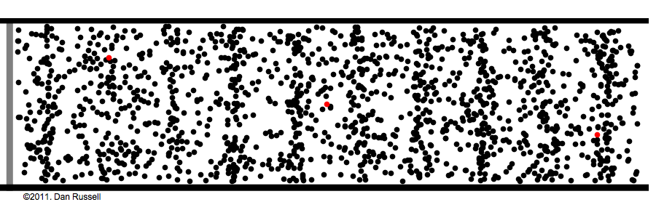
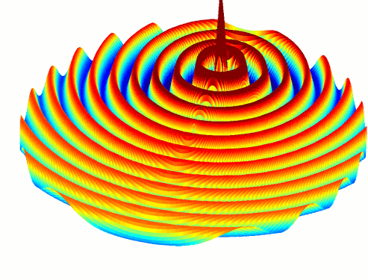
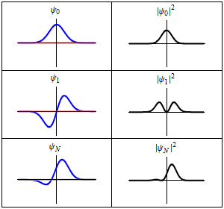
Waves!

Slide 2
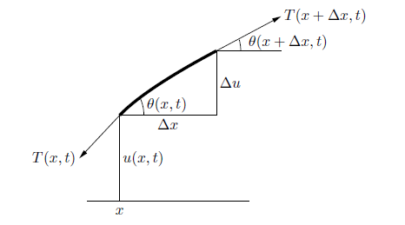
Solving something like this…

Slide 3
The Wave Equation
(1-D)
(n-D)
$$\frac{∂^{2}y}{∂t^{2}}=c^{2}\frac{∂^{2}y}{∂x^{2}}$$
$$\frac{∂^{2}y}{∂t^{2}}=c^{2} ∇^{2}y$$

Slide 4
The Wave Equation
$$\frac{∂}{∂t}\frac{y_{x,t+1}−y_{x,t}}{∆t}=c^{2}\frac{∂}{∂x}\frac{y_{x+1,t}−y_{x,t}}{∆x}$$
→
$$\frac{{(y}_{x,t+1}−y_{x,t})−{(y}_{x,t}−y_{x,t−1})}{{(∆t)}^{2}}=c^{2}\frac{{(y}_{x+1,t}−y_{x,t})−{(y}_{x,t}−y_{x−1,t})}{{(∆x)}^{2}}$$
→
$$y_{x,t+1}=2y_{x,t}−y_{x,t−1}+{\left(\frac{c∆t}{∆x}\right)}^{2}{(y}_{x+1,t}−2y_{x,t}+y_{x−1,t})$$

Slide 5
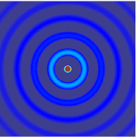
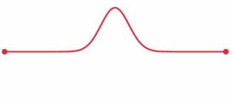
Boundary Conditions
Examples:
Manual motion at an end
u(0, t) = f(t)
Bounded ends:
u(0, t) = u(L, t) = 0 for all t

Slide 6
Discrete solution
Deal with three states at a time (all positions at t -1, t, t+1)
Let L = number of nodes (distinct discrete positions)
Create a 2D array of size 3*L
Denote pointers to where each region begins
Cyclically overwrite regions you don’t need!

Slide 7
Discrete solution
Sequential pseudocode:
fill data array with initial conditions
for all times t = 0… t_max
point old_data pointer where current_data used to be
point current_data pointer where new_data used to be
point new_data pointer where old_data used to be!
(so that we can overwrite the old!)
for all positions x = 1…up to number of nodes-2
calculate f(x, t+1)
end
set any boundary conditions!
(every so often, write results to file)
end

Slide 8
GPU Algorithm - Kernel
(Assume kernel launched at some time t…)
Calculate y(x, t+1)
Each thread handles only a few values of x!
Similar to polynomial problem
$$y_{x,t+1}=2y_{x,t}−y_{x,t−1}+{\left(\frac{c∆t}{∆x}\right)}^{2}{(y}_{x+1,t}−2y_{x,t}+y_{x−1,t})$$

Slide 9
GPU Algorithm – The Wrong Way
Recall the old “GPU computing instructions”:
Setup inputs on the host (CPU-accessible memory)
Allocate memory for inputs on the GPU
Copy inputs from host to GPU
Allocate memory for outputs on the host
Allocate memory for outputs on the GPU
Start GPU kernel
Copy output from GPU to host

Slide 10
GPU Algorithm – The Wrong Way
Sequential pseudocode:
fill data array with initial conditions
for all times t = 0… t_max
adjust old_data pointer
adjust current_data pointer
adjust new_data pointer
allocate memory on the GPU for old, current, new
copy old, current data from CPU to GPU
launch kernel
copy new data from GPU to CPU
free GPU memory
set any boundary conditions!
(every so often, write results to file)
end

Slide 11
GPU Algorithm – The Wrong Way
Insidious memory transfer!
Many memory allocations!

Slide 12
GPU Algorithm – The Right Way
Sequential pseudocode:
allocate memory on the GPU for old, current, new
Either:
Create initial conditions on CPU, copy to GPU
Or, calculate and/or set initial conditions on the GPU!
for all times t = 0… t_max
adjust old_data address
adjust current_data address
adjust new_data address
launch kernel with the above addresses
Either:
Set boundary conditions on CPU, copy to GPU
Or, calculate and/or set boundary conditions on the GPU
End
free GPU memory

Slide 13
GPU Algorithm – The Right Way
Everything stays on the GPU all the time!
Almost…

Slide 14
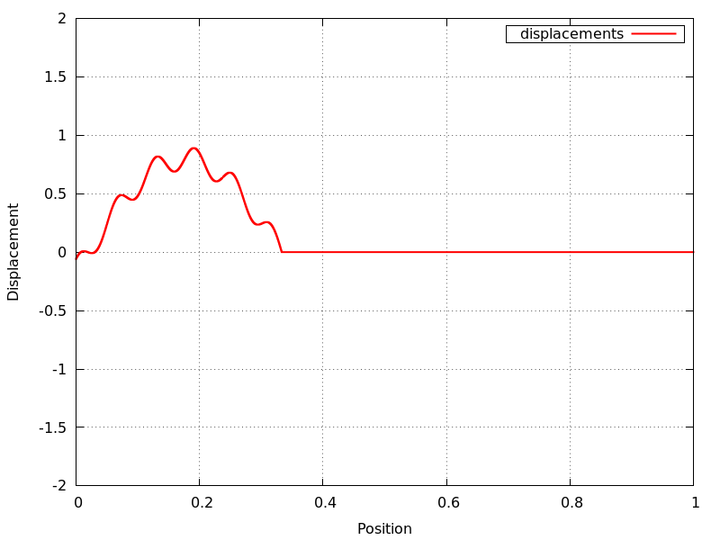
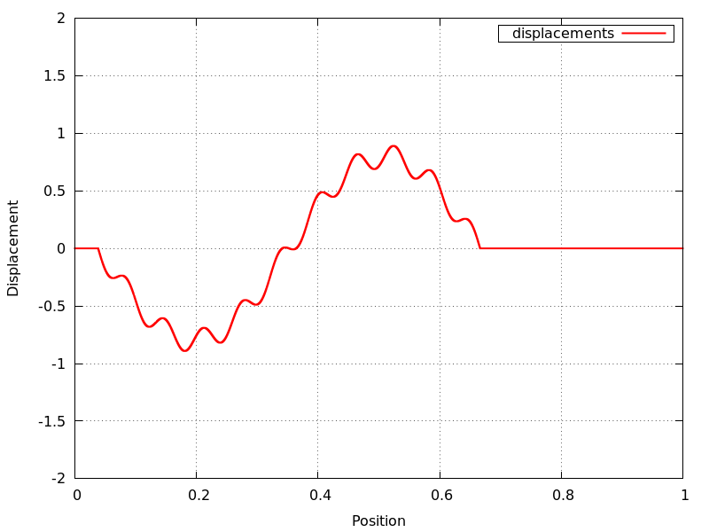
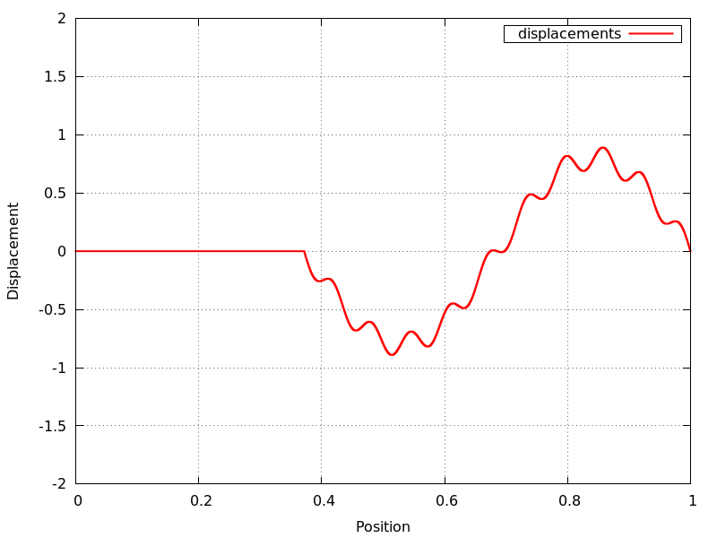
Getting output
What if we want to get a “snapshot” of the simulation?
That’s when we GPU-CPU copy!

Slide 15
GPU Algorithm – The Right Way
Sequential pseudocode:
allocate memory on the GPU for old, current, new
Either:
Create initial conditions on CPU, copy to GPU
Or, calculate and/or set initial conditions on the GPU!
for all times t = 0… t_max
adjust old_data address
adjust current_data address
adjust new_data address
launch kernel with the above addresses
Either:
Set boundary conditions on CPU, copy to GPU
Or, calculate and/or set boundary conditions on the GPU
Every so often, copy from GPU to CPU and write to file
End
free GPU memory

Slide 16
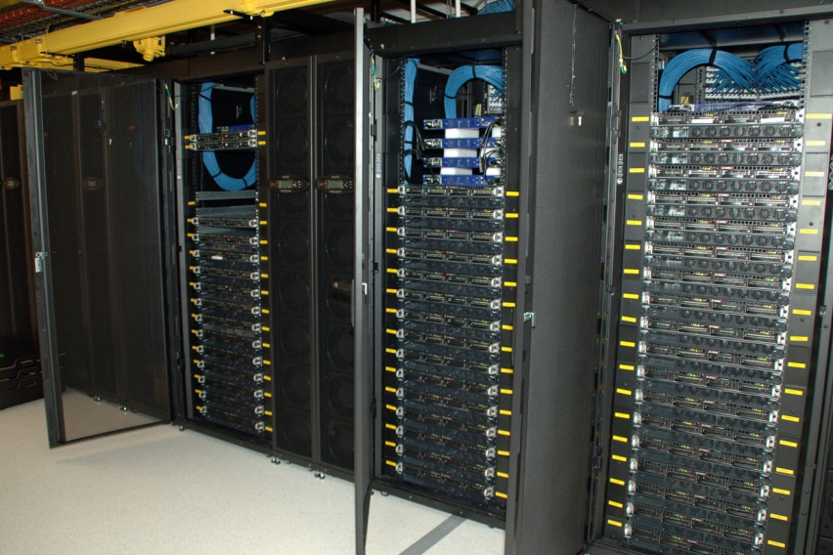
Multi-GPU Utilization
What if we want to use multiple GPUs…
Within the same machine?
Across a distributed system?
GPU cluster, CSIRO

Slide 17
Recall our calculation:
$$y_{x,t+1}=2y_{x,t}−y_{x,t−1}+{\left(\frac{c∆t}{∆x}\right)}^{2}{(y}_{x+1,t}−2y_{x,t}+y_{x−1,t})$$

Slide 18
Multiple GPU Solution
Big idea: Divide our data array between n GPUs!

Slide 19
Multiple GPU Solution
In reality: We have three regions of data at a time (old, current, new)

Slide 20
Multiple GPU Solution
Calculation for timestep t+1 uses the following data:
$$y_{x,t+1}=2y_{x,t}−y_{x,t−1}+{\left(\frac{c∆t}{∆x}\right)}^{2}{(y}_{x+1,t}−2y_{x,t}+y_{x−1,t})$$
t+1
t
t-1

Slide 21
Multiple GPU Solution
Problem if we’re at the boundary of a process!
$$y_{x,t+1}=2y_{x,t}−y_{x,t−1}+{\left(\frac{c∆t}{∆x}\right)}^{2}{(y}_{x+1,t}−2y_{x,t}+y_{x−1,t})$$
t+1
t
t-1
x
Where do we get $y_{x−1,t}$? (It’s outside our process!)

Slide 22
Multiple GPU Solution
After every time-step, each process gives its leftmost and rightmost piece of “current” data to neighbor processes!
Proc0
Proc1
Proc2
Proc3
Proc4

Slide 23
Multiple GPU Solution
Pieces of data to communicate:
Proc0
Proc1
Proc2
Proc3
Proc4

Slide 24
Multiple GPU Solution
(More details next lecture)
General idea – suppose we’re on GPU r in 0…(N-1):
If we’re not GPU N-1:
Send data to process r+1
Receive data from process r+1
If we’re not GPU 0:
Send data to process r-1
Receive data from process r-1
Wait on requests

Slide 25
Multiple GPU Solution
Communication can be expensive!
Expensive to communicate every timestep to send 1 value!
Better solution: Send some m values every m timesteps!

Slide 27
Possible Implementation
Initial setup: (Assume 3 processes)
Proc0
Proc1
Proc2

Slide 28
Possible Implementation
Give each array “redundant regions”
(Assume communication interval = 3)
Proc0
Proc1
Proc2

Slide 29
Possible Implementation
Every (3) timesteps, send some of your data to neighbor processes!

Slide 30
Possible Implementation
Send “current” data (current at time of communication)
Proc0
Proc1
Proc2

Slide 31
Possible Implementation
Then send “old” data
Proc0
Proc1
Proc2

Slide 32
Then…
Do our calculation as normal, if we’re not at the ends of our array
Our entire array, including redundancies!
$$y_{x,t+1}=2y_{x,t}−y_{x,t−1}+{\left(\frac{c∆t}{∆x}\right)}^{2}{(y}_{x+1,t}−2y_{x,t}+y_{x−1,t})$$

Slide 33
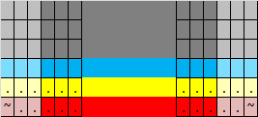
What about corruption?
Suppose we’ve just copied our data… (assume a non-boundary process)
. = valid
? = garbage
~ = doesn’t matter
(Recall that there exist only 3 spaces – gray areas are nonexistent in our current time

Slide 34
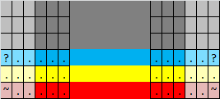
What about corruption?
Calculate new data…
Value unknown!

Slide 35
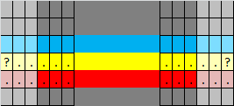
What about corruption?
Time t+1:
Current -> old, new -> current (and space for old is overwritten by new…)

Slide 36
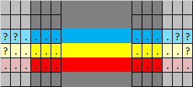
What about corruption?
More garbage data!
“Garbage in, garbage out!”

Slide 37
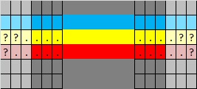
What about corruption?
Time t+2…

Slide 38
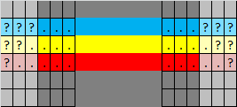
What about corruption?
Even more garbage!

Slide 39
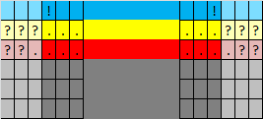
What about corruption?
Time t+3…
Core data region - corruption imminent!?

Slide 40
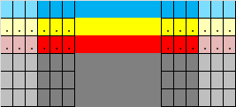
What about corruption?
Saved!
Data exchange occurs after communication interval has passed!

Slide 41
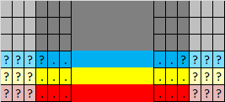
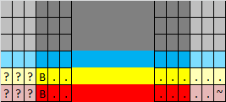
Boundary corruption?
Examine left-most process:
We never copy to it, so left redundant region is garbage!
(B = boundary condition set)

Slide 42
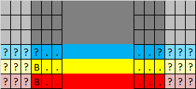
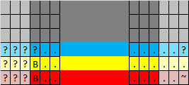
Boundary corruption?
Calculation brings garbage into non-redundant region!

Slide 43
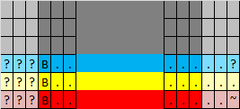
Boundary corruption?
…but boundary condition is set at every interval!

