Slide 1
cuRAND
cuRAND uses GPU to generate pseudorandom numbers
Host and Device API
Host API like cuBLAS but for random numbers
Device API can generate numbers while in kernel, more complicated

Slide 2
Monte Carlo Example
Cuda with random numbers is very useful for Monte Carlo
Repeated random sampling of the same system to get results
Each repetition is independent -> parallelizable!

Slide 3
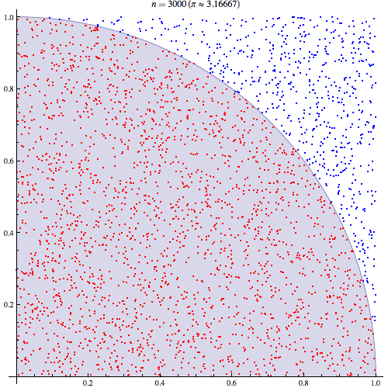
Monte Carlo Example
Simple example: numerically approximate pi
randomly scatter points, in a region, and calculate the fraction of points inside the circle

Slide 4
Monte Carlo Example
Parametric definition of a circle makes it easy to tell which points are in the circle
x^2 + y^2 < 1 : inside unit circle

Slide 5
Monte Carlo Example
Generate points uniformly distributed in
{(0, 1], (0, 1]}
float* dev_points;
curandGenerator_t gen;
curandCreateGenerator(&gen,CURAND_RNG_PSEUDO_DEFAULT);
curandGenerateUniform(gen, dev_points, numPoints * 2);

Slide 6
Monte Carlo Example
Check bounds and reduce
__global__ void countPointsInCircle(float* points, int n)
{
extern int sharedMem[];
int idx = threadIdx.x + blockIdx.x * blockDim.x;
float x = points[idx];
float y = points[idx + n];
sharedMem[threadIdx.x] = (x * x + y * y < 1);
//syncthreads and perform summing reduction
}

Slide 7
Monte Carlo Example
Just use our count to calculate the value we want
sum/numPoints is pi/4

Slide 8
Gillespie algorithm
Stochastic simulation of dynamic systems
Individual transitions are memoryless, if nothing happens for a long time, the system does not “remember” this

Slide 9
Gillespie algorithm
Simulation step:
Calculate the probability of each transition being the next event, calculate the distribution of the time the next event will occur at

Slide 10
Gillespie algorithm
Minimum of exponential random variables
if X1, X2, X3… are exponential random variables
min(X1, X2, X3…) is an exponential random variable with λ=λ1 + λ2 + λ3...

Slide 11
Gillespie algorithm
So we can calculate our transition distributions
P(event i happens next) = λi/sum(all λ)
Distribution of times
T : exponential with rate constant = sum(all λ)

Slide 12
Gillespie algorithm
We can sample these random variables using uniform distributions taken from cuRAND

Slide 13
Simple Chemical Simulation
A biological molecule is produced by a large reservoir of reactants, and decays at a rate proportional to concentration
reactants -> X -> 0

Slide 14
Simple Chemical Simulation
Nonstochastic model
d[X]/dt = k - γ * [X]
Only accounts for average behavior What is the variance of [X] at equilibrium?

Slide 15
Simple Chemical Simulation
Reaction propensities
X++ k
X-- γ * X

Slide 16
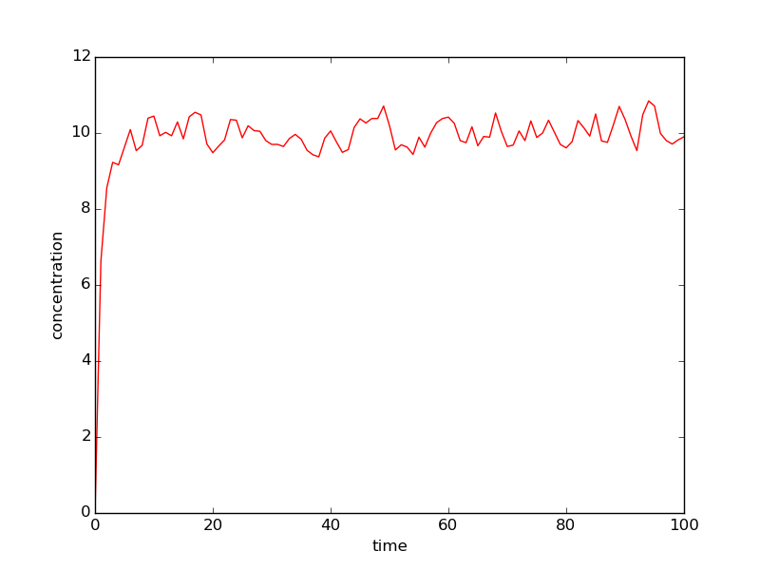
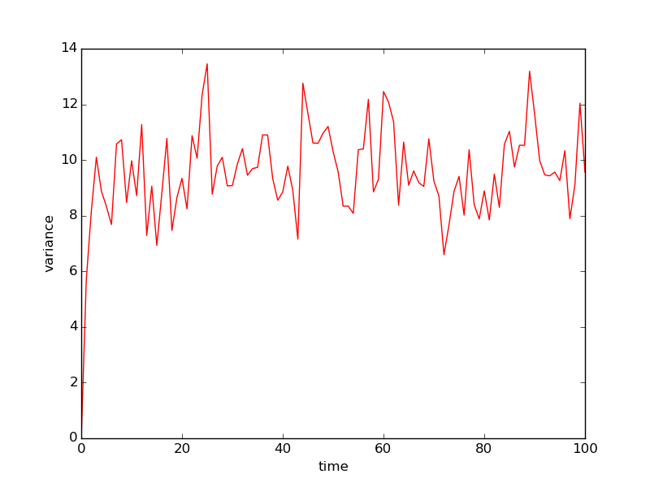
Simple Chemical Simulation

