Slide 1
CS 179 Lecture 16
Logistic Regression & Parallel SGD

Slide 2
Outline
logistic regression
(stochastic) gradient descent
parallelizing SGD for neural nets (with emphasis on Google’s distributed neural net implementation)

Slide 3
Binary classification
Goal: Classify data into one of two categories.
“Is this Yelp review of a restaurant or of a different type of business”?
Given:
training set of (data, category) aka (X, y)
test set of (X) for which we want to estimate y
Notes:
supervised learning task

Slide 4
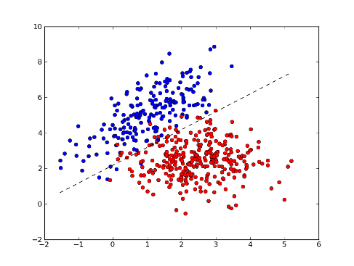
Logistic regression
There are many other binary classification algorithms (random forests, SVM, Bayesian methods), but we’ll study logistic regression.
Notes:
logistic regression is a linear method

Slide 5
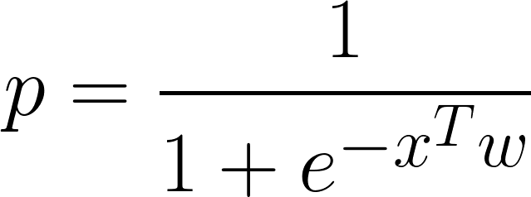
Scalar Logistic Regression
p: probability of belonging to category 1
x: data point as n component vector
w: learned weight vector

Slide 6
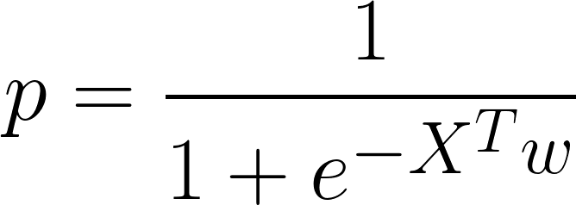
Vectorized Logistic Regression
Let matrix X be n x m with each column being a seperate data point.
Now p is an m component vector of probabilities

Slide 7
Learning
How can we find an optimal weight vector w from our training set?
In what sense can w be optimal?

Slide 8
Loss functions
Weights can only be optimal with respect to some objective function. In general, we call this function the “loss” and we try to minimize it with respect to weights.
is the loss that gives logistic regression.
Notes:
sum is

Slide 9
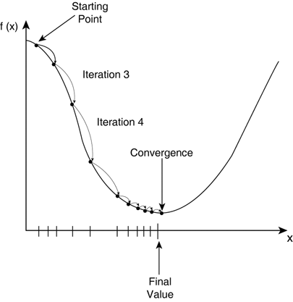
Gradient Descent
Compute the gradient of loss with respect to weights, and update weights in direction of negative gradient.
Repeat until you hit a local minima. Have to pick a step size.
Notes:
talk about convex functions and how they have global minima. Logistic regression is convex, neural nets are not.

Slide 10
Stochastic Gradient Descent (SGD)
The current formulation of gradient descent involves computing gradient over the entire dataset before stepping (called batch gradient set).
What if we pick a random data point, compute gradient for that point, and update the weights? Called stochastic gradient descent.

Slide 11
SGD advantages
easier to implement for large datasets
works better for non-convex loss functions
sometimes faster (you update the gradient much earlier and more incrementally)
Often use SGD on a “mini-batch” rather than just a single point at a time. Allows higher throughput and more parallelization.

Slide 12
Parallelizing SGD
2 (not mutually exclusive) routes:
parallelize computation of a single gradient (model parallelism)
compute multiple gradients at once (data parallelism)

Slide 13
Model parallelism
Model parallelism is “single model with parallel components”.
Can generally parallelize over the mini-batch.

Slide 14
Model “MATLAB parallelism”
Many models (including logistic regression!) include matrix multiplication or convolution in gradient computation.
This is a good example of “MATLAB-parallelism”, scriptable parallel computation built on top of a few kernels

Slide 15
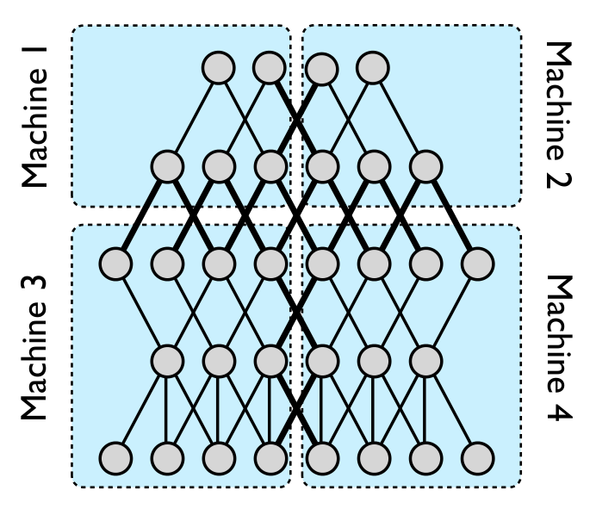
Model pipeline parallelism (in Google Brain neural nets)
Notes:
Can do pipeline parallelism. All of these ideas about parallelizing on a single GPU mostly carry over to distributed computation.
Can do pipeline parallelism on a single GPU with streams

Slide 16
Data parallelism
Run multiple copies of the model (that all share weights) on different data
Problem: SGD is very iterative. How do I synchronize updates to the weights?
Notes:
Grab weights, run computation with weights, update weights with gradient. Can’t technically change weights in this cycle

Slide 17
Hogwild!
Some problems such as matrix completion have sparse gradients. A single output depends only on a single row and column of factorization.
Solution: Don’t worry about synchronization! Gradient updates unlikely to touch each other because of sparsity.
Notes:
proof of convergence in 2011 paper called “Hogwild!”

Slide 18
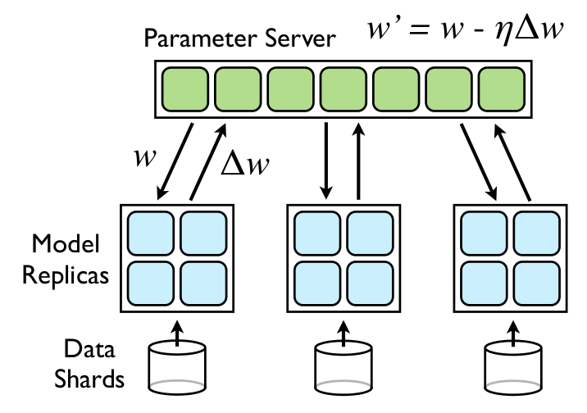
Downpour SGD from Google Brain
Notes:
combines model parallelism (each 2x2 box) with data parallelism
each replica fetches parameters every n_fetch mini-batches and pushes gradient every n_push mb’s

Slide 19
Downpour SGD
Store all weights on a “parameter server”
Each model replica fetches updated weights from server every n_{fetch} steps and pushes gradient to server every n_{push} steps.
Not a lot of theoretical justification, but it works :)
Notes:
parameter server could be a thread
n_fetch and n_push allow lowering communication overhead. want to keep high enough to lower communication overhead but low enough to prevent weight divergence

Slide 20
Google Brain parallelism summary
Data parallelism - multiple model replicas communication with parameter server, using downpour SGD
Model pipeline parallelism - each replica consists of a group of machines computing parts of model
Model “MATLAB parallelism” - each part of each pipeline uses GPUs to process mini-batch in parallel
Check out the paper
Notes:
“train in a day what takes 6 weeks on a single GPU”
“almost anything a human brain can do in 0.1s can be done with a 10 layer neural net now”

Slide 21
Final thoughts
“MATLAB parallelism” is by far the simplest parallelism and is what you want when you have a single GPU.
Other parallelization techniques needed for bigger systems.
Keep GPUs in mind when doing machine learning, can often get ~10x speed-ups.
Notes:
GPUs are what brought me here. training neural nets, turn an hour of training into 6 minutes.

