Slide 1
CS 179: GPU Programming
Lecture 10

Slide 2
Topics
Non-numerical algorithms
Parallel breadth-first search (BFS)
Texture memory

Slide 3
GPUs – good for many numerical calculations…
What about “non-numerical” problems?

Slide 4
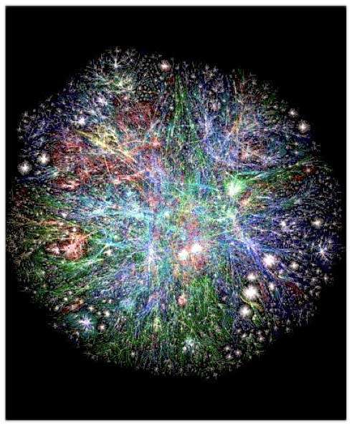
Graph Algorithms

Slide 5
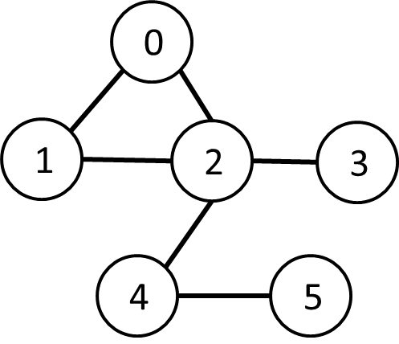
Graph Algorithms
Graph G(V, E) consists of:
Vertices
Edges (defined by pairs of vertices)
Complex data structures!
How to store?
How to work around?
Are graph algorithms parallelizable?

Slide 6
Breadth-First Search*
Given source vertex S:
Find min. #edges to reach every vertex from S
*variation

Slide 7
Breadth-First Search*
0
Given source vertex S:
Find min. #edges to reach every vertex from S
(Assume source is vertex 0)
1
1
2
2
3
*variation

Slide 8
Breadth-First Search*
0
Given source vertex S:
Find min. #edges to reach every vertex from S
(Assume source is vertex 0)
1
1
2
2
3
Sequential pseudocode:
let Q be a queue
Q.enqueue(source)
label source as discovered
source.value <- 0
while Q is not empty
v ← Q.dequeue()
for all edges from v to w in G.adjacentEdges(v):
if w is not labeled as discovered
Q.enqueue(w)
label w as discovered, w.value <- v.value + 1

Slide 9
Breadth-First Search*
0
Given source vertex S:
Find min. #edges to reach every vertex from S
(Assume source is vertex 0)
1
1
2
2
3
Sequential pseudocode:
let Q be a queue
Q.enqueue(source)
label source as discovered
source.value <- 0
while Q is not empty
v ← Q.dequeue()
for all edges from v to w in G.adjacentEdges(v):
if w is not labeled as discovered
Q.enqueue(w)
label w as discovered, w.value <- v.value + 1
Runtime:
O( |V| + |E| )
Notes:
End: How do we parallelize?

Slide 10
Representing Graphs
“Adjacency matrix”
A: |V| x |V| matrix:
A_{ij} = 1 if vertices i,j are adjacent, 0 otherwise
O(V²) space
“Adjacency list”
Adjacent vertices noted for each vertex
O(V + E) space

Slide 11
Representing Graphs
“Adjacency matrix”
A: |V| x |V| matrix:
A_{ij} = 1 if vertices i,j are adjacent, 0 otherwise
O(V²) space <- hard to fit, more copy overhead
“Adjacency list”
Adjacent vertices noted for each vertex
O(V + E) space <- easy to fit, less copy overhead

Slide 12
Representing Graphs
“Compact Adjacency List”
Array E_{a}: Adjacent vertices to vertex 0, then vertex 1, then … size: O(E)
Array V_{a}: Delimiters for E_{a} size: O(V)
1 | 2 | 0 | 2 | 0 | 1 | 3 | 4 | 2 | 2 | 5 | 4
0 | 2 | 4 | 8 | 9 | 11
Vertex:
0 | 1 | 2 | 3 | 4 | 5
Notes:
End: We have data structure, but still a big problem!

Slide 13
Breadth-First Search*
0
Given source vertex S:
Find min. #edges to reach every vertex from S
(Assume source is vertex 0)
1
1
2
2
3
Sequential pseudocode:
let Q be a queue
Q.enqueue(source)
label source as discovered
source.value <- 0
while Q is not empty
v ← Q.dequeue()
for all edges from v to w in G.adjacentEdges(v):
if w is not labeled as discovered
Q.enqueue(w)
label w as discovered, w.value <- v.value + 1
How to “parallelize” when there’s a queue?

Slide 14
Breadth-First Search*
0
Sequential pseudocode:
let Q be a queue
Q.enqueue(source)
label source as discovered
source.value <- 0
while Q is not empty
v ← Q.dequeue()
for all edges from v to w in G.adjacentEdges(v):
if w is not labeled as discovered
Q.enqueue(w)
label w as discovered, w.value <- v.value + 1
Why do we use a queue?
1
1
2
2
3

Slide 15
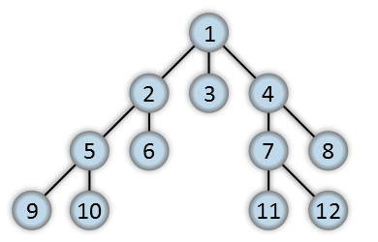
BFS Order
Here, vertex #s are possible BFS order
"Breadth-first-tree" by Alexander Drichel - Own work. Licensed under CC BY 3.0 via Wikimedia Commons - http://commons.wikimedia.org/wiki/File:Breadth-first-tree.svg#/media/File:Breadth-first-tree.svg

Slide 16
BFS Order
Permutation within ovals preserves BFS!
"Breadth-first-tree" by Alexander Drichel - Own work. Licensed under CC BY 3.0 via Wikimedia Commons - http://commons.wikimedia.org/wiki/File:Breadth-first-tree.svg#/media/File:Breadth-first-tree.svg

Slide 17
BFS Order
Queue replaceable if layers preserved!
Permutation within ovals preserves BFS!
"Breadth-first-tree" by Alexander Drichel - Own work. Licensed under CC BY 3.0 via Wikimedia Commons - http://commons.wikimedia.org/wiki/File:Breadth-first-tree.svg#/media/File:Breadth-first-tree.svg

Slide 18
Alternate BFS algorithm
Construct arrays of size |V|:
“Frontier” (denote F):
Boolean array - indicating vertices “to be visited” (at beginning of iteration)
“Visited” (denote X):
Boolean array - indicating already-visited vertices
“Cost” (denote C):
Integer array - indicating #edges to reach each vertex
Goal: Populate C

Slide 19
Alternate BFS algorithm
New sequential pseudocode:
Input: Va, Ea, source (graph in “compact adjacency list” format)
Create frontier (F), visited array (X), cost array (C)
F <- (all false)
X <- (all false)
C <- (all infinity)
F[source] <- true
C[source] <- 0
while F is not all false:
for 0 ≤ i < |Va|:
if F[i] is true:
F[i] <- false
X[i] <- true
for all neighbors j of i:
if X[j] is false:
C[j] <- C[i] + 1
F[j] <- true

Slide 20
Alternate BFS algorithm
New sequential pseudocode:
Input: Va, Ea, source (graph in “compact adjacency list” format)
Create frontier (F), visited array (X), cost array (C)
F <- (all false)
X <- (all false)
C <- (all infinity)
F[source] <- true
C[source] <- 0
while F is not all false:
for 0 ≤ i < |Va|:
if F[i] is true:
F[i] <- false
X[i] <- true
for Ea[Va[i]] ≤ j < Ea[Va[i+1]]:
if X[j] is false:
C[j] <- C[i] + 1
F[j] <- true

Slide 21
Alternate BFS algorithm
New sequential pseudocode:
Input: Va, Ea, source (graph in “compact adjacency list” format)
Create frontier (F), visited array (X), cost array (C)
F <- (all false)
X <- (all false)
C <- (all infinity)
F[source] <- true
C[source] <- 0
while F is not all false:
for 0 ≤ i < |Va|:
if F[i] is true:
F[i] <- false
X[i] <- true
for Ea[Va[i]] ≤ j < Ea[Va[i+1]]:
if X[j] is false:
C[j] <- C[i] + 1
F[j] <- true
Parallelizable!

Slide 22
GPU-accelerated BFS
CPU-side pseudocode:
Input: Va, Ea, source (graph in “compact adjacency list” format)
Create frontier (F), visited array (X), cost array (C)
F <- (all false)
X <- (all false)
C <- (all infinity)
F[source] <- true
C[source] <- 0
while F is not all false:
call GPU kernel( F, X, C, Va, Ea )
GPU-side kernel pseudocode:
if F[threadId] is true:
F[threadId] <- false
X[threadId] <- true
for Ea[Va[threadId]] ≤ j < Ea[Va[threadId + 1]]:
if X[j] is false:
C[j] <- C[threadId] + 1
F[j] <- true
Can represent boolean values as integers

Slide 23
GPU-accelerated BFS
CPU-side pseudocode:
Input: Va, Ea, source (graph in “compact adjacency list” format)
Create frontier (F), visited array (X), cost array (C)
F <- (all false)
X <- (all false)
C <- (all infinity)
F[source] <- true
C[source] <- 0
while F is not all false:
call GPU kernel( F, X, C, Va, Ea )
GPU-side kernel pseudocode:
if F[threadId] is true:
F[threadId] <- false
X[threadId] <- true
for Ea[Va[threadId]] ≤ j < Ea[Va[threadId + 1]]:
if X[j] is false:
C[j] <- C[threadId] + 1
F[j] <- true
Can represent boolean values as integers
Unsafe operation?

Slide 24
GPU-accelerated BFS
CPU-side pseudocode:
Input: Va, Ea, source (graph in “compact adjacency list” format)
Create frontier (F), visited array (X), cost array (C)
F <- (all false)
X <- (all false)
C <- (all infinity)
F[source] <- true
C[source] <- 0
while F is not all false:
call GPU kernel( F, X, C, Va, Ea )
GPU-side kernel pseudocode:
if F[threadId] is true:
F[threadId] <- false
X[threadId] <- true
for Ea[Va[threadId]] ≤ j < Ea[Va[threadId + 1]]:
if X[j] is false:
C[j] <- C[threadId] + 1
F[j] <- true
Can represent boolean values as integers
Safe! No ambiguity!

Slide 25
Summary
Tricky algorithms need drastic measures!
Resources
“Accelerating Large Graph Algorithms on the GPU Using CUDA” (Harish, Narayanan)

Slide 26
Texture Memory

Slide 27
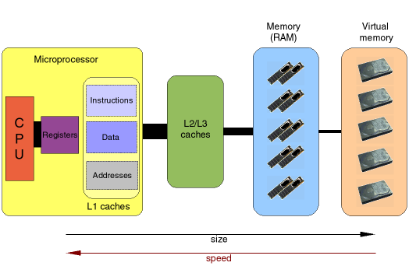
“Ordinary” Memory Hierarchy
http://www.imm.dtu.dk/~beda/SciComp/caches.png

Slide 28
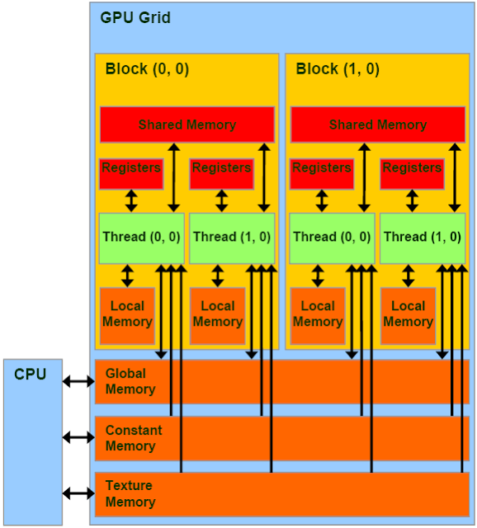
GPU Memory
Lots of types!
Global memory
Shared memory
Constant memory

Slide 29
GPU Memory
Lots of types!
Global memory
Shared memory
Constant memory
Must keep in mind:
Coalesced access
Divergence
Bank conflicts
Random serialized access
…
Size!

Slide 30
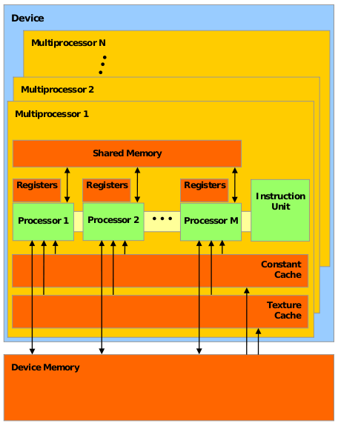
Hardware vs. Abstraction

Slide 31
Hardware vs. Abstraction
Names refer to manner of access on device memory:
“Global memory”
“Constant memory”
“Texture memory”

Slide 32
Review: Constant Memory
Read-only access
64 KB available, 8 KB cache – small!
Not “const”!
Write to region with cudaMemcpyToSymbol()

Slide 33
Review: Constant Memory
Broadcast reads to half-warps!
When all threads need same data: Save reads!
Downside:
When all threads need different data: Extremely slow!

Slide 34
Review: Constant Memory
Example application: Gaussian impulse response (from HW 1):
Not changed
Accessed simultaneously by threads in warp

Slide 35
Texture Memory (and co-stars)
Another type of memory system, featuring:
Spatially-cached read-only access
Avoid coalescing worries
Interpolation
(Other) fixed-function capabilities
Graphics interoperability

Slide 36
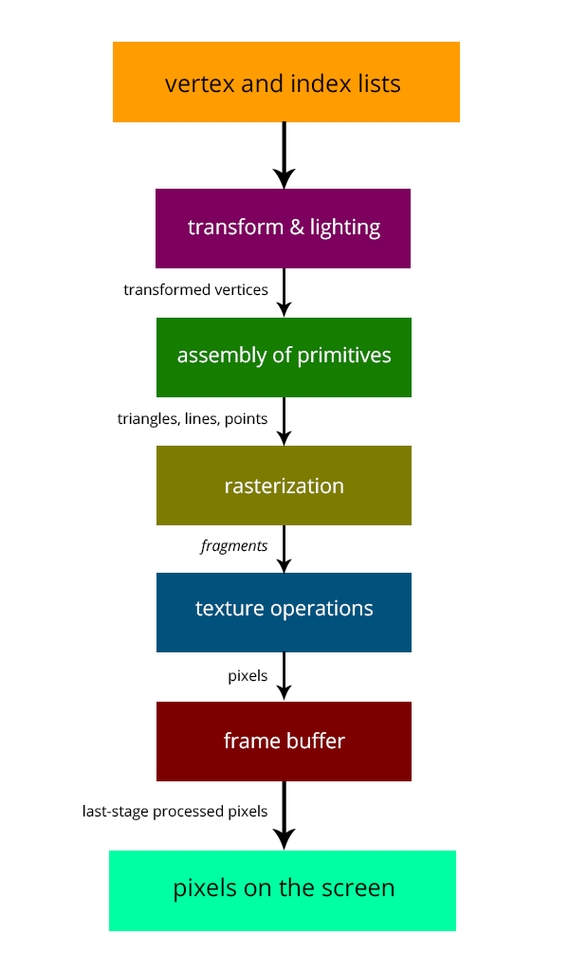
Fixed Functions
Like GPUs in the old days!
Still important/useful for certain things

Slide 37
Traditional Caching
When reading, cache “nearby elements”
(i.e. cache line)
Memory is linear!
Applies to CPU, GPU L1/L2 cache, etc

Slide 38
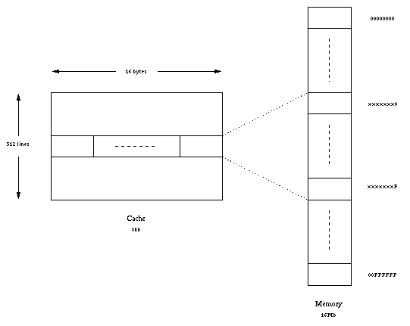
Traditional Caching

Slide 39
Traditional Caching
2D array manipulations:
One direction goes “against the grain” of caching
E.g. if array is stored row-major, traveling along “y-direction” is sub-optimal!

Slide 40
Texture-Memory Caching
Can cache “spatially!” (2D, 3D)
Specify dimensions (1D, 2D, 3D) on creation
1D applications:
Interpolation, clipping (later)
Caching when e.g. coalesced access is infeasible

Slide 41
Texture Memory
“Memory is just an unshaped bucket of bits” (CUDA Handbook)
Need texture reference in order to:
Interpret data
Deliver to registers

Slide 42
Texture References
“Bound” to regions of memory
Specify (depending on situation):
Access dimensions (1D, 2D, 3D)
Interpolation behavior
“Clamping” behavior
Normalization
…

Slide 43
Interpolation
Can “read between the lines!”
http://cuda-programming.blogspot.com/2013/02/texture-memory-in-cuda-what-is-texture.html

Slide 44
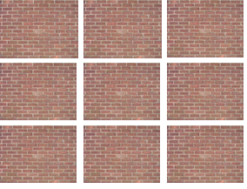
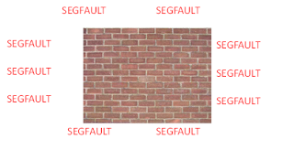
Clamping
Seamlessly handle reads beyond region!
http://cuda-programming.blogspot.com/2013/02/texture-memory-in-cuda-what-is-texture.html

Slide 45
“CUDA Arrays”
So far, we’ve used standard linear arrays
“CUDA arrays”:
Different addressing calculation
Contiguous addresses have 2D/3D locality!
Not pointer-addressable
(Designed specifically for texturing)
Notes:
There’s a CS 24 set about this or something

Slide 46
Texture Memory
Texture reference can be attached to:
Ordinary device-memory array
“CUDA array”
Many more capabilities

Slide 47
Texturing Example (2D)
http://www.math.ntu.edu.tw/~wwang/mtxcomp2010/download/cuda_04_ykhung.pdf
http://www.math.ntu.edu.tw/~wwang/mtxcomp2010/download/cuda_04_ykhung.pdf

Slide 48
Texturing Example (2D)
http://www.math.ntu.edu.tw/~wwang/mtxcomp2010/download/cuda_04_ykhung.pdf

Slide 49
Texturing Example (2D)
http://www.math.ntu.edu.tw/~wwang/mtxcomp2010/download/cuda_04_ykhung.pdf

Slide 50
Texturing Example (2D)

