Slide 1
CS 179: GPU Programming
Lecture 8

Slide 2
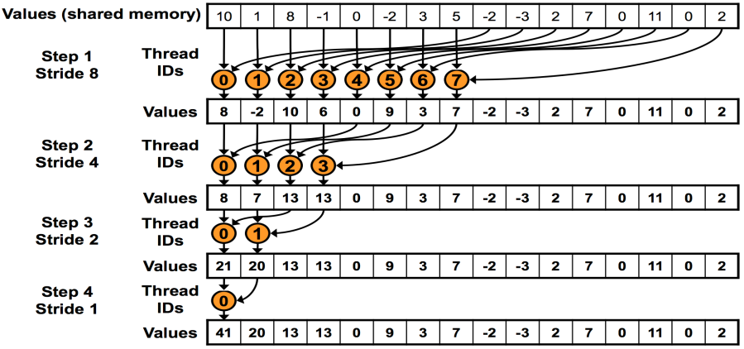
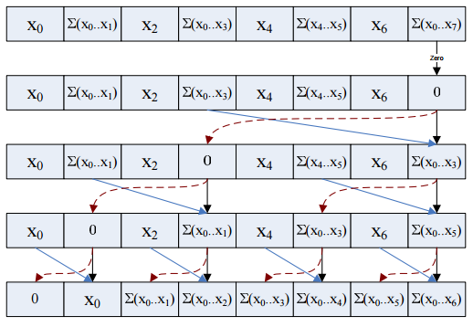
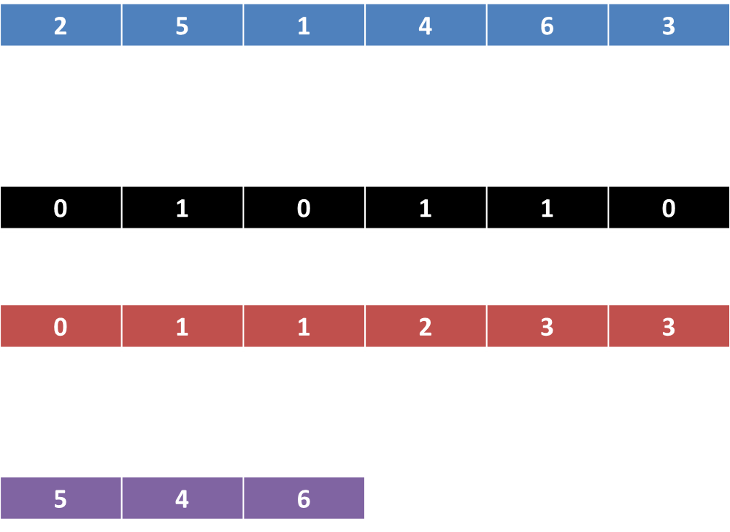
Last time
GPU-accelerated:
Reduction
Prefix sum
Stream compaction
Sorting (quicksort)

Slide 3
Today
GPU-accelerated Fast Fourier Transform
cuFFT (FFT library)

Slide 4
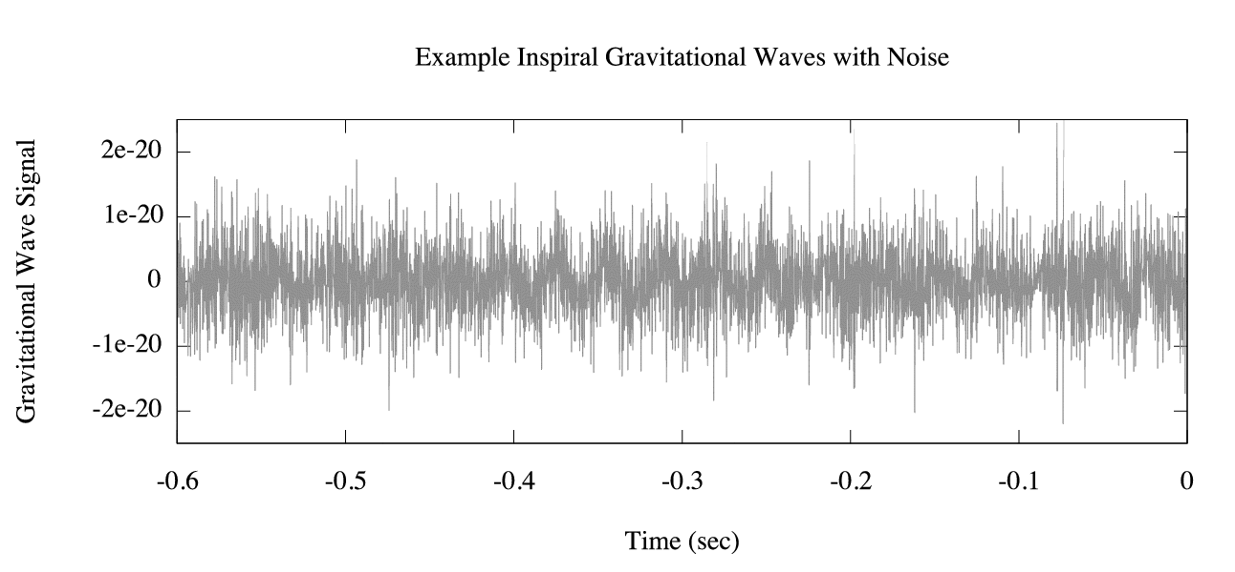
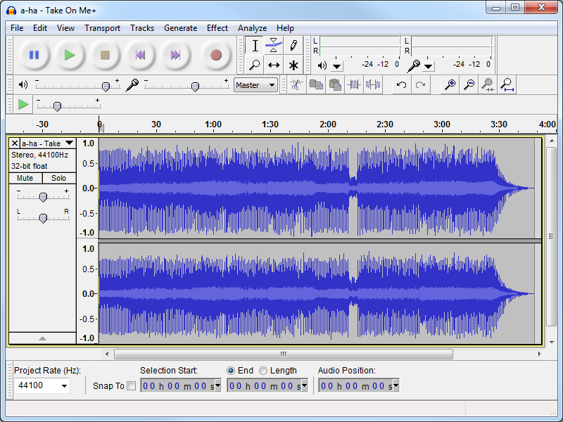
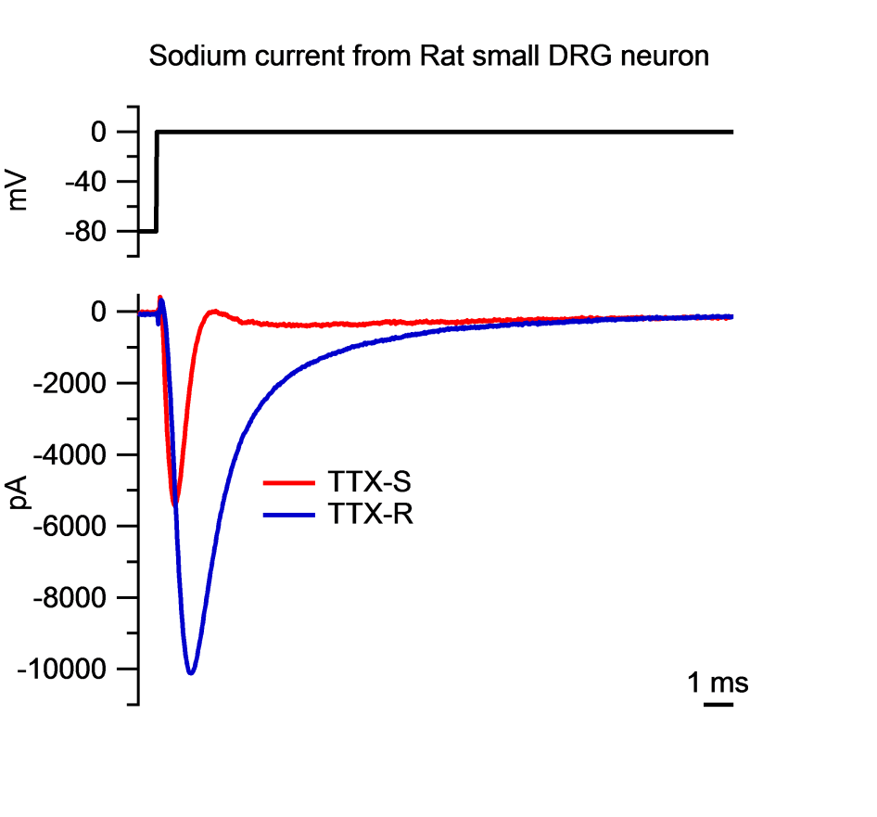
Signals (again)

Slide 5
“Frequency content”
What frequencies are present in our signals?

Slide 6
Discrete Fourier Transform (DFT)
Given signal $\vec{x}=(x_{1},…,x_{N})$ over time,
$\vec{y}=W\vec{x}$ represents DFT of $\vec{x}$
Each row of W is a complex sine wave
Each row multiplied with $\vec{x}$ - inner product of wave with signal
Corresponding entries of $\vec{y}$ - “content” of that sine wave!
$ω=e^{−2πj/N}$

Slide 7
Discrete Fourier Transform (DFT)
Alternative formulation:
$X_{k}$ - values corresponding to wave k
Periodic – calculate for 0 ≤ k ≤ N - 1

Slide 8
Discrete Fourier Transform (DFT)
Alternative formulation:
$X_{k}$ - values corresponding to wave k
Periodic – calculate for 0 ≤ k ≤ N - 1
Naive runtime: O(N²)
Sum of N iterations, for N values of k

Slide 9
Discrete Fourier Transform (DFT)
Alternative formulation:
$X_{k}$ - values corresponding to wave k
Periodic – calculate for 0 ≤ k ≤ N - 1
Naive runtime: O(N²)
Sum of N iterations, for N values of k

Slide 10
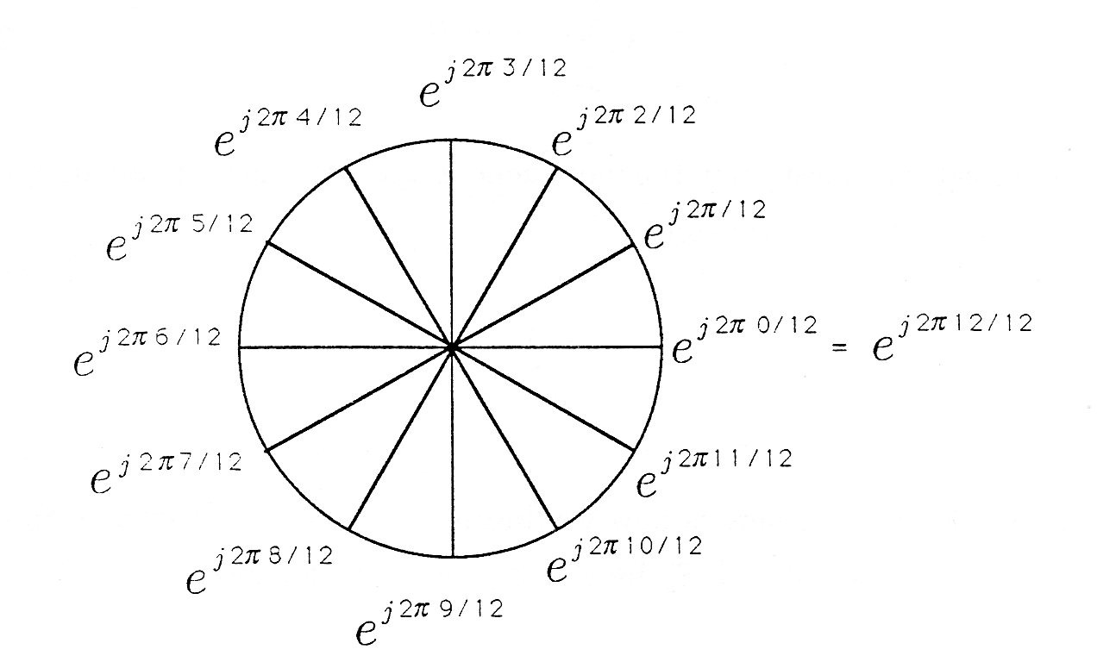
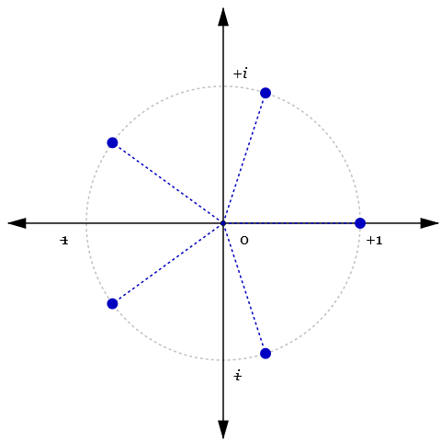
Roots of unity

Slide 11
Discrete Fourier Transform (DFT)
Alternative formulation:
$X_{k}$ - values corresponding to wave k
Periodic – calculate for 0 ≤ k ≤ N - 1
Number of distinct values: N, not N² !

Slide 12
(Proof)
Breakdown (assuming N is power of 2):
(Let $ω_{N}=e^{−2πi/N}$, smallest root of unity)
$$\sum_{n=0}^{N−1}{x_{n}{ω_{N}}^{kn}}$$

Slide 13
(Proof)
Breakdown (assuming N is power of 2):
(Let $ω_{N}=e^{−2πi/N}$, smallest root of unity)
$$\sum_{n=0}^{N−1}{x_{n}{ω_{N}}^{kn}}$$
$$=\sum_{n=0}^{2N−1}{x_{(2n)}{ω_{N}}^{k(2n)}}+\sum_{n=0}^{2N−1}{x_{(2n+1)}{ω_{N}}^{k(2n+1)}}$$

Slide 14
(Proof)
Breakdown (assuming N is power of 2):
(Let $ω_{N}=e^{−2πi/N}$, smallest root of unity)
$$\sum_{n=0}^{N−1}{x_{n}{ω_{N}}^{kn}}$$
$$=\sum_{n=0}^{2N−1}{x_{(2n)}{ω_{N}}^{k(2n)}}+\sum_{n=0}^{2N−1}{x_{(2n+1)}{ω_{N}}^{k(2n+1)}}$$
$$=\sum_{n=0}^{2N−1}{x_{(2n)}{ω_{N}}^{k(2n)}}+ω_{N}\sum_{n=0}^{2N−1}{x_{(2n+1)}{ω_{N}}^{k(2n)}}$$

Slide 15
(Proof)
Breakdown (assuming N is power of 2):
(Let $ω_{N}=e^{−2πi/N}$, smallest root of unity)
$$\sum_{n=0}^{N−1}{x_{n}{ω_{N}}^{kn}}$$
$$=\sum_{n=0}^{2N−1}{x_{(2n)}{ω_{N}}^{k(2n)}}+\sum_{n=0}^{2N−1}{x_{(2n+1)}{ω_{N}}^{k(2n+1)}}$$
$$=\sum_{n=0}^{2N−1}{x_{(2n)}{ω_{N}}^{k(2n)}}+ω_{N}\sum_{n=0}^{2N−1}{x_{(2n+1)}{ω_{N}}^{k(2n)}}$$
$$=\sum_{n=0}^{2N−1}{x_{(2n)}{ω_{N/2}}^{kn}}+ω_{N}\sum_{n=0}^{2N−1}{x_{(2n+1)}{ω_{N/2}}^{kn}}$$

Slide 16
(Proof)
Breakdown (assuming N is power of 2):
(Let $ω_{N}=e^{−2πi/N}$, smallest root of unity)
$$\sum_{n=0}^{N−1}{x_{n}{ω_{N}}^{kn}}$$
$$=\sum_{n=0}^{2N−1}{x_{(2n)}{ω_{N}}^{k(2n)}}+\sum_{n=0}^{2N−1}{x_{(2n+1)}{ω_{N}}^{k(2n+1)}}$$
$$=\sum_{n=0}^{2N−1}{x_{(2n)}{ω_{N}}^{k(2n)}}+ω_{N}\sum_{n=0}^{2N−1}{x_{(2n+1)}{ω_{N}}^{k(2n)}}$$
$$=\sum_{n=0}^{2N−1}{x_{(2n)}{ω_{N/2}}^{kn}}+ω_{N}\sum_{n=0}^{2N−1}{x_{(2n+1)}{ω_{N/2}}^{kn}}$$
DFT of x_{n}, even n!
DFT of x_{n}, odd n!

Slide 17
(Divide-and-conquer algorithm)
Recursive-FFT(Vector x):
if x is length 1:
return x
x_even <- (x0, x2, ..., x_(n-2) )
x_odd <- (x1, x3, ..., x_(n-1) )
y_even <- Recursive-FFT(x_even)
y_odd <- Recursive-FFT(x_odd)
for k = 0, …, (n/2)-1:
y[k] <- y_even[k] + w^{k} * y_odd[k]
y[k + n/2] <- y_even[k] - w^{k} * y_odd[k]
return y

Slide 18
(Divide-and-conquer algorithm)
Recursive-FFT(Vector x):
if x is length 1:
return x
x_even <- (x0, x2, ..., x_(n-2) )
x_odd <- (x1, x3, ..., x_(n-1) )
y_even <- Recursive-FFT(x_even)
y_odd <- Recursive-FFT(x_odd)
for k = 0, …, (n/2)-1:
y[k] <- y_even[k] + w^{k} * y_odd[k]
y[k + n/2] <- y_even[k] - w^{k} * y_odd[k]
return y
T(n/2)
T(n/2)
O(n)

Slide 19
Runtime
Recurrence relation:
T(n) = 2T(n/2) + O(n)
O(n log n) runtime! Much better than O(n²)
(Minor caveat: N must be power of 2)
Usually resolvable

Slide 20
Parallelizable?
O(n²) algorithm certainly is!
for k = 0,…,N-1:
for n = 0,…,N-1:
...
Sometimes parallelization outweighs runtime!
(N-body problem, …)

Slide 21
Recursive index tree
x0, x1, x2, x3, x4, x5, x6, x7
x0, x2, x4, x6
x1, x3, x5, x7
x0, x4
x2, x6
x1, x5
x3, x7
x0
x4
x2
x6
x1
x5
x3
x7

Slide 22
Recursive index tree
x0, x1, x2, x3, x4, x5, x6, x7
x0, x2, x4, x6
x1, x3, x5, x7
x0, x4
x2, x6
x1, x5
x3, x7
x0
x4
x2
x6
x1
x5
x3
x7
Order?

Slide 23
0 000
4 100
2 010
6 110
1 001
5 101
3 011
7 111

Slide 24
Bit-reversal order
0 000 reverse of… 000
4 100 001
2 010 010
6 110 011
1 001 100
5 101 101
3 011 110
7 111 111

Slide 25
Iterative approach
x0, x1, x2, x3, x4, x5, x6, x7
Stage 3
x0, x2, x4, x6
x1, x3, x5, x7
Stage 2
x0, x4
x2, x6
x1, x5
x3, x7
Stage 1
x0
x4
x2
x6
x1
x5
x3
x7

Slide 26
(Divide-and-conquer algorithm review)
Recursive-FFT(Vector x):
if x is length 1:
return x
x_even <- (x0, x2, ..., x_(n-2) )
x_odd <- (x1, x3, ..., x_(n-1) )
y_even <- Recursive-FFT(x_even)
y_odd <- Recursive-FFT(x_odd)
for k = 0, …, (n/2)-1:
y[k] <- y_even[k] + w^{k} * y_odd[k]
y[k + n/2] <- y_even[k] - w^{k} * y_odd[k]
return y
T(n/2)
T(n/2)
O(n)

Slide 27
Iterative approach
x0, x1, x2, x3, x4, x5, x6, x7
Stage 3
x0, x2, x4, x6
x1, x3, x5, x7
Stage 2
x0, x4
x2, x6
x1, x5
x3, x7
Stage 1
x0
x4
x2
x6
x1
x5
x3
x7

Slide 28
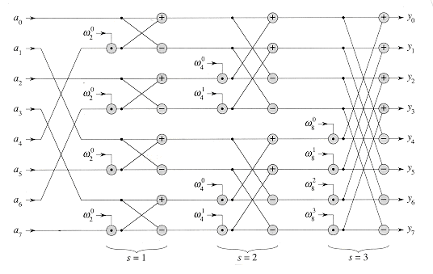
Iterative approach
Bit-reversed access
http://staff.ustc.edu.cn/~csli/graduate/algorithms/book6/chap32.htm

Slide 29
Iterative approach
Bit-reversed access
Stage 1
Stage 2
Stage 3
http://staff.ustc.edu.cn/~csli/graduate/algorithms/book6/chap32.htm

Slide 30
Iterative approach
Bit-reversed access
Stage 1
Stage 2
Stage 3
Iterative-FFT(Vector x):
y <- (bit-reversed order x)
N <- y.length
for s = 1,2,…,log(N):
m <- 2^{s}
w_{n} <- e^{2πj/m}
for k: 0 ≤ k ≤ N-1, stride m:
for j = 0,…,(m/2)-1:
u <- y[k + j]
t <- (w_{n})^{j} * y[k + j + m/2]
y[k + j] <- u + t
y[k + j + m/2] <- u - t
return y
http://staff.ustc.edu.cn/~csli/graduate/algorithms/book6/chap32.htm

Slide 31
Iterative approach
Iterative-FFT(Vector x):
y <- (bit-reversed order x)
N <- y.length
for s = 1,2,…,log(N):
m <- 2^{s}
w_{n} <- e^{2πj/m}
for k: 0 ≤ k ≤ N-1, stride m:
for j = 0,…,(m/2)-1:
u <- y[k + j]
t <- (w_{n})^{j} * y[k + j + m/2]
y[k + j] <- u + t
y[k + j + m/2] <- u - t
return y
O(log N) iterations
O(N/m) iterations
O(m) iterations
Total: O(N log N) runtime

Slide 32
CUDA approach
Bit-reversed access
Stage 1
Stage 2
Stage 3
http://staff.ustc.edu.cn/~csli/graduate/algorithms/book6/chap32.htm

Slide 33
CUDA approach
__syncthreads() barriers!
Bit-reversed access
Stage 1
Stage 2
Stage 3
http://staff.ustc.edu.cn/~csli/graduate/algorithms/book6/chap32.htm

Slide 34
CUDA approach
Non-coalesced memory access!!
__syncthreads() barriers!
Bit-reversed access
Stage 1
Stage 2
Stage 3
http://staff.ustc.edu.cn/~csli/graduate/algorithms/book6/chap32.htm

Slide 35
CUDA approach
Non-coalesced memory access!!
__syncthreads() barriers!
Bit-reversed access
Stage 1
Stage 2
Stage 3
Load into shared memory
http://staff.ustc.edu.cn/~csli/graduate/algorithms/book6/chap32.htm

Slide 36
CUDA approach
Non-coalesced memory access!!
Bank conflicts!!
__syncthreads() barriers!
Bit-reversed access
Stage 1
Stage 2
Stage 3
Load into shared memory
http://staff.ustc.edu.cn/~csli/graduate/algorithms/book6/chap32.htm

Slide 37
Generalization
Above algorithm works for array sizes of 2^{n} (integer n)
Generalize?

Slide 38
“Bit”-reversal order
N = 6: (small example)
Factors into 3,2
1st digit: base 3
2nd digit: base 2
0
1
2
3
4
5
00
01
10
11
20
21
00
10
20
01
11
21
0
2
4
1
3
5

Slide 39
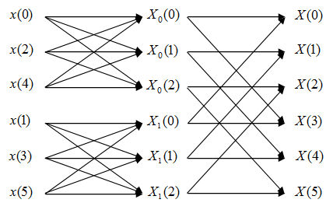
Generalization
Radix-3 case (followed by radix-2)
https://www.projectrhea.org/

Slide 40
Suppose N = N₁N₂ (factorization…)
Algorithm: (recursive)
Take FFT along rows
Do multiply operations (complex roots of unity)
Take FFT along columns
“Cooley-Tukey FFT algorithm”

Slide 41
Inverse DFT/FFT
Similarly parallelizable!
(Sign change in complex terms)

Slide 42
cuFFT
FFT library included with CUDA
Approximately implements previous algorithms
(Cooley-Tukey/Bluestein)
Also handles higher dimensions

Slide 43
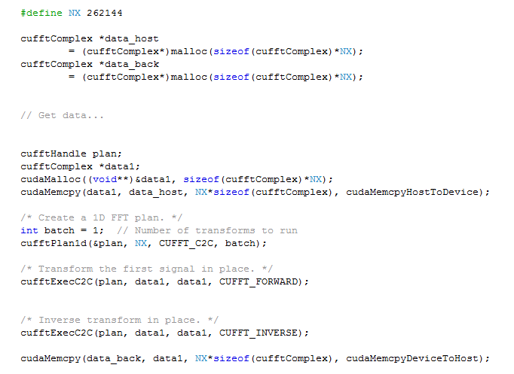
cuFFT 1D example
Correction: Remember to use cufftDestroy(plan) when finished with transforms

Slide 44
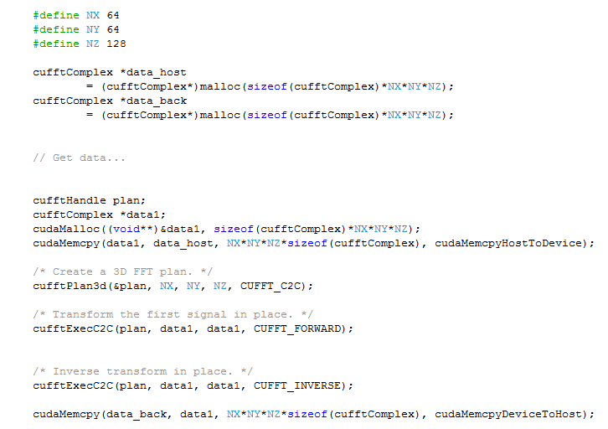
cuFFT 3D example
Correction: Remember to use cufftDestroy(plan) when finished with transforms

Slide 45
Remarks
As before, some parallelizable algorithms don’t easily “fit the mold”
Hardware matters more!
Some resources:
Introduction to Algorithms (Cormen, et al), aka “CLRS”, esp. Sec 30.5
“An Efficient Implementation of Double Precision 1-D FFT for GPUs Using CUDA” (Liu, et al.)

