Slide 1
CS 179 Lecture 5
GPU Memory Systems

Slide 2
Last time
A block executes on a single streaming multiprocessor (SM).
Threads execute in groups of 32 called warps.
Want threads in a warp to do the same thing to avoid divergence.
SMs hide latency by executing instructions for multiple warps at once.

Slide 3
Last time
Minimize instruction dependencies to take advantage of instruction level parallelism (ILP)
Occupancy allows us to reason about how well we are using hardware (but higher occupancy isn’t always better)

Slide 4
Final notes on compute
Integer instructions (especially / and %) slow
GPUs have >4GB of RAM, so pointers are 64 bits :(
All instructions have dependencies on previous writes to memory
CPU hyper-threading is similar to what GPU does. 2 concurrent hyper threads processing 16 elements (AVX-512) on CPU rather than 64 concurrent warps processing 32 elements on SM
Notes:
64 bit integer arithmetic is extra slow, watch out for complicated pointer math

Slide 5
Clarification on dependencies
x0 = x[0];
y0 = y[0];
z0 = x0 + y0;
x1 = x[1];
y1 = y[1];
z1 = x1 + y1;
An instruction cannot start executing until
all of its dependencies have finished executing
all of the instructions before it have at least started executing (which mean dependencies for all previous instructions are met)
Notes:
Sam asked a question that tricked me up a bit, here’s a better explanation

Slide 6
GPU Memory Breakdown
Global memory & local memory
Shared memory & L1 cache
Registers
Constant memory
Texture memory & read-only cache (CC 3.5)
L2 cache
Memory types implemented on same hardware are grouped.
Notes:
Give brief explanation of each type of memory.
I’ll go over the most important types of memory first.

Slide 7
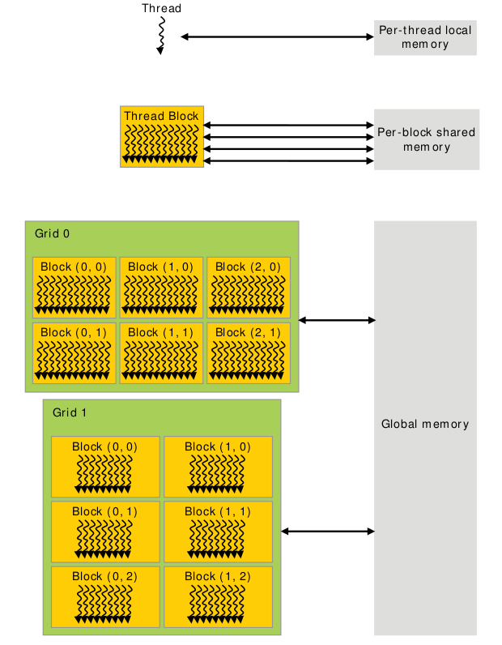
constant memory
Memory Scope
Notes:
When talking about different memory types, we need to talk about both the scope as well as the hardware implementation.
The scope is simply who can access the memory and what is the lifetime of the memory.
Notably, the hardware implementation can limit the scope (as is the case for local memory), but the scope is often limited beyond what the hardware does.

Slide 8
Global Memory
Global memory is the “main” memory of the GPU. It has global scope and lifetime of the allocating program (or until cudaFree is called).
Global memory is similar to the heap in a C program.

Slide 9
Global Memory syntax
Allocate with
cudaMalloc(void** devPtr, size_t size)
Free with
cudaMalloc(void* devPtr)
Notes:
This is what you were using on the first set.

Slide 10
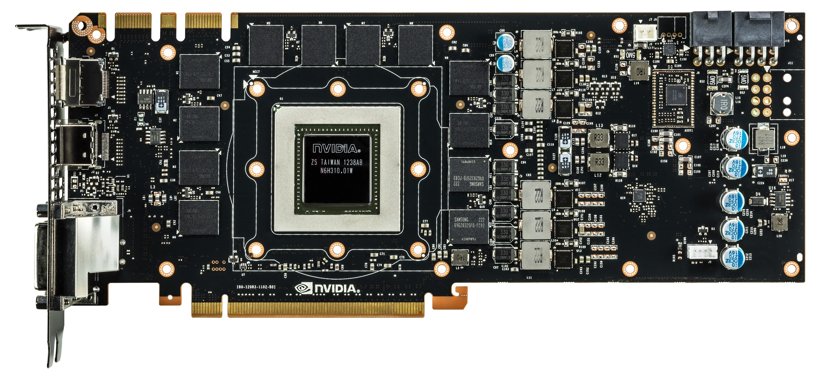
Green box is GK110, red lines are global memory
Nvidia GeForce GTX 780
Notes:
Everything we’ve been talking about is the GPU core. These are made by Nvidia and are the “interesting” part of the GPU.
The global memory is not part of the GPU core, and is in this case manufactured by Samsung. Its RAM similar to what is already in your computer.
Note that not being located on the same silicon generally hurts performance. This is true for accessing global memory from the GPU, and is also (very) true for moving data to GPU over PCI-E.
Light travels about 1 foot each ns (in vacuum).

Slide 11
Global Memory Hardware
Global memory is separate hardware from the GPU core (containing SM’s, caches, etc).
The vast majority of memory on GPU is global memory. If data doesn’t fit into global memory, you are going to have process it in chunks that do fit in global memory.
GPUs have .5 - 24GB of global memory, with most now having ~2GB.
Global memory latency is ~300ns on Kepler and ~600ns on Fermi

Slide 12
Accessing global memory efficiently
IO often dominates computation runtime, and global memory IO is the slowest form of IO on GPU (except for accessing host memory).
Because of this, we want to access global memory as little as possible.
Access patterns that play nicely with GPU hardware are called coalesced memory accesses.

Slide 13
Memory Coalescing
Memory coalescing is a bit more complicated in reality (see Ch 5.2 of CUDA Handbook), but there’s 1 simple thing to remember that will lead to coalesced accesses:
GPU cache lines are 128 bytes and are aligned. Try to make all memory accesses by warps touch the minimum number of cache lines (ideally 1 for 4 byte / warp accesses).
Notes:
Explain what a cache line is from perspective of CPU.
On CPU, 1 load only touches 1 cache line. On GPU, not the case.
Follow with several slides of pictures.

Slide 14
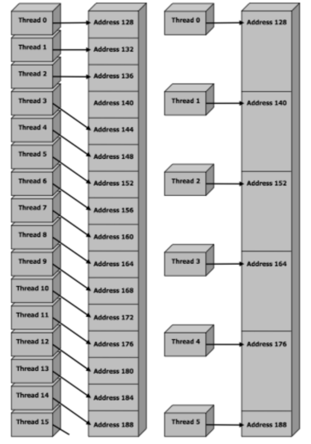
touches 2 cache lines
touches 3 cache lines
Two different non-coalesced accesses
Notes:
Warp has uneven spacing, so the warp is reading 128 bytes with a 4 byte hole = 132 bytes = 2 cache lines instead of 1
The second accesses are uniformly spaced but are 12 bytes = 3 * 4 floats across, so accessing 3 cache lines

Slide 15
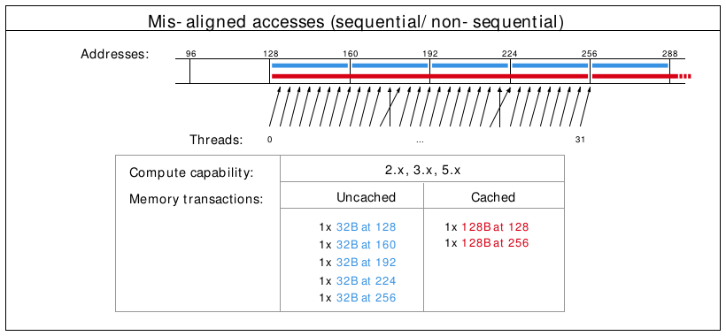
Misalignment can cause non-coalesced access
Notes:
The cross lines don’t matter, but the misalignment causes 2 loads to be done (because first loaded address is 130 rather than 120)

Slide 16
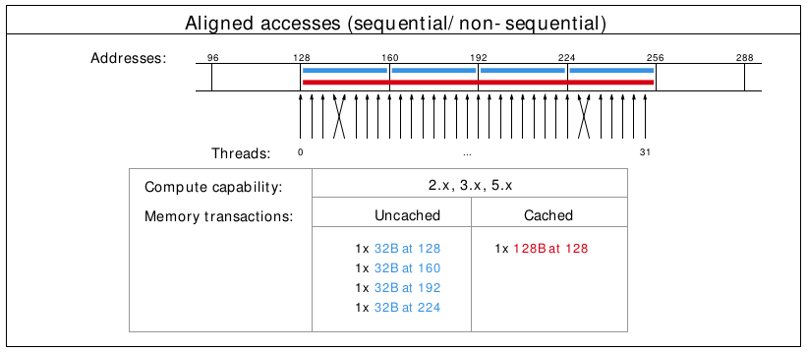
A coalesced access!
Notes:
The cross lines don’t matter, just the total number of cache lines touched.

Slide 17
Shared Memory
Very fast memory located in the SM
Same hardware as L1 cache, ~5ns of latency
Maximum size of 48KB, but user configurable
Scope of shared memory is the block
Remember
SM = streaming multiprocessor
SM ≠ shared memory
Notes:
Nvidia says shared memory latency is “roughly 100x lower”, so probably closer to 3ns, but 5ns is closer enough and easier to think about.
Why is scope of shared memory not global?

Slide 18
Shared memory syntax
Can allocate shared memory statically (size known at compile time) or dynamically (size not known until runtime)
Static allocation syntax:
__shared__ float data[1024]; declaration in kernel, nothing in host code

Slide 19
Shared memory dynamic allocation
Host:
kernel<<<grid, block, numBytesShMem>>>(arg);
Device (in kernel):
extern __shared__ float s[];
Some complexities with multiple dynamically sized variables, see this blog post

Slide 20
A shared memory application
Task: Compute byte frequency counts
Input: array of bytes of length n
Output: 256 element array of integers containing number of
occurrences of each byte
Naive: build output in global memory, n global stores
Smart: build output in shared memory, copy to global memory at end, 256 global stores
Notes:
You could declare byte frequency counts as a “stack” variable (local) and hope L1 cache does a good job.
For algorithms where you iteratively build output, you often want to do this in shared memory.

Slide 21
Computational Intensity
Computational intensity = FLOPs / IO
Matrix multiplication: n³ / n² = n
n-body simulation: n² / n = n
If computational intensity is > 1, then same data used in more than 1 computation. Do as few global loads and as many shared loads as possible.
Notes:
FLOP = floating point operations
IO = IO operations
blocking algorithms for matrix multiplication

Slide 22
A common pattern in kernels
copy from global memory to shared memory
__syncthreads()
perform computation, incrementally storing output in shared memory, __syncthreads() as necessary
copy output from shared memory to output array in global memory
Notes:
syncthreads works at block scope, synchronizes all warps in the block.
question: is __syncthreads needed to synchronize within a warp?
answer: not always, called warp synchronous coding. more about synchronization on friday

Slide 23
Bank Conflicts
Shared memory consists of 32 banks of width 4 bytes.
Element i is in bank i % 32.
A bank conflict occurs when 2 threads in a warp access different elements in the same bank.
Bank conflicts cause serial memory accesses rather than parallel, are bad for performance.

Slide 24
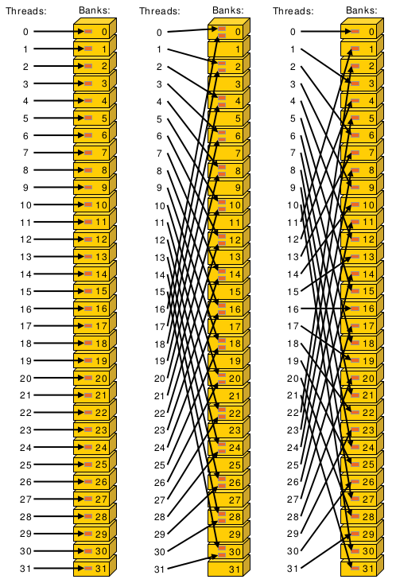
Left: Conflict free with stride 1
Center: 2-way bank conflict due to stride 2
Right: Conflict free with stride 3
Bank conflict examples
Notes:
Center example would take roughly twice as long.
Bank conflicts might not seem like a huge deal (because access with 2-way bank conflict is same latency as arithmetic instruction) but can have significant effect on already partially tuned programs.

Slide 25
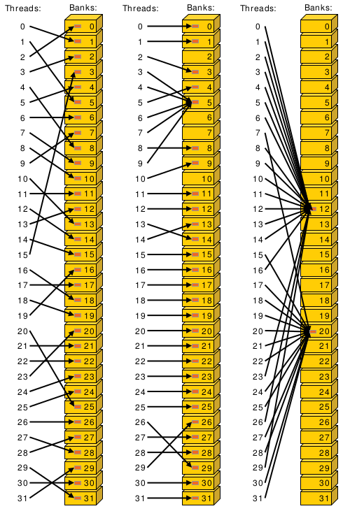
Left: conflict-free
Center: conflict-free because same element accessed in bank 5
Right: conflict-free because same element accessed in banks 12 and 20. Broadcasting occurs.
More bank conflict examples
Notes:
Hardware support for broadcasting (when lots of threads access the same word in shared memory).

Slide 26
Bank conflicts and strides
Stride 1 ⇒ 32 x 1-way “bank conflicts” (so conflict-free)
Stride 2 ⇒ 16 x 2-way bank conflicts
Stride 3 ⇒ 32 x 1-way “bank conflicts” (so conflict-free)
Stride 4 ⇒ 8 x 4-way bank conflicts
…
Stride 32 ⇒ 1 x 32-way bank conflict :(
Can anyone think of a way to modify the data to have conflict-free access in the stride 32 case?
Notes:
Stride is distance from thread i access to thread i+1 access.
How many unique banks are accessed, and how many threads are accessing that bank

Slide 27
Padding to avoid bank conflicts
To fix the stride 32 case, we’ll waste a byte on padding and make the stride 33 :)
Don’t store any data in slots 32, 65, 98, ....
Now we have
thread 0 ⇒ index 0 (bank 0)
thread 1 ⇒ index 33 (bank 1)
thread i ⇒ index 33 * i (bank i)
Notes:
Note padding is wasting some very precious hardware, and also makes code uglier.

Slide 28
Bank conflicts and coalescing
Bank conflicts are the “noncoalesced access” equivalent for shared memory.
Note stride 1 accesses are both conflict-free and coalesced.
In the “load from global, store into shared, do quadratic computation on shared data” pattern, you sometimes have to choose between noncoalesced loads or bank conflicts on stores. Generally bank conflicts on stores will be faster, but it’s worth benchmarking. The important thing is that the shared memory loads in the “quadratic computation” part of the code are conflict-free (because there are more of these loads than either other operation).

Slide 29
Registers
Fastest “memory” possible, about 10x faster than shared memory
Most stack variables declared in kernels are stored in registers (example: float x).
Statically indexed arrays stored on the stack are sometimes put in registers
Notes:
Need to check assembly to see what is in registers.
Arrays must be statically indexed because instructions hard code register number.

Slide 30
Local Memory
Local memory is everything on the stack that can’t fit in registers. The scope of local memory is just the thread.
Local memory is stored in global memory (much slower than registers!)
Notes:
What’s the downside of storing local memory in global memory?
So how can we avoid storing anything in local memory?
Answer: use less local variables than registers
yes, but we’ve seen that using more local variables can help performance (assuming the local variables in registers)
sounds like we want to have as many variables that we can put in registers and no more!
If we have more local variables then registers, then some local variables will be spilled to local/global memory. This is called register spilling and kills performance.

Slide 31
Register spilling example
Recall coordinate addition from previous lecture.
When we have enough registers, this code does 4 loads from local memory and 0 stores.
Now assume we only have 3 free registers before any of this code is executed (but don’t worry about z0 and z1)
x0 = x[0];
y0 = y[0];
x1 = x[1];
y1 = y[1];
z0 = x0 + y0;
z1 = x1 + y1;

Slide 32
Register spilling example
x0 = x[0];
y0 = y[0];
x1 = x[1];
y1 = y[1];
z0 = x0 + y0;
z1 = x1 + y1;
starting with only 3 free registers...
Register spilling cost:
1 extra load
1 extra store
2 extra pairs of consecutive
dependent instructions
cannot load y[1] until we free a register. store x1 to make space.
Now we need to load x1 again.
Notes:
Stores also have instruction dependencies (cannot use a register until the store from it is done).
The pairs of dependent instructions are the store x1, load y[1] (because we’re loading y1 into the same register that we’re storing from) and load x1, z1 = x1 + y1
There are worse spilling scenarios (what if x0 was stored?) and also better (just don’t load y1 until after computing z0), but its difficult for compiler to find optimal instruction ordering wrt spilling and dependencies.
A form of register allocation problem can be reduced to k-coloring a graph, which is NP-complete.
So, is register spilling (and any use of local memory) truly so bad for performance? Thankfully not (in small doses), due to the L1 cache.

Slide 33
L1 Cache
Fermi - caches local & global memory
Kepler, Maxwell - only caches local memory
same hardware as shared memory
configurable size (16, 32, 48KB)
each SM has its own L1 cache
Notes:
There are PTX instructions to load global memory to indicate whether you want to put it in L1 cache.
Recommendation: Use shared memory for whatever you can think of using it for, then make the rest of the space L1.
Makes local memory much cheaper (as register spills now go into L1 which is about as fast as shared).
so a little register spilling can be OK sometimes
L1 actually merged with texture cache in Maxwell.

Slide 34
L2 cache
caches all global & local memory accesses
~1MB in size
shared by all SM’s
Notes:
can look at L1/L2 hit/miss rates in profiler to see if local memory use is problematic

Slide 35
Constant Memory
Used for constants that cannot be compiled into program
Constants must be set from host before running kernel.
Constant memory is global memory with a special cache
64KB for user, 64KB for compiler (kernel arguments are passed through constant memory)

Slide 36
Constant Cache
8KB cache on each SM specially designed to broadcast a single memory address to all threads in a warp (called static indexing)
Can also load any statically indexed data through constant cache using “load uniform” (LDU) instruction
Notes:
in this contxt, static does not mean known at compile time, it mans all threads accessing the same same address.
Memory address cannot depend on threadId.
Cache is small/cheap because no writeback mechanism required.
Compiler uses LDU sometimes (const + pointer aliasing concerns)

Slide 37
Constant memory syntax
In global scope (outside of kernel, at top level of program):
__constant__ int foo[1024];
In host code:
cudaMemcpyToSymbol(foo, h_src, sizeof(int) * 1024);

Slide 38
Texture Memory
Complicated and only marginally useful for general purpose computation
Useful characteristics:
2D or 3D data locality for caching purposes through “CUDA arrays”. Goes into special texture cache.
fast interpolation on 1D, 2D, or 3D array
converting integers to “unitized” floating point numbers
Use cases:
Read input data through texture cache and CUDA array to take advantage of spatial caching. This is the most common use case.
Take advantage of numerical texture capabilities.
Interaction with OpenGL and general computer graphics
Notes:
for general purpose computing “texture support could not have been justified if the hardware hadn’t already been there” - cuda handbook
I’ve never used textures personally, and they are the most foreign part of CUDA to me.
CUDA arrays use trick like a space filling curve

Slide 39
Texture Memory
And that’s all we’re going to say on texture memory for now, more on future set!
It’s a complex topic, you can learn everything you want to know about it from CUDA Handbook Ch 10
Notes:
complex and not super useful in my opinion

Slide 40
Read-Only Cache
Many CUDA programs don’t use textures, but we should take advantage of the texture cache hardware.
CC ≥ 3.5 makes it much easier to use texture cache.
Many const restrict variables will automatically load through texture cache (also called read-only cache).
Can also force loading through cache with __ldg intrinsic
Differs from constant memory because doesn’t require static indexing

Slide 41
Extra topic: vectorized IO
Besides vectorizing over the 32 threads in a warp, CUDA has instructions for each thread to do 64 or 128 bit loads/stores (rather than standard 32 bit transactions).
These transactions happen whenever an appropriately sized and aligned type is dereferenced. Alignment requirements are equal to type size, so a double must be 8 byte aligned, float4 must be 16 byte aligned, etc.
Notes:
It’s funny to talk about vectorized anything on GPU, because everything on GPU is vectorized.
But CUDA does have some instructions that allow a single thread to process 2 or 4 elements at once (rather than just one).

Slide 42
Compute & IO Throughput
GeForce GTX Titan Black (GK110 based)
Compute throughput | 5 TFLOPS (single precision)
Global memory bandwidth | 336 GB/s (84 Gfloat/s)
Shared memory bandwidth | 3.4 TB/s (853 Gfloat/s)
GPU is very IO limited! IO is very often the throughput bottleneck, so its important to be smart about IO.
If you want to get beyond ~900 GFLOPS, need to do multiple FLOPs per shared memory load.
cuBLAS obtains about 4 TFLOPS on this GPU. Utilization is hard!
Notes:
Due to design of GPU, IO and compute happen at the same time. IO is generally the bottleneck.
Based on these numbers, will GPUs perform better on algorithms will high computational density or low computational density?
This is why bank conflicts matter.
80% utilization on GPU is great. We’re up to around 93% utilization for single threaded CPU matrix multiplication (probably the most tuned optimized code).

