Slide 1
CS 179: GPU Computing
Lecture 2: The Basics
Notes:
Resume – remarks:
Welcome back
Storytelling/motivational purposes
Introducing

Slide 2
Recap
Can use GPU to solve highly parallelizable problems
Performance benefits vs. CPU
Straightforward extension to C language

Slide 3
Disclaimer
Goal for Week 1:
Fast-paced introduction
“Know enough to be dangerous”
We will fill in details later!

Slide 4
Our original problem…
Add two arrays
A[] + B[] -> C[]
Goal: Understand what’s going on

Slide 5
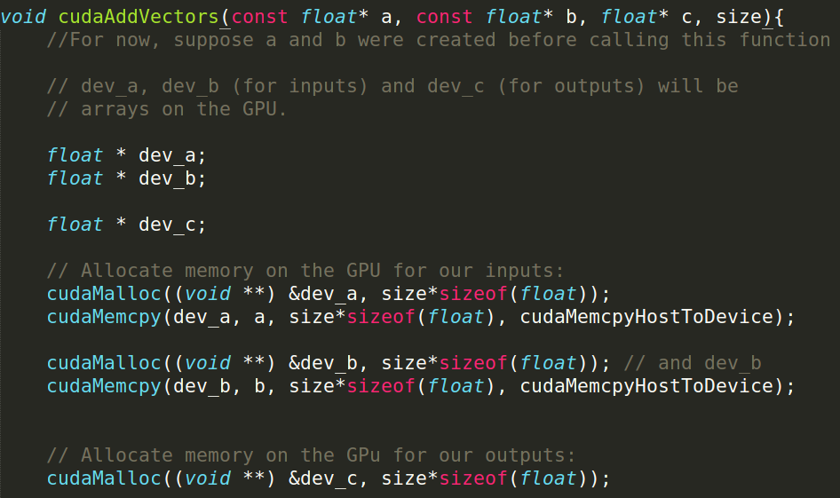
CUDA code (first part)

Slide 6
Basic “formula”
Setup inputs on the host (CPU-accessible memory)
Allocate memory for inputs on the GPU
Copy inputs from host to GPU
Allocate memory for outputs on the host
Allocate memory for outputs on the GPU
Start GPU kernel
Copy output from GPU to host

Slide 8
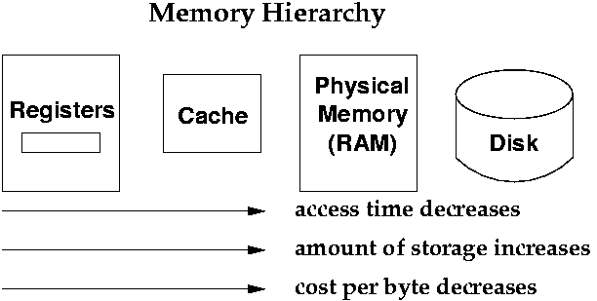
“Classic” Memory Hierarchy

Slide 9
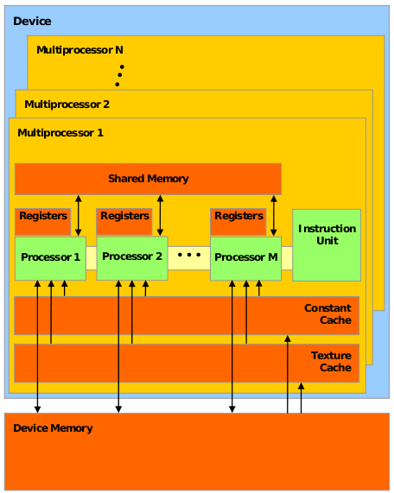
The GPU

Slide 10
The GPU
“Global memory”

Slide 12
Pointers
Difference between CPU and GPU pointers?

Slide 13
Pointers
Difference between CPU and GPU pointers?
None – pointers are just addresses!

Slide 14
Pointers
Difference between CPU and GPU pointers?
None – pointers are just addresses!
Up to the programmer to keep track!

Slide 15
Pointers
Good practice:
Special naming conventions, e.g. “dev_” prefix

Slide 18
Memory allocational
With the CPU (host memory)…
float *c = malloc(N * sizeof(float));
Attempts to allocate #bytes in argument

Slide 19
Memory allocation
On the GPU (global memory):
float *dev_c;
cudaMalloc(&dev_c, N * sizeof(float));
Signature:
cudaError_t cudaMalloc (void ** devPtr, size_t size)
Attempts to allocate #bytes in arg2
arg1 is the pointer to the pointer in GPU memory!
Passed into function for modification
Result after successful call: Memory allocated in location given by dev_c on GPU
Return value is error code, can be checked

Slide 22
Memory copying
With the CPU (host memory)…
// pointers source,destination to memory regions
memcpy(destination, source, N);
Signature:
void * memcpy (void * destination, const void * source, size_t num);
Copies num bytes from (area pointed to by) source to (area pointed to by) destination

Slide 23
Memory copying
Versatile cudaMemcpy() equivalent
CPU -> GPU
GPU -> CPU
GPU -> GPU
CPU -> CPU

Slide 24
Memory copying
Signature:
cudaError_t cudaMemcpy(void *destination, void *src, size_t count,
enum cudaMemcpyKind kind)
f

Slide 25
Memory copying
Signature:
cudaError_t cudaMemcpy(void *destination, void *src, size_t count,
enum cudaMemcpyKind kind)
Values:
cudaMemcpyHostToHost
cudaMemcpyHostToDevice
cudaMemcpyDeviceToHost
cudaMemcpyDeviceToDevice
F

Slide 26
Memory copying
Signature:
cudaError_t cudaMemcpy(void *destination, void *src, size_t count,
enum cudaMemcpyKind kind)
Values:
cudaMemcpyHostToHost
cudaMemcpyHostToDevice
cudaMemcpyDeviceToHost
cudaMemcpyDeviceToDevice
F
Determines treatment of dst. and src. as CPU or GPU addresses

Slide 28
Summary of memory
CPU vs. GPU pointers
cudaMalloc()
cudaMemcpy()

Slide 29
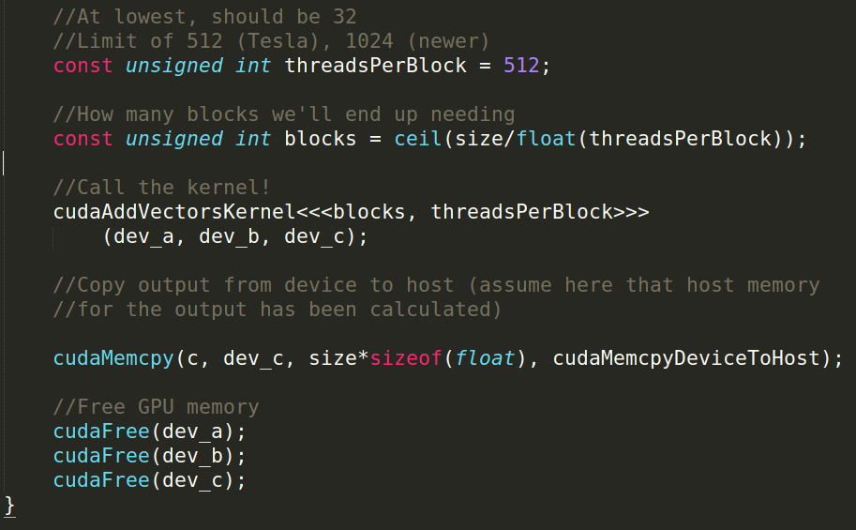

Slide 30
Part 2

Slide 31
Recall…
GPUs…
Have lots of cores
Are suited toward “parallel problems”

Slide 32
GPU internals

Slide 33
GPU internals

Slide 34
GPU internals

Slide 35
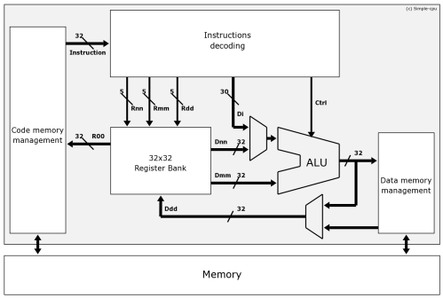
CPU internals

Slide 36
GPU internals
One instruction unit for multiple cores!

Slide 37
Warps
Groups of threads simultaneously execute same instructions!
Called a “warp”
(32 threads in a warp under current standards)

Slide 38
GPU internals

Slide 39
Blocks
Group of threads scheduled to a multiprocessor
Contain multiple warps
Has a max. number (varies by GPU, e.g. 512 or 1024)

Slide 40
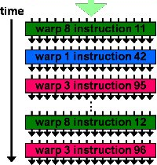
Multiprocessor execution timeline

Slide 41
Thread groups
A grid (all the threads started…):
…contains blocks <- assigned to multiprocessors
Each block contains warps <- executed simultaneously
Each warp contains individual threads

Slide 42
Part 2

Slide 43
Moral 1: (from Lecture 1)
Start lots of threads!
Recall: Low context switch penalty
Hide latency
Start enough blocks!
Occupy SMs
e.g. Don’t call:
kernel<<<1,1>>>(); // 1 block, 1 thread per block
Call:
kernel<<<50,512>>>();// 50 blocks, 512 threads per block

Slide 44
Moral 2:
Multiprocessors execute warps (of 32 threads)
Block sizes of 32*n (integer n) are best
e.g. Don’t call:
kernel<<<50,97>>>(); // 50 blocks, 97 threads per block
Call:
kernel<<<50,128>>>();// 50 blocks, 128 threads per block

Slide 45
Summary (processor internals)
Key parameters on kernel call:
Threads per block
Number of blocks
Choose carefully!

Slide 47
Kernel argument passing
Similar to arg-passing in C functions
Some rules:
Don’t pass host-memory pointers
Small variables (e.g. individual ints) are fine
No pass-by-reference

Slide 48
Kernel function
Executed by many threads
Threads have unique ID mechanism:
Thread index within block
Block index

Slide 49
Out of bounds issue:
If index > (#elements), illegal access!

Slide 50
Out of bounds issue:
If index > (#elements), illegal access!

Slide 51
#Threads issue:
Cannot start e.g. 1e9 threads!
Threads should handle arbitrary # of elements

Slide 52
#Threads issue:
Cannot start e.g. 1e9 threads!
Threads should handle arbitrary # of elements

Slide 53
#Threads issue:
Cannot start e.g. 1e9 threads!
Threads should handle arbitrary # of elements
Total number of blocks

Slide 54
GPU -> CPU
Host memory pointer (copy to here)
Device memory pointer (copy from here)

Slide 56
cudaFree()
Equivalent to host memory’s free() function
(As on host) Free memory after completion!

Slide 57
Summary
GPU global memory:
Pointers (CPU vs GPU)
cudaMalloc() and cudaMemcpy()
GPU processor details:
Thread group hierarchy
Launch parameters
Threads in kernel

